Slide 1
Chameleon for edge to cloud reproducibility
Kate Keahey
Mathematics and CS Division, Argonne National Laboratory
CS CASE, University of Chicago
keahey@anl.gov

Slide 2
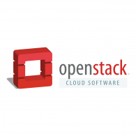
Chameleon in a nutshell
From large to small – diversity and scale in hardware:
Supercomputing datacenters (UC, TACC) over 100G network – to edge devices
Diverse: FPGAs, GPUs, NVMe, NVDIMMs, Corsa switches, edge devices via CHI@Edge, etc.
Distributed: CHI-in-a-Box sites at IIT, NCAR, Northwestern, and UIC – more coming
Chameleons like to change – testbed that adapts to your experimental needs
From bare metal reconfigurability/isolation -- KVM cloud – to containers for edge
Capabilities: power on/off, reboot, custom kernel boot, serial console access, etc.
Based on mainstream open source – proud to be cheap!
50% leveraging and influencing OpenStack + 50% “special sauce”
Promoting disruption in digital artifact sharing
Integration with Jupyter for non-transactional experiment packaging
Trovi for experiment sharing and discovery, Chameleon Daypass for access sharing
Reproducibility and education: digital sharing killer apps!

Slide 3
testbed BY THE NUMBERS
600+ Papers published
1,000+
Unique projects
95
Countries
9,000+
Users
350+
Institutions
+3 More Years to Grow!
Notes:
635 publications as of current counting – NOT including any publications from the Chameleon team

Slide 4
Chameleon hardware
Notable still to come:
disaggregated hardware (GigaIO)
CHI@UC
Skylake, CascadeLake, IceLake, and AMD nodes GPUs (A100, V100, RTX6000), FPGAs (Xilinx Alveo U280)
Storage (NVMe SSD, NVDIMM)
Network (Corsa SDN, 25G Ethernet, 200G InfiniBand)
Chameleon Volunteer Sites
Storage
~0.5 PB
CHI@Edge
Raspberry Pi, Jetson Nano, Jetson Xavier NX, AGX Orin
+ User-added devices
Network
100Gbps public network
Chicago
Austin
CHI@TACC
Haswell, SkyLake, CascadeLake, Fugaku (ARM64 + HBM), AMD nodes, and LIQID disaggregated hardware
GPU (K80, M40, P100, MI100), FPGAs (Altera)
Storage (NVMe, SSD, NVDIMM)
Network (Corsa SDN, 25G Ethernet, 200G InfiniBand)
Commercial Clouds via CloudBank
Storage
~3.5PB
FABRIC, FAB
and other partners
Notes:
UC
42x Intel nodes with 48 cores and 192GB of RAM, 10x AMD Epyc with 48 cores, 256GB of RAM, and a 960GB NVMe root disk. Additionally, a subset:
2 nodes, each with 2x Intel D7-P5510 7.68TB datacenter SSDs
2 nodes, each with 2x Samsung PM1733 7.68TB datacenter SSDs
2 nodes, each with 4x Samsung PM1733 1.92TB datacenter SSDs
2 nodes, each with 2x Corsair Force MP600 2TB consumer SSDs
2x: Intel Optane nodes with 112 Cores, 768GB of RAM, and 3TB of NVDIMMs
3x: Intel nodes with 4x Nvidia V100 GPUs connected by NVLink
1x: Intel node with 4x Nvidia V100 GPUs connected by PCIe
16x of the regular compute nodes have HDR100 (100gb/s) InfiniBand, as do all of the Optane and GPU nodes. All the SSD nodes have HDR (200gb/s) InfiniBand.
At TACC
32x compute_zen3: AMD nodes, each with 2x two AMD EPYC 7763 (128c / 256t), 256GB RAM, 480GB ssd storage.
8x gpu_mi100: same specs as compute_zen3, with addition of 2x AMD MI100 GPUs each
All 40 are connected via HDR100 Infiniband.
Volunteer sites:
NCAR: ARM Thunder Nodes
IIT, Northwestern, & UIC: Chameleon Legacy program
Purdue: ~400 of their own Haswells added on an ephemeral basis to support IndySCC specifically

Slide 5
Hardware for storage experiments
CHI@UC
10x storage_nvme: Dell R6525, each with 960GB Kioxia NVME SSD, 256GB RAM, 200G HDR Infiniband, 2x 25G Ethernet.
2 nodes of each (2x 7.68TB Intel Enterprise SSDs, 2x 7.68TB Samsung Enterprise SSDs, 4x 1.92TB Samsung Enterprise SSDs, 2x 2TB Corsair Consumer SSDs)
2x compute_nvdimm: Dell R840 Quad-CPU nodes, with 112 Cores, 768Gb of RAM, and 3TB of Intel Optane NVDIMM, connected to the InfiniBand Fabric with 100GB/s HDR100
CH@TACC
20x storage: Dell PowerEdge FC430, 1x 400g intel SATA SSD, 16x Seagate 2tb SAS HDD
2x storage_heirarchy: Dell PowerEdge R730, 2x Intel P3700 2TB nvme/optane, 4x Intel SSDSC2BX01 1.6TB, 4x Seagate ST600MP0005 600gb HDD
8x compute_liqid: Dell PowerEdge R6525, sharing 2x 30.72 TB LIQID Element LQD4500 “Honeybadger” SSDs over a Pcie4.0 external fabric. Each SSD presents as 8x pcie devices, with 2 of these logical devices currently mapped to each server.
Chameleon Blog by H. Gunawi: “Conducting Storage Research on Chameleon”

Slide 6
ChI Experimental workflow
discover
resources
allocate
resources
configure and interact
monitor
- Fine-grained
- Complete
- Up-to-date
- Versioned
- Verifiable
- Allocatable resources: nodes, VLANs, IPs
- Advance reservations and on-demand
- Fungible/non-fungible interface
- Isolation
- Bare metal, KVM, containers for edge
- Image catalog
- Snapshotting
- Orchestration (Heat)
- Jupyter integration
- Networks: stitching and BYOC
- Hardware metrics
- Fine-grained data
- Aggregate
- Archive
Authentication via federated identity, accessed via GUI, CLI and python/Jupyter (python-chi)
Paper: “Lessons Learned from the Chameleon Testbed”, USENIX ATC 2020
Notes:
Highlight:
Interfaces – everything goes via OpenStack-based API (even if it is just a veneer as for CHI@Edge)
Emphasis on *programmatic interfaces* with python-chi and Jupyter – they can be easily scripted/repeated (unlike GUI), preferred by most users

Slide 7
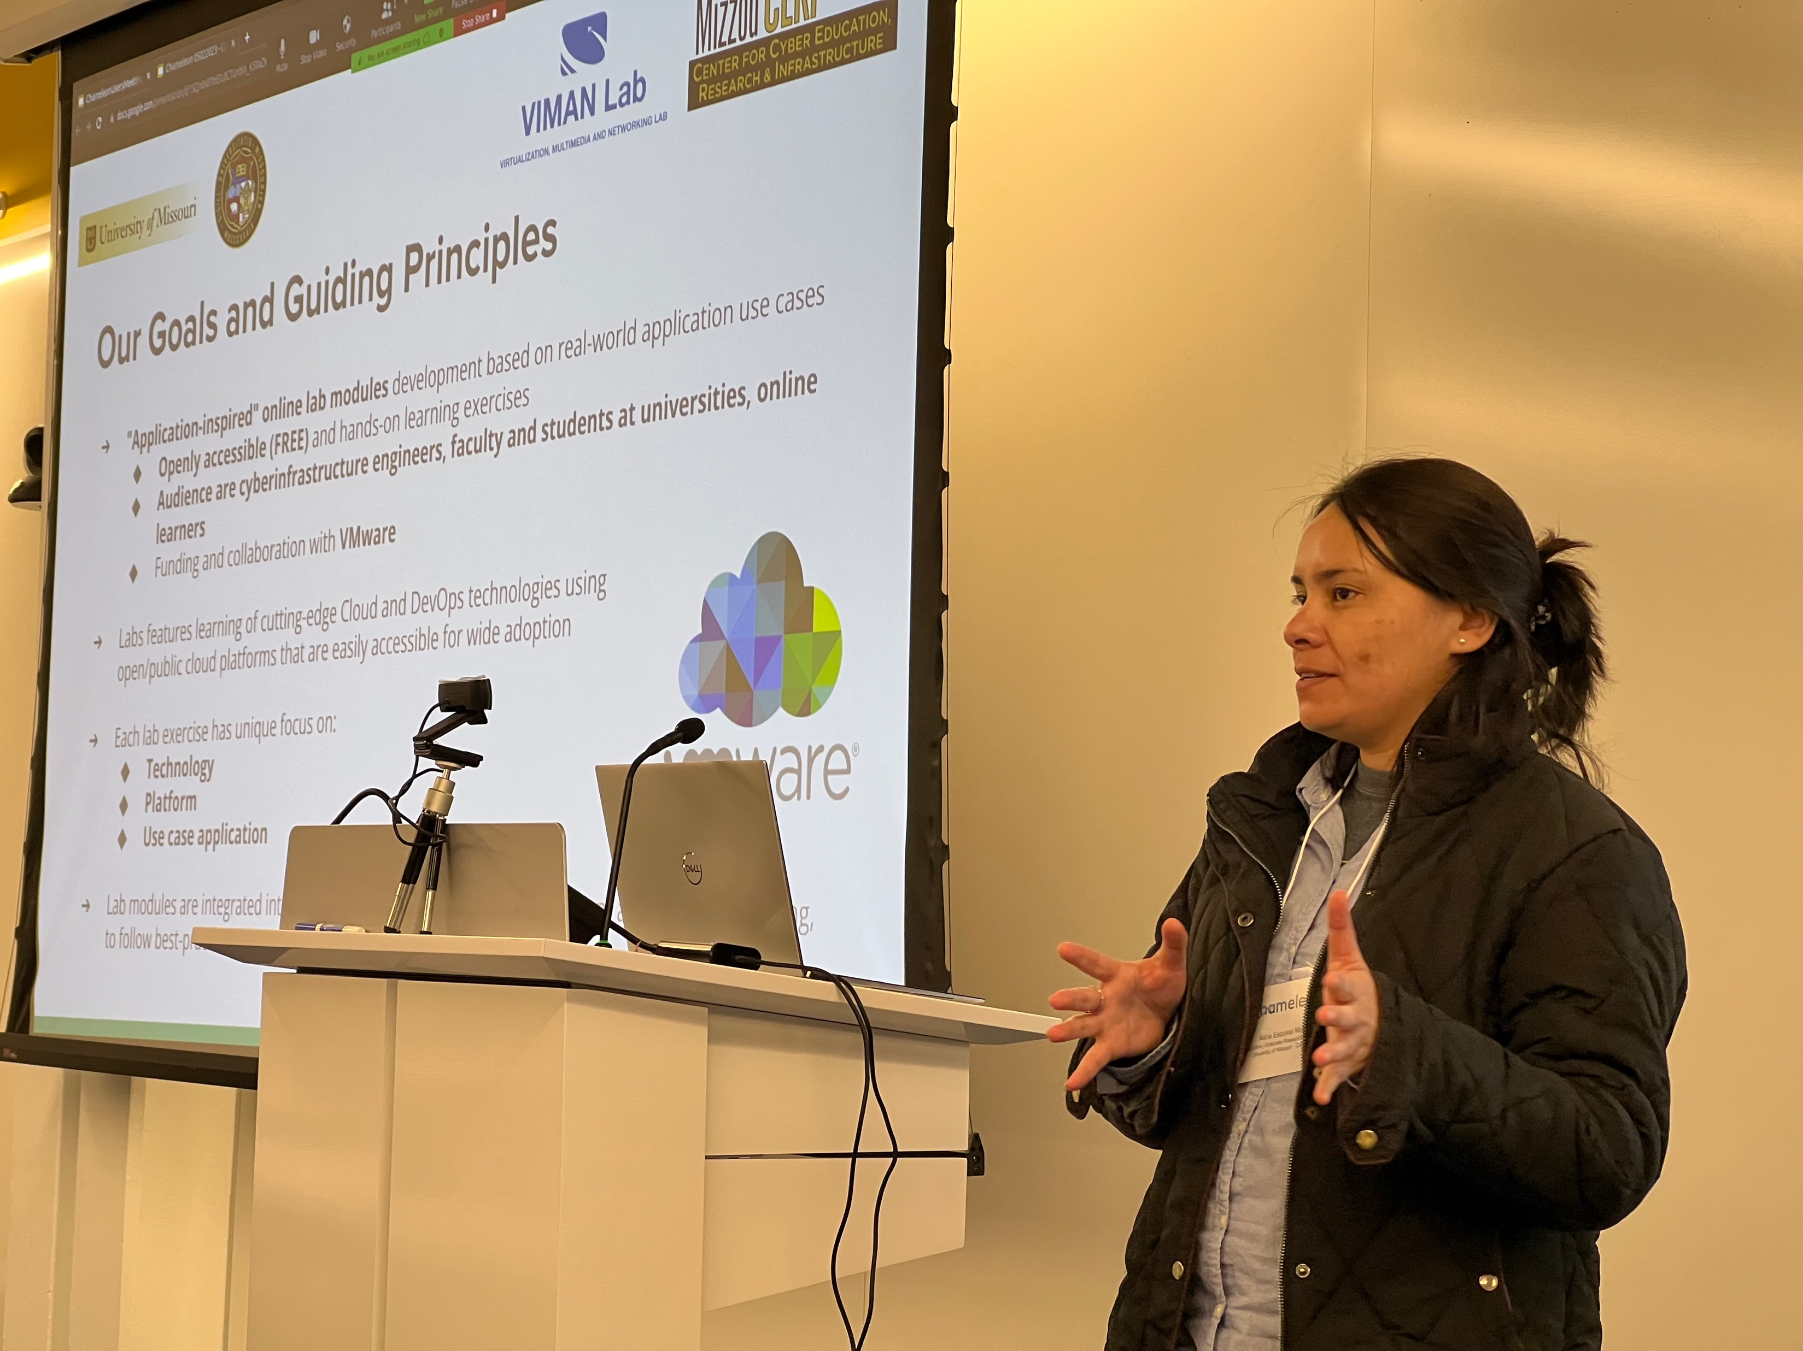
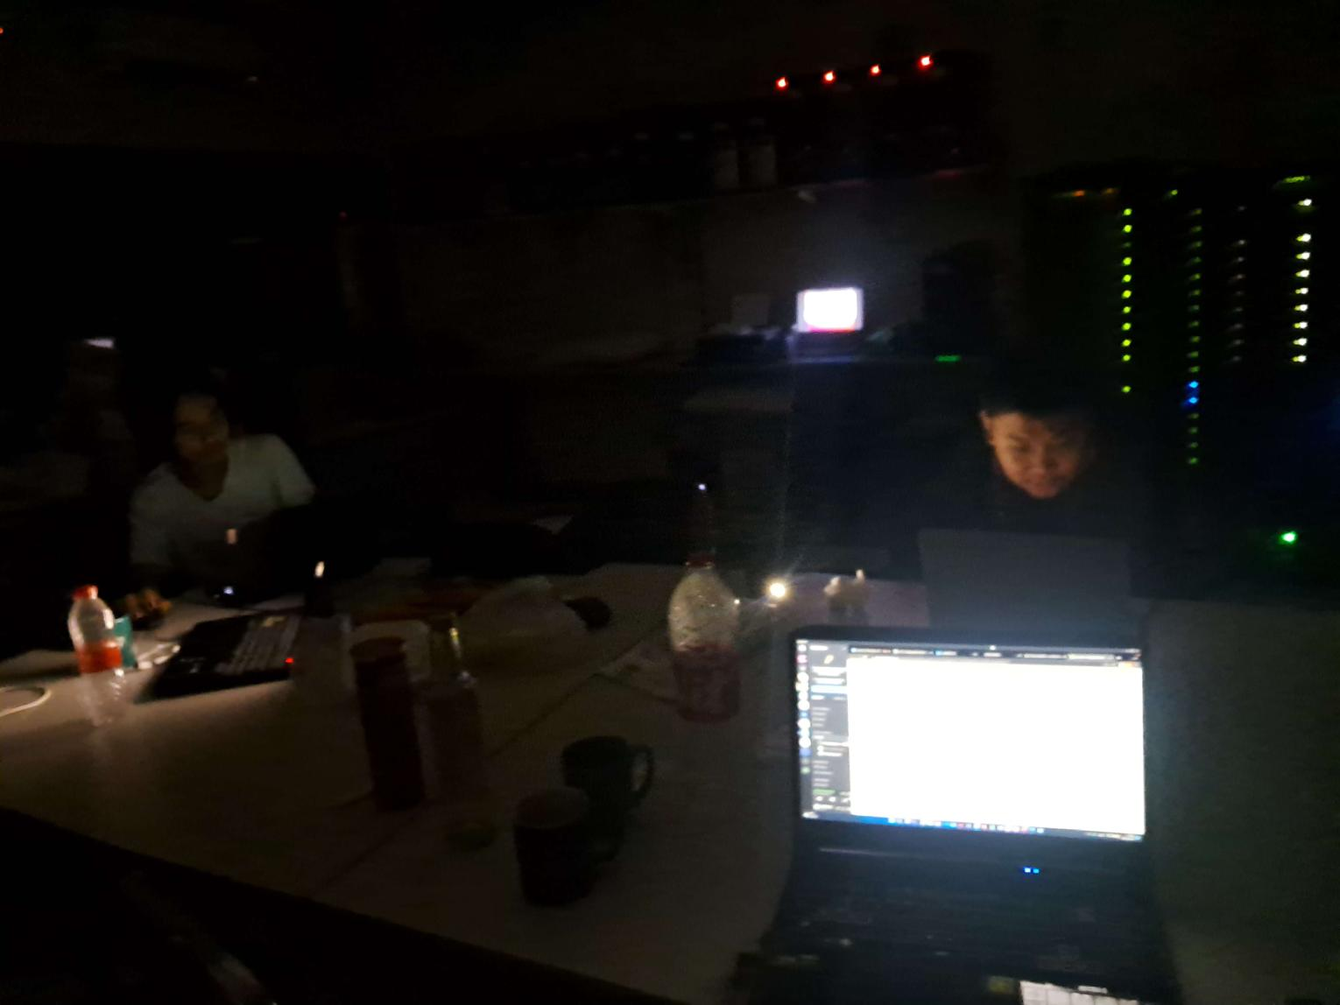
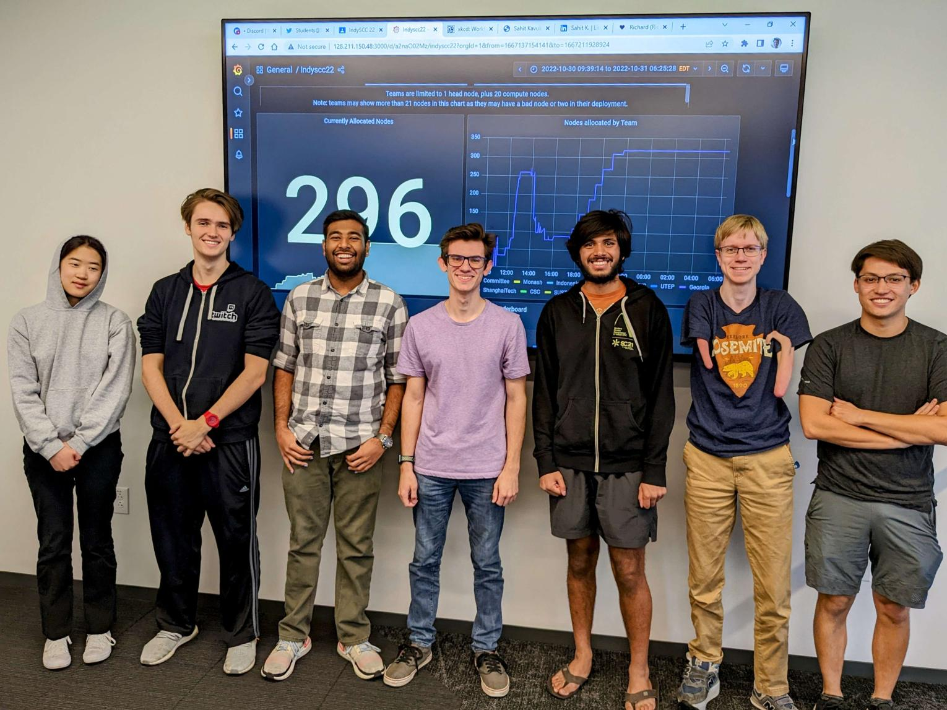
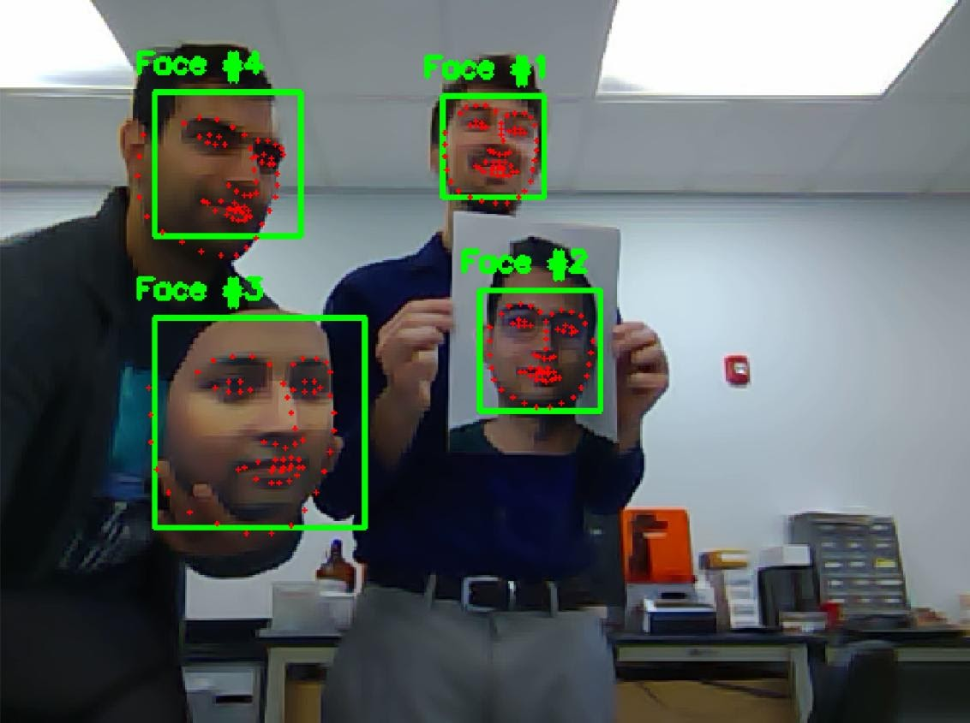
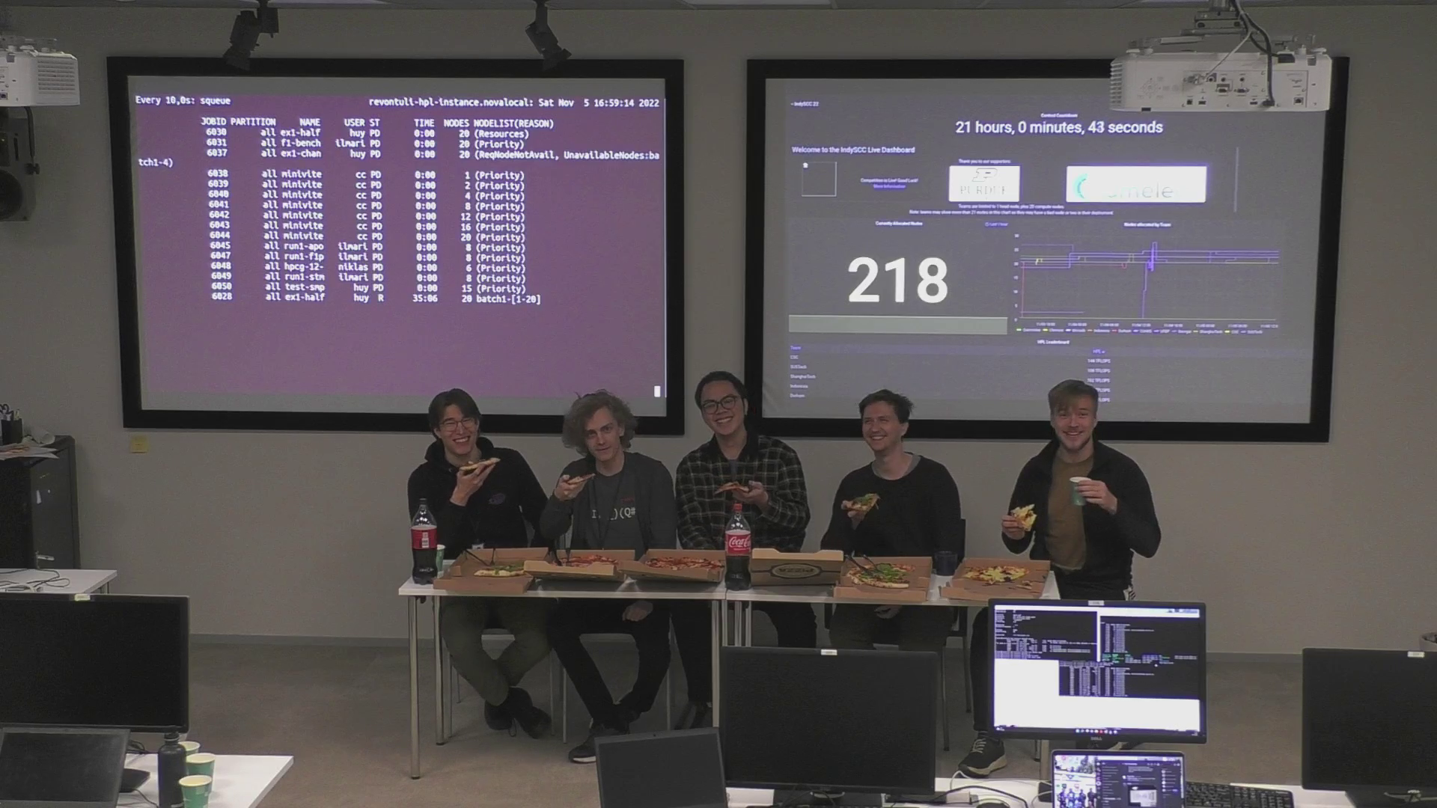
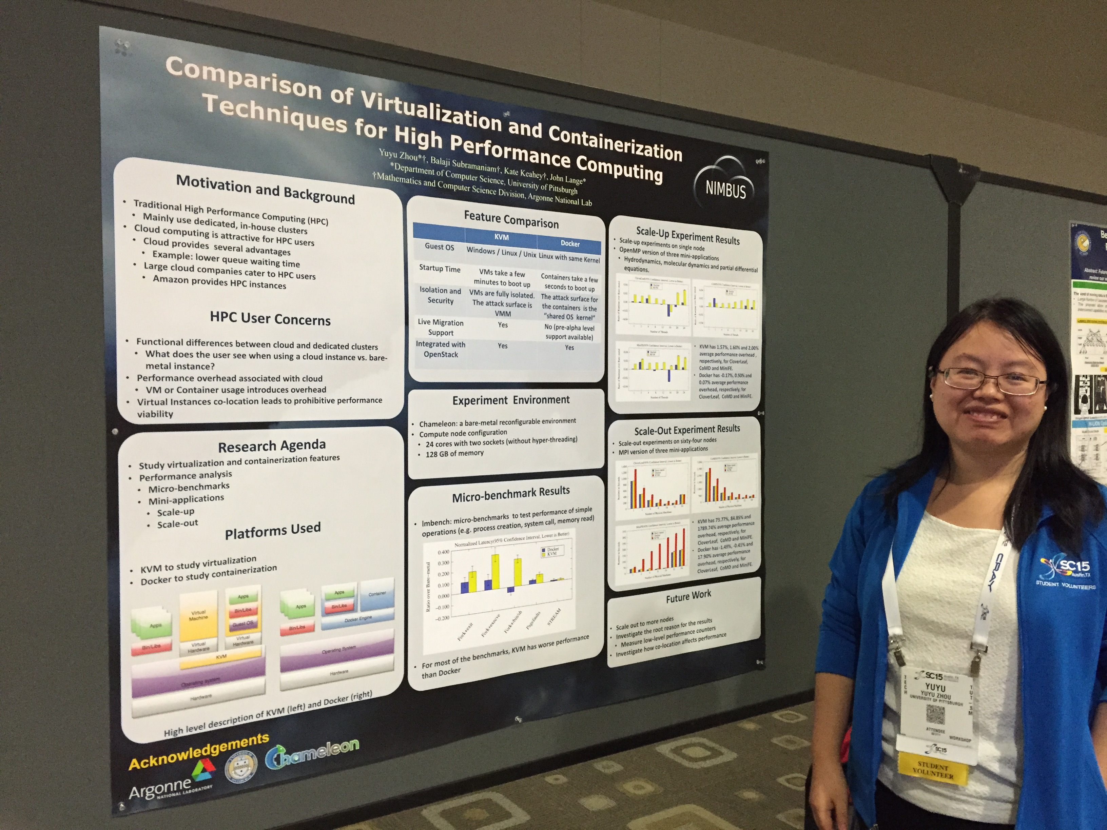
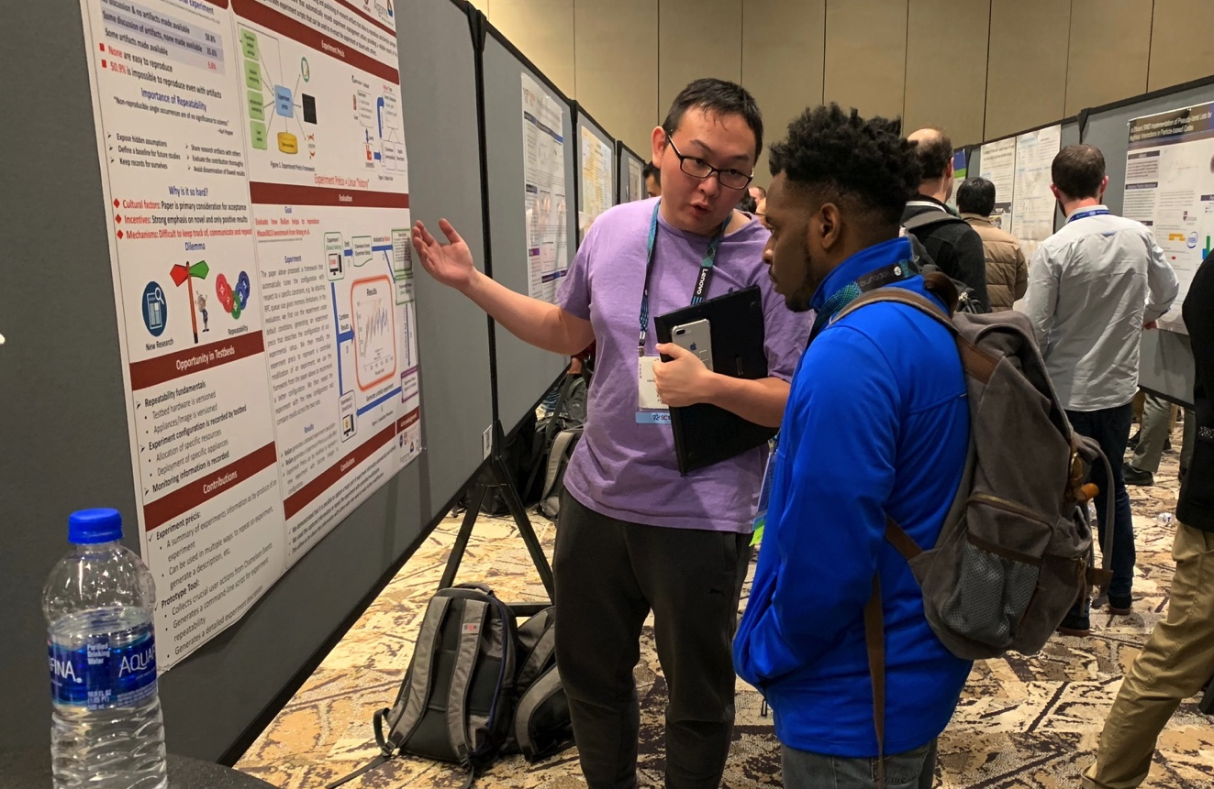
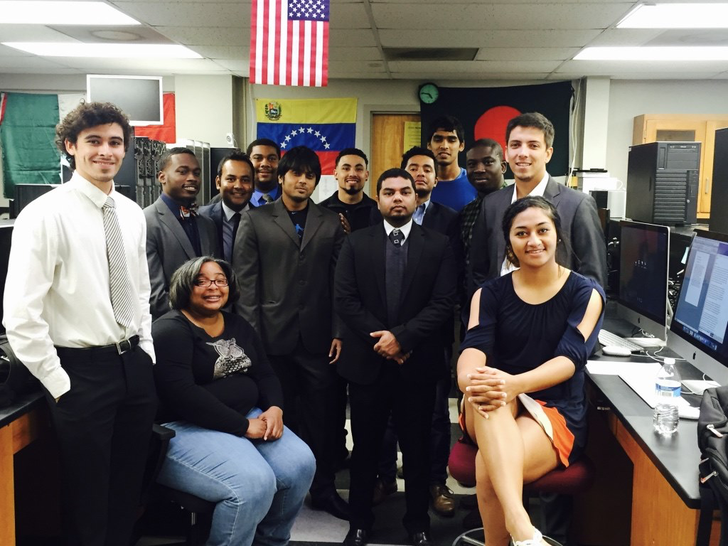
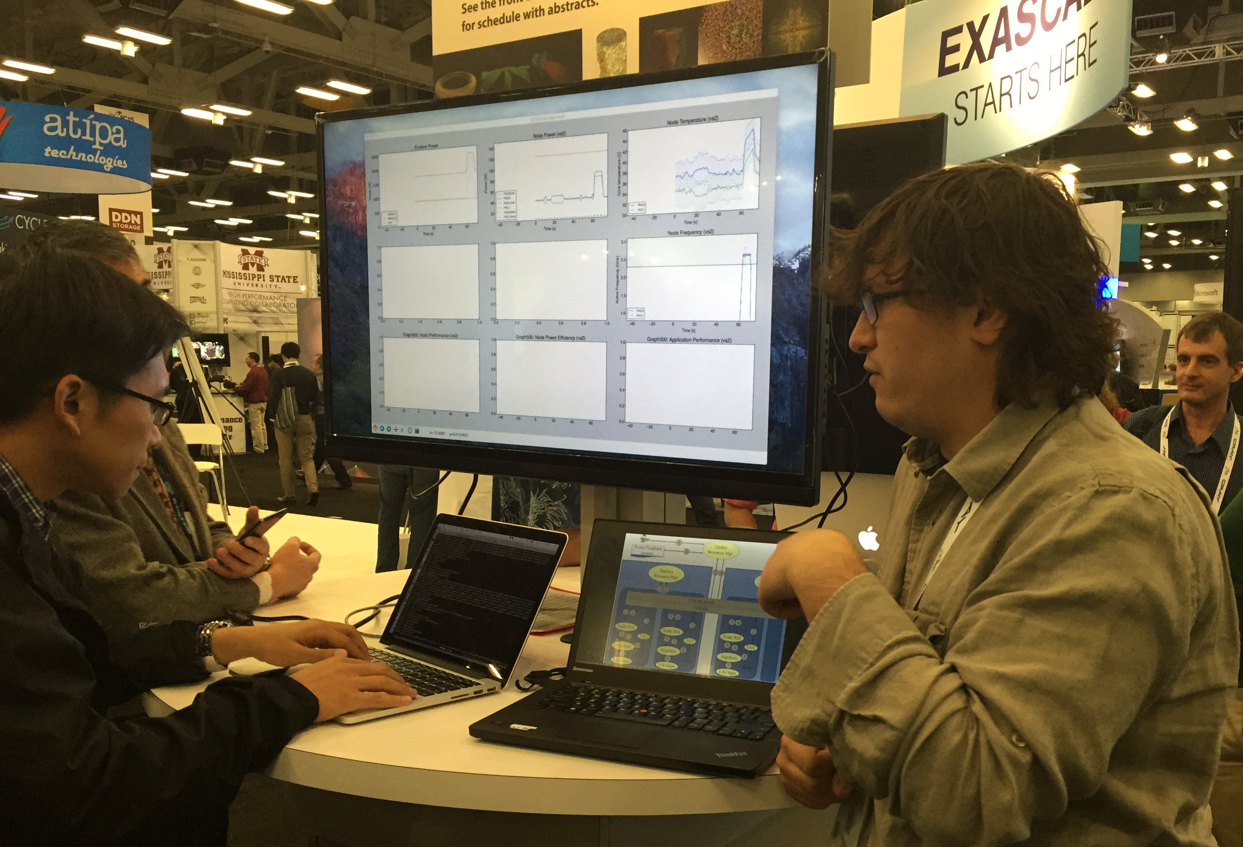
Not just a testbed, a community
Supporting research projects in architecture, operating systems design, virtualization, power management, real-time analysis, security, storage systems, databases, networking, machine learning, neural networks, data science, and many others.
Check out user experiment stories on our blog:
https://www.chameleoncloud.org/blog/category/user-experiments/
Notes:
Anybody wants to find out more it is under the user experiments tab on our blog

Slide 8
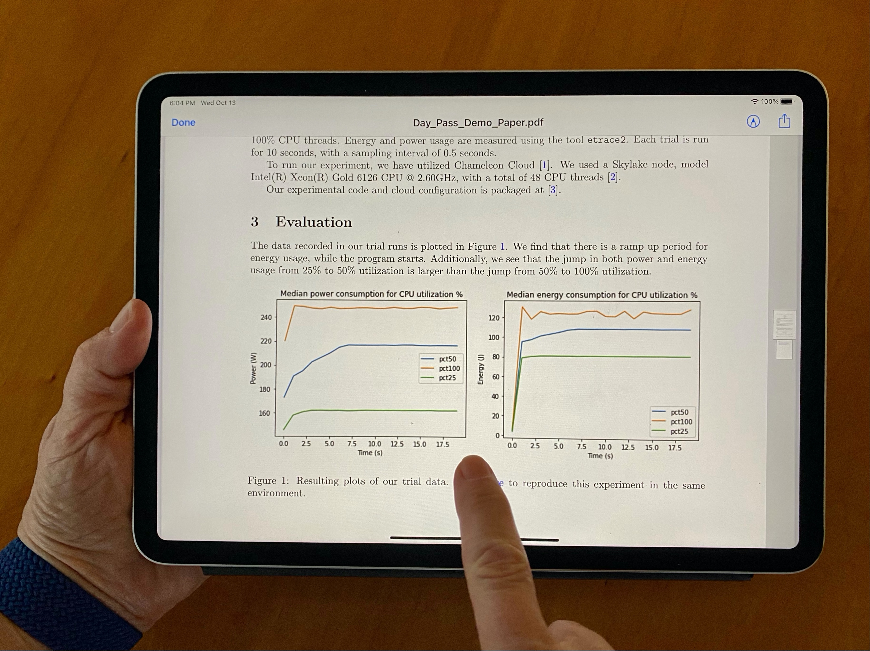
Sharing Science digitally
Can digital experiments be as sharable as papers are today?
Can I simply integrate somebody’s model into my research instead of reinventing the wheel and get to a new result faster?
Can I discover something new through playing with somebody else’s experiment?
Can I develop exercises for my class based on most recent research results?
Should our next Program Committee meeting be a reproducibility hackathon?
https://repeto.cs.uchicago.edu

Slide 9
DIGITAL content and infrastructure
Open platforms are essential for sharing – especially in computer science
Open, version-controlled hardware
Non-fungible resources
Sharing via cloud pattern
Disk images, orchestration templates, and other artifacts
Thousands of images, orchestration templates, digital artifacts of various kinds
Are we there yet?
A car without a road
Paper: “The Silver Lining”, IEEE Internet Computing 2020

Slide 10
What is missing?
Packaging: complete, imperative, non-transactional, integrated (literate programming)
Get access for reproducibility
Discover/find experiments through various channels
Package experiment in a way that is cost-effective but also user-friendly
Give access for reproducibility
Share work in progress, completed work, get credit

Slide 11
Highlight: Practical Reproducibility
Practical reproducibility:
cost-effective enough to be mainstream
End-to-end packaging with literate programming
Credential integrated JupyterLab environment: convenience of notebook + power of testbed
Imperative, non-transactional, annotated
Trovi: an experiment sharing repository
Portal to present, browse, filter, and find
Integrated with Jupyter/Chameleon, Swift, Zenodo, and github
Open APIs: FABRIC, Jetstream2, and others
Chameleon daypass
Reproducibility initiatives: >6x the usage 22/23
Effective packaging via a “compute capsule”
Finding and sharing experiments
integrated with platform
Open, integrated access to all aspects of experiment
Paper: “Three Pillars of Reproducibility”, ReWords’23
Notes:
2022: Middleware, ICSE, and SC (7846 SUs)
2023: ICPP, TPDS, SC23, FAST'23, OSDI'23, and Journal of Systems Research; 49,288 Sus)

Slide 12
Summary
Chameleon is an open platform for systems research
Bare metal reconfiguration, direct resource access
Diverse range of hardware – let us know what other storage hardware you need!
Practical reproducibility: don’t just read about science, play with it!
Support for reproducibility process in Chameleon
Programmatic interface to the testbed via Jupyter interface
Trovi – a repository of ”compute capsules” integrated with and executable on the testbed with open APIs
Chameleon daypass for ephemeral access
PI Eligibility for qualified international PIs attending FAST (use code FAST24)
Notes:
Cloud to IoT is a massive opportunity that challenges many assumptions we were making about infrastructure

Slide 13
We’re here to change
www.chameleoncloud.org

