Slide 1
Research infrastructure for
infrastructure research
Kate Keahey
Mathematics and CS Division, Argonne National Laboratory
CS Department, University of Chicago
keahey@anl.gov

Slide 2
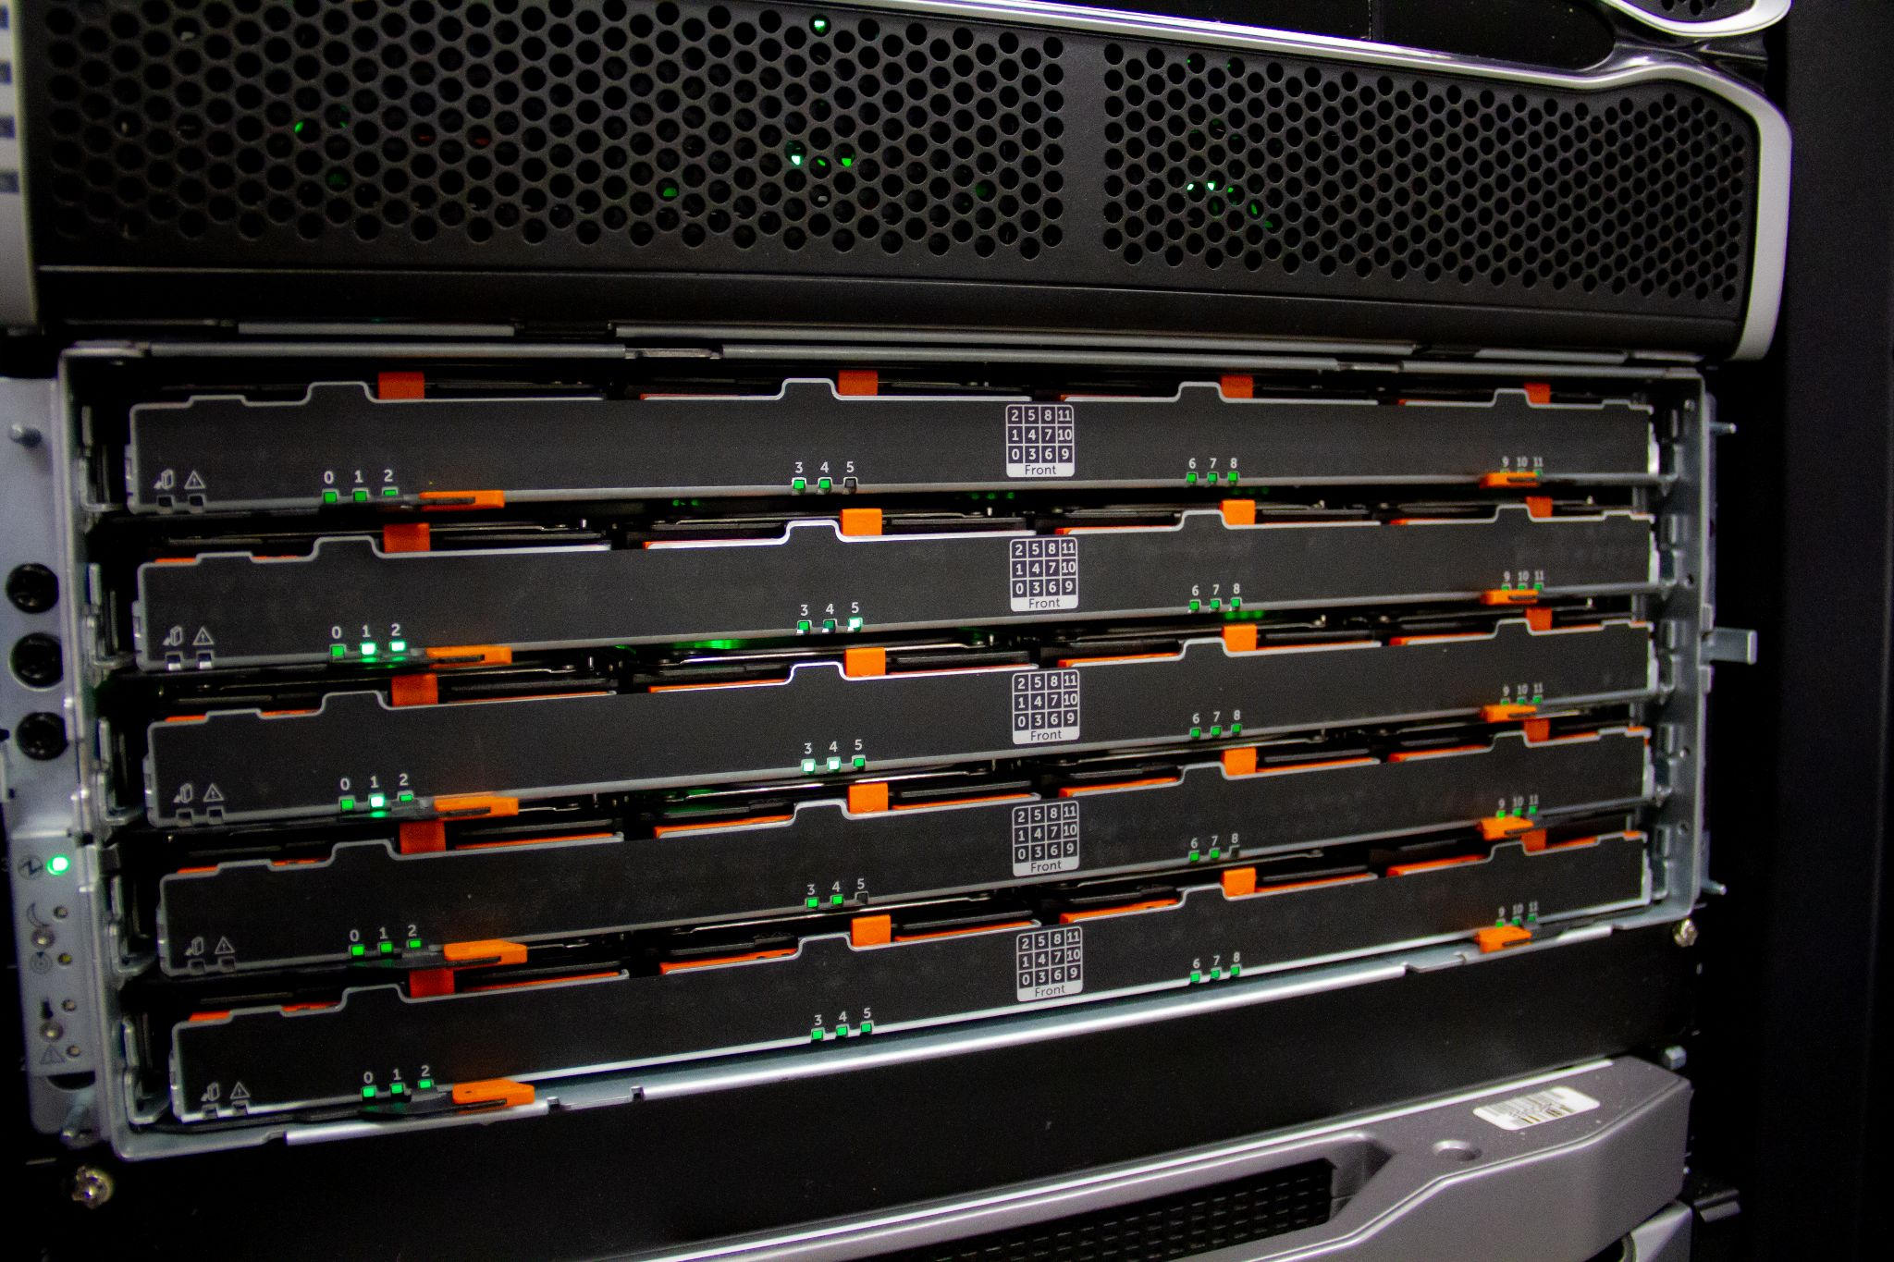
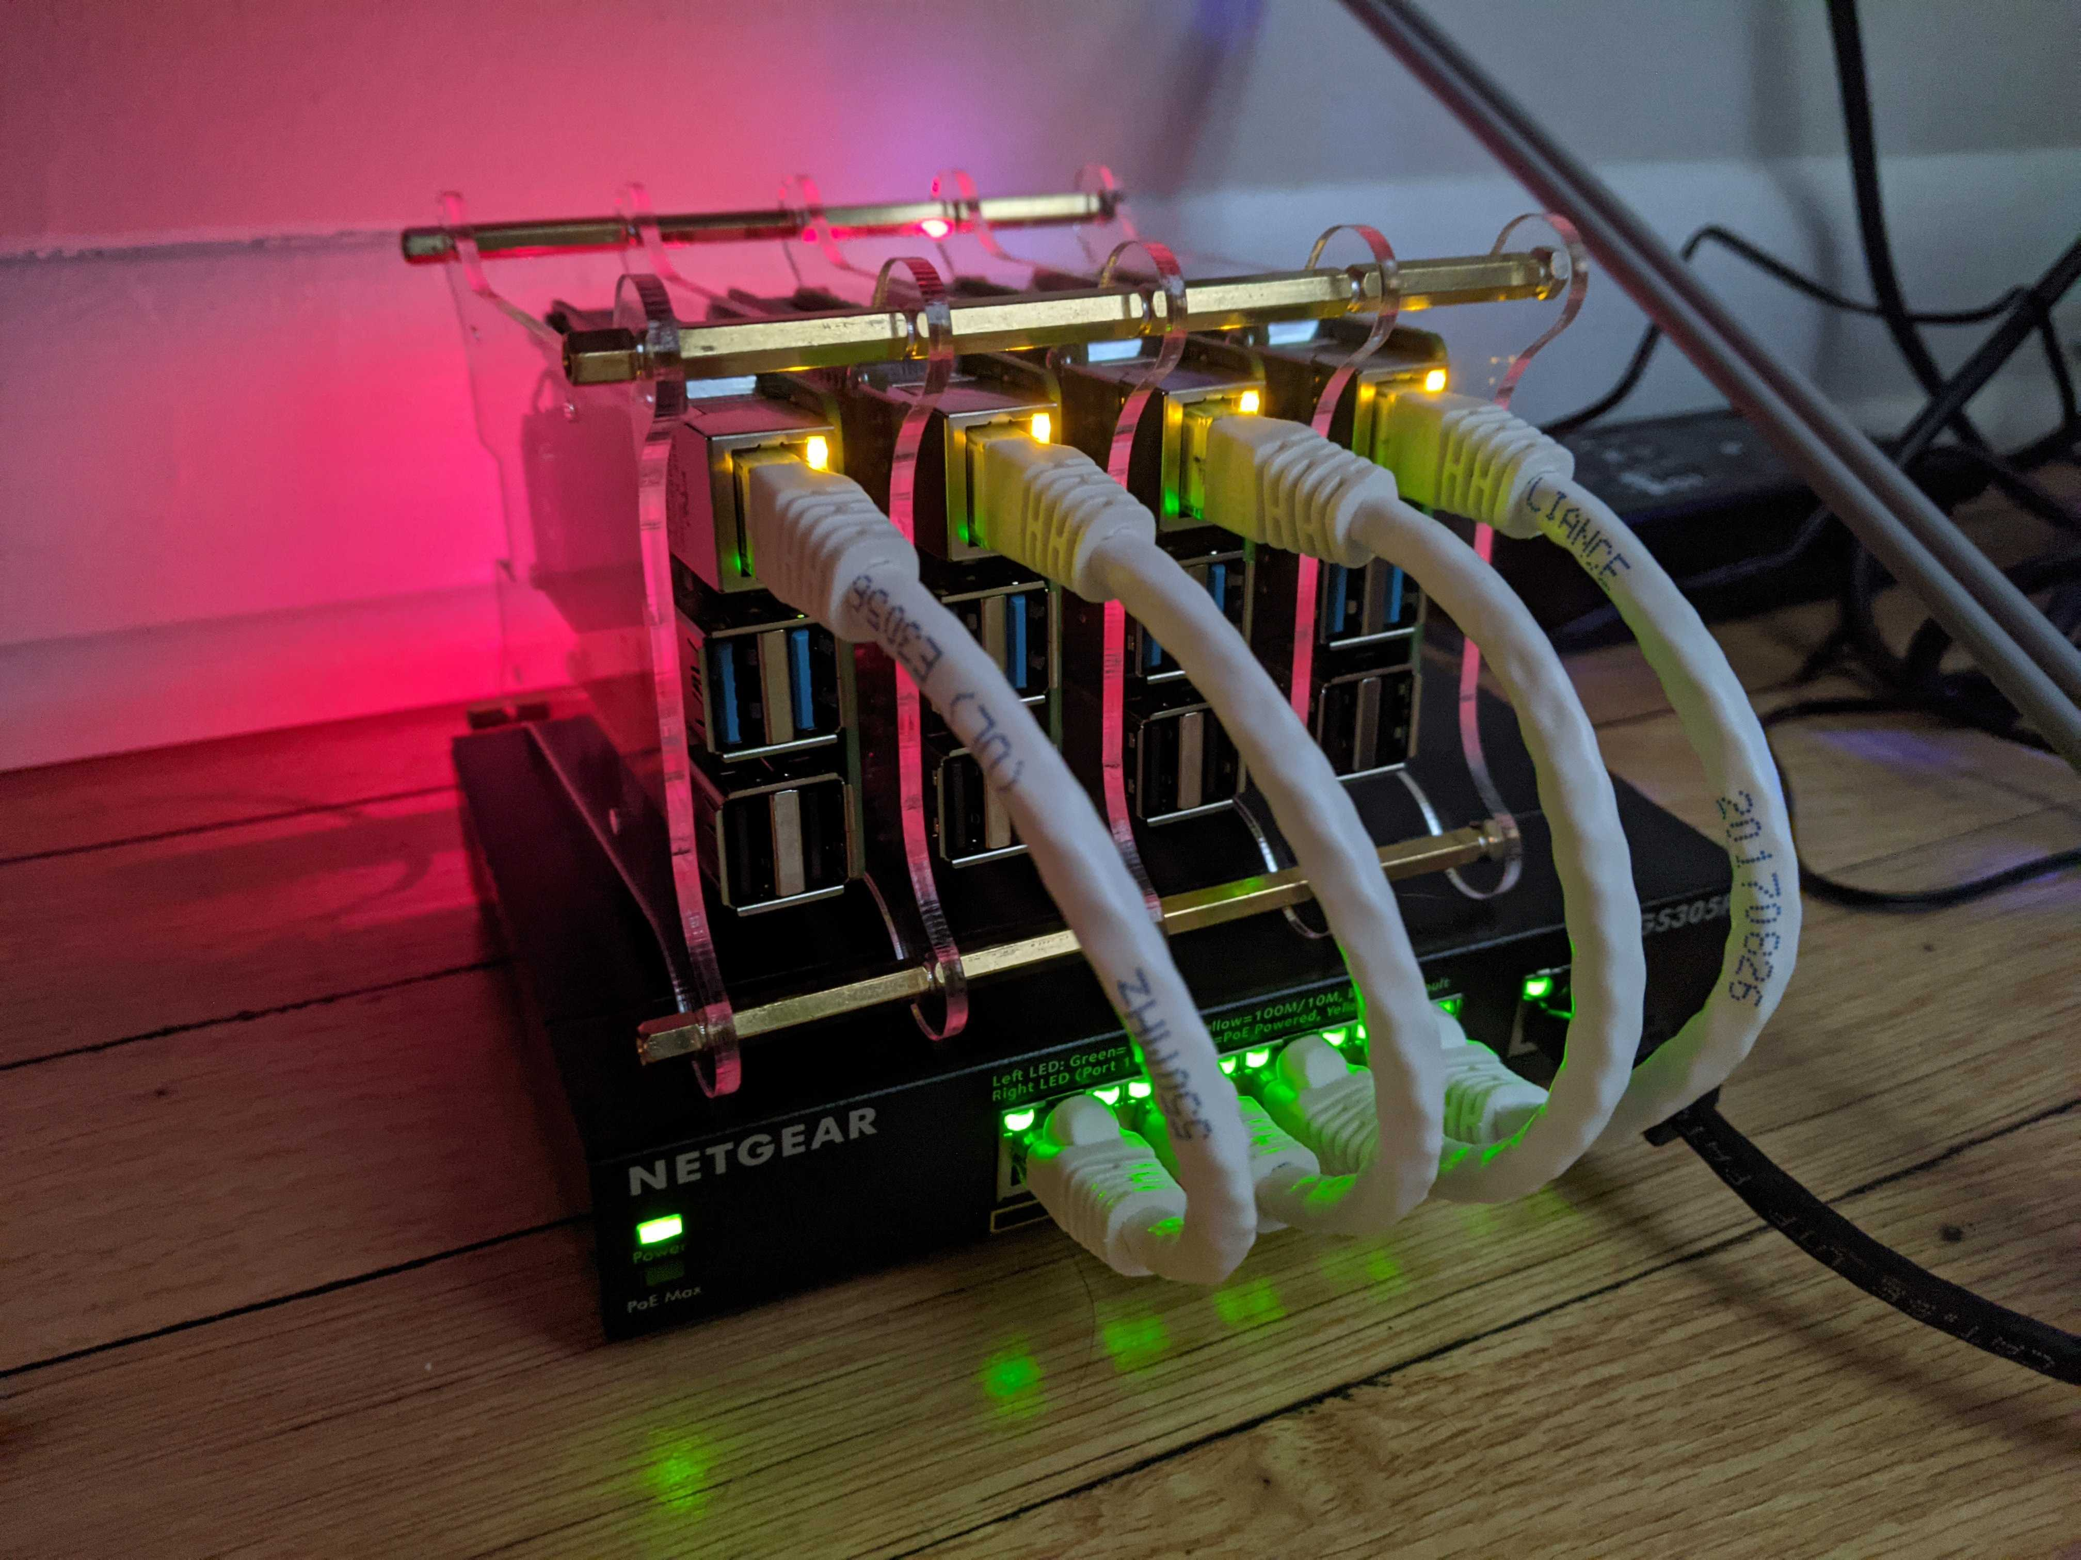

1,100+
Unique projects
700+ Papers published
10,000+
Users

Slide 3

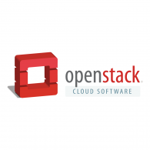
Chameleon: AN Edge To cloud testbed
From large to small – diversity and scale in hardware:
  Supercomputing datacenters (UC, TACC) over 100G network – to edge devices
  Diverse: FPGAs, GPUs, NVMe, NVDIMMs, Corsa switches, edge devices via CHI@Edge, etc.
  Distributed: CHI-in-a-Box sites at IIT, NCAR, Northwestern, and UIC – more coming
Chameleons like to change – testbed that adapts to your experimental needs
  From bare metal reconfigurability/isolation -- KVM cloud – to containers for edge
  Capabilities: power on/off, reboot, custom kernel boot, serial console access, etc.
Based on mainstream open source – proud to be cheap!
  50% leveraging and influencing OpenStack + 50% “special sauce” (incl. fed id)
A network of partnerships with an ecosystem of NSF-funded testbeds
  Networking: core network reconfigurability via NSF-funded FABRIC + FAB
  Wireless: PAWR projects: COSMOS+POWDER (urban), ARA (rural), and AIRPAW
  Others: SPHERE, Jetstream2, OCT, and other specialized testbeds and clouds

Slide 4
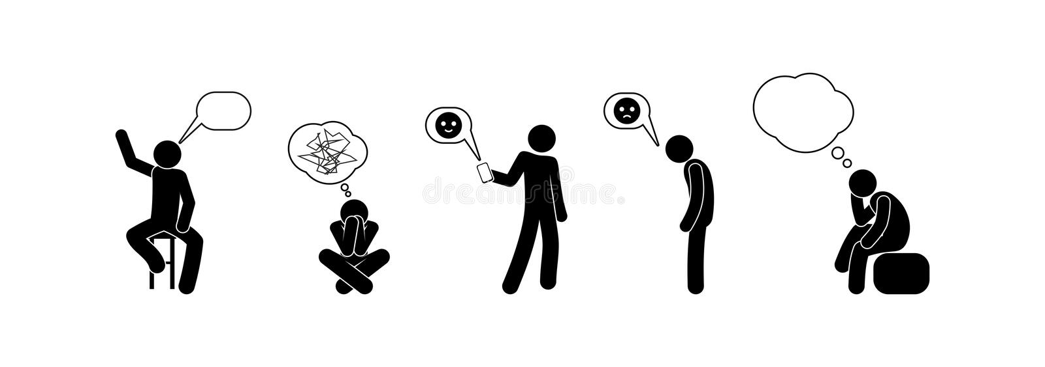
CHI@Edge
A lot like a cloud!
All the features we know and love – but for edge!
“Edge to cloud from one Jupyter notebook.”
Not at all like a cloud!
Location, location, location!
IoT: cameras, actuators, SDRs!
Not server-class!
And many other challenges!
CHI@Edge: all the features you love in CHI, plus:
  Reconfiguration through non-prescriptive container deployment via OpenStack interfaces (using K3 under the covers)
  Support for IoT peripherals (camera, GPIO, serial, etc.) + extensible framework for you to add support for your own peripherals
  Bring Your Own Device (BYOD): Mixed ownership model via an SDK with devices, virtual site, and restricted sharing – building on OpenBalena
Paper: “Chameleon@Edge Community Workshop Report”, 2021
Notes:
Non-prescriptive!

Slide 5
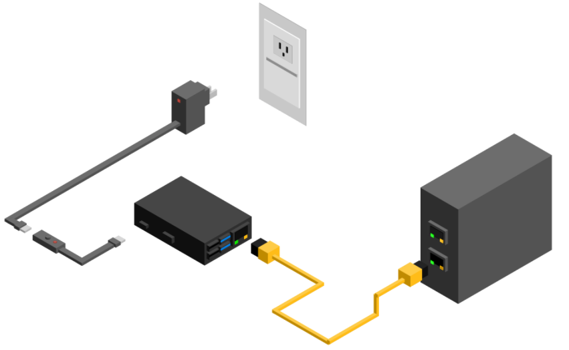
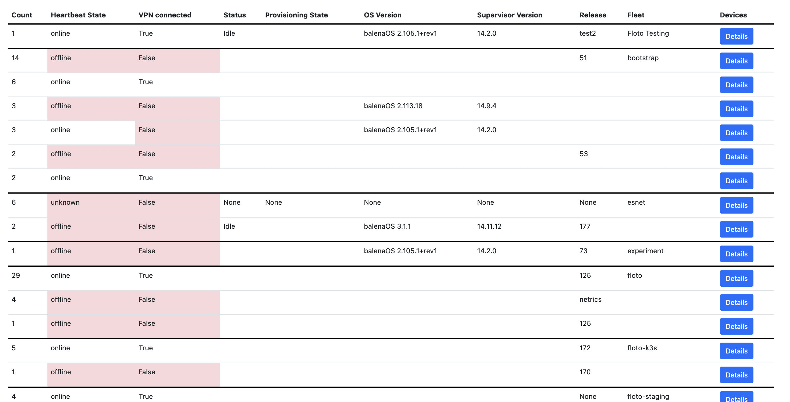
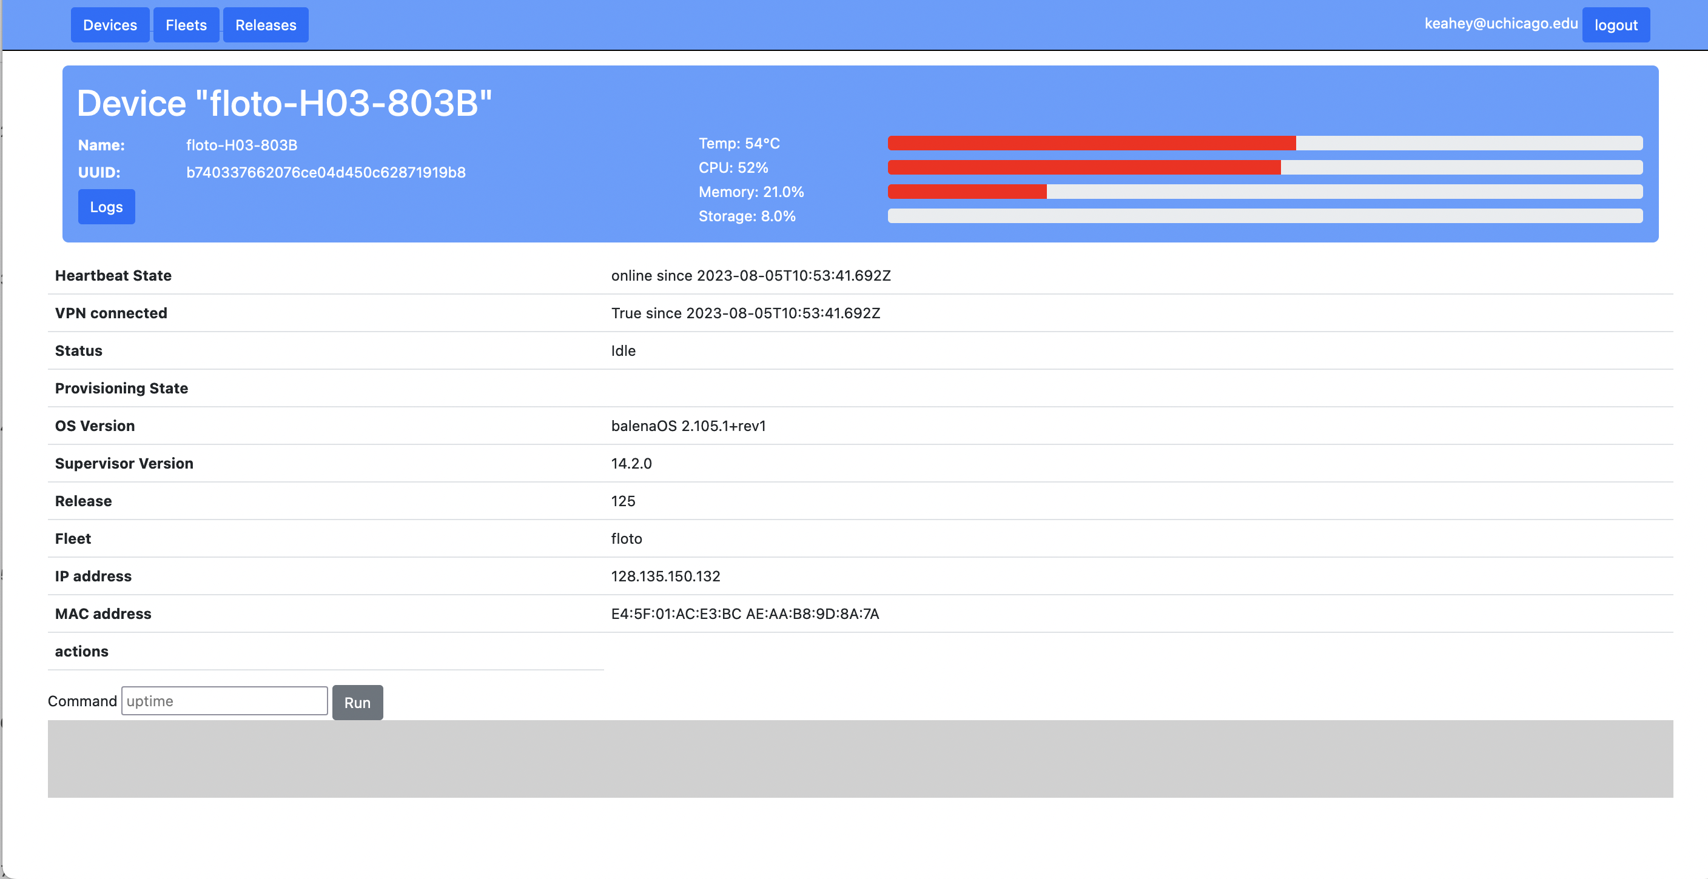
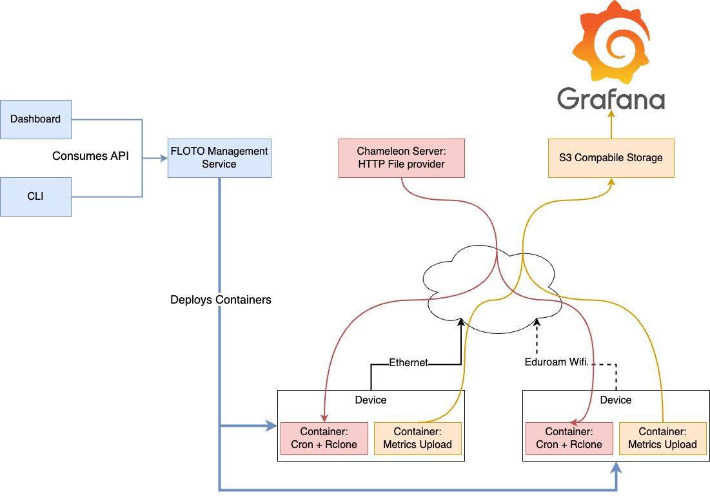
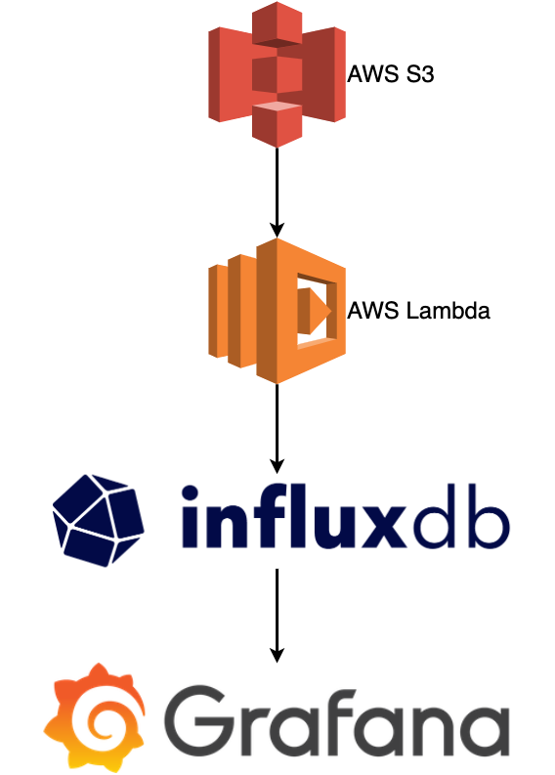
Floto: a discovery edge testbed
Deploys 1,000 Raspberry Pis across the US to measure broadband
Key features
  Zero touch deployment
  Management without physical access
  Deployment at scale
  Supports multiple testing applications non-invasive to network tests
  Data upload
  Services for data collection and analysis
CHI@Edge derivative supporting deployment for data collection
https://floto.cs.uchicago.edu

Slide 6
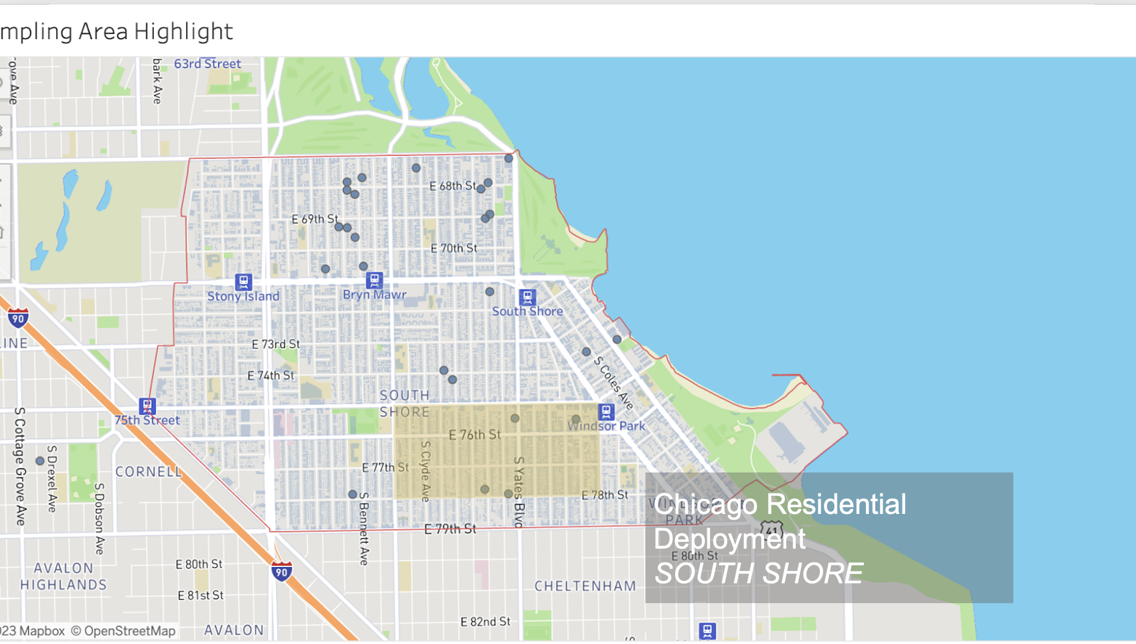
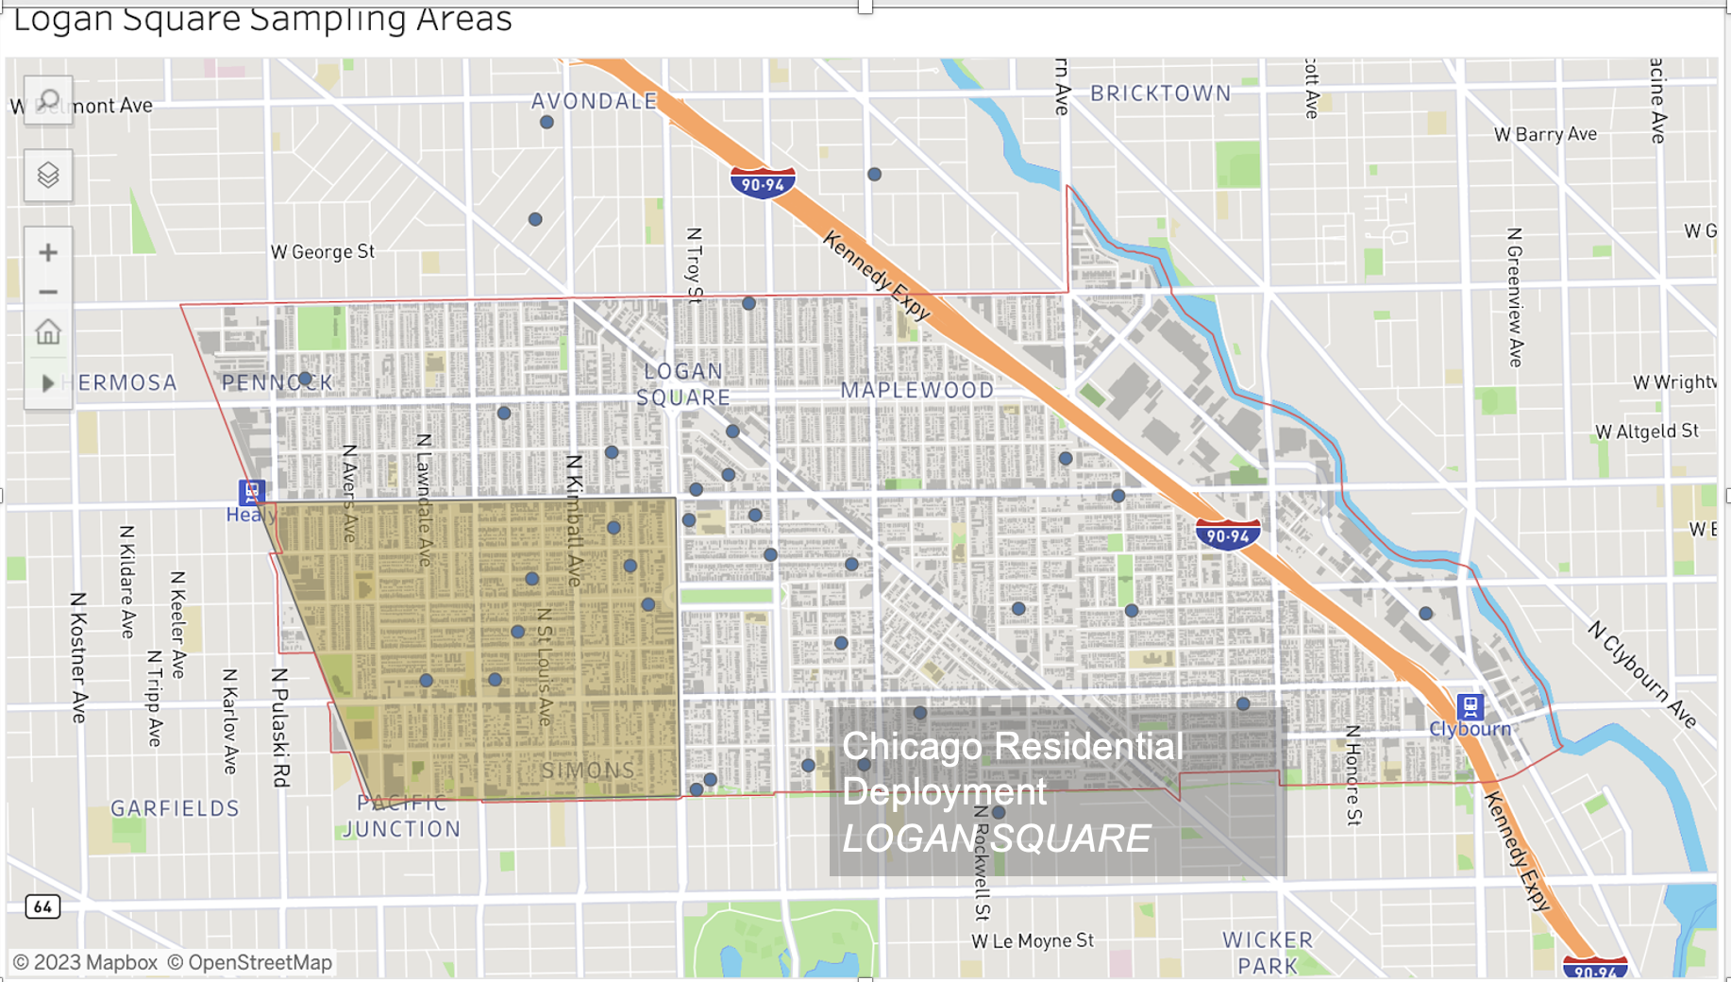
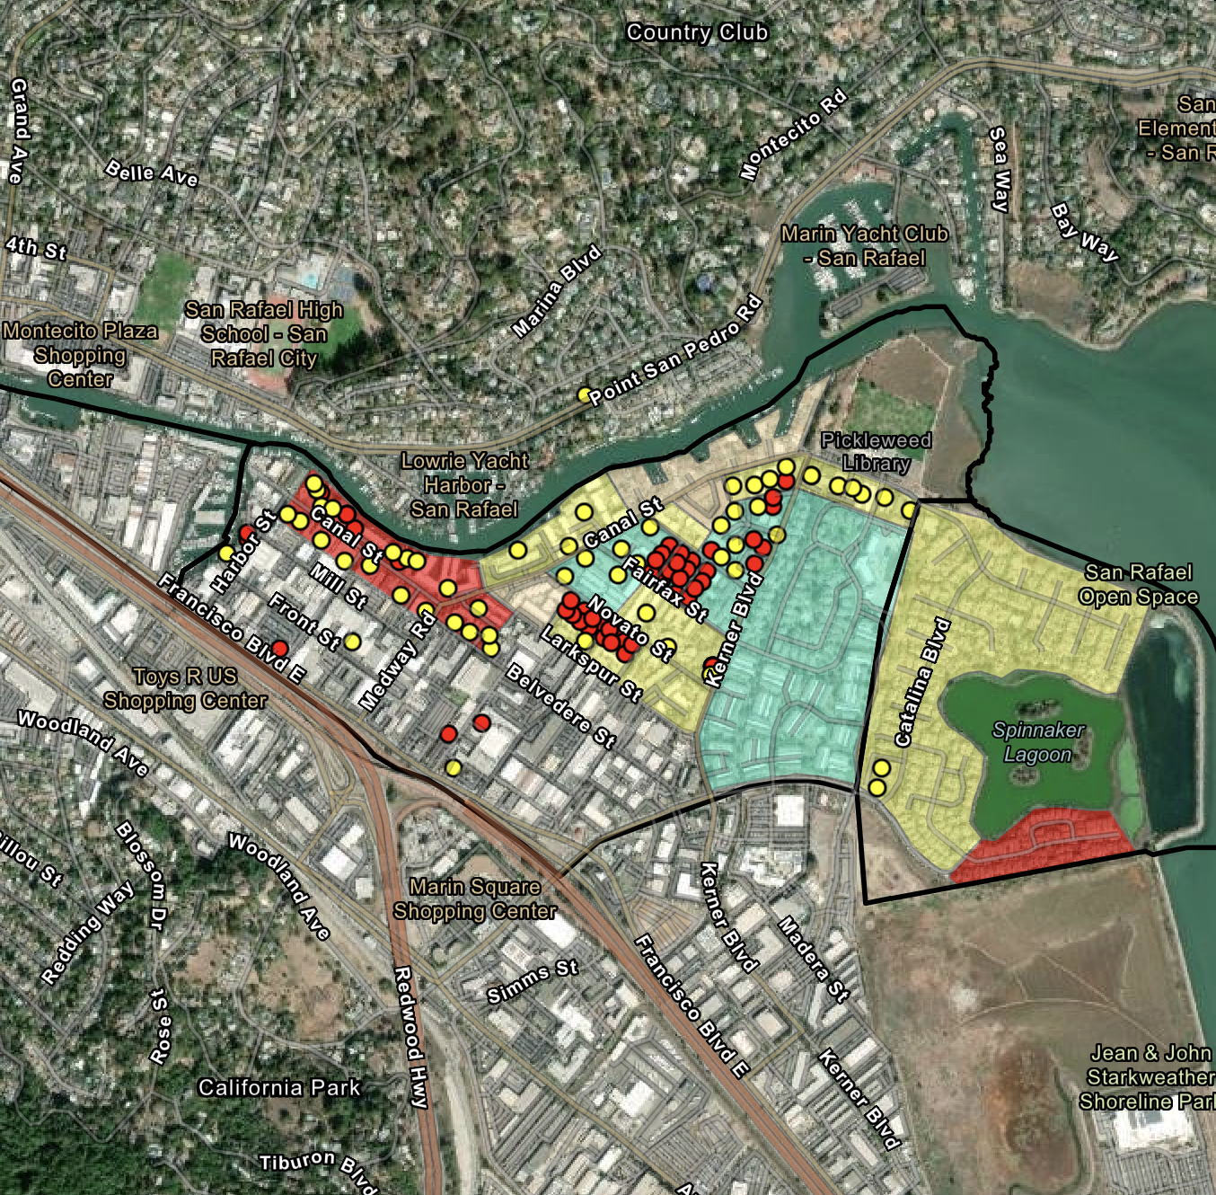
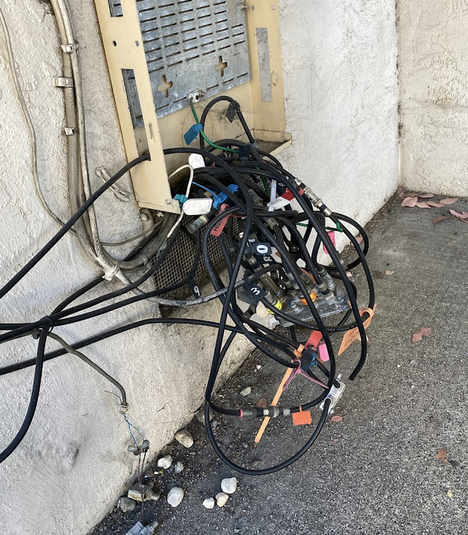
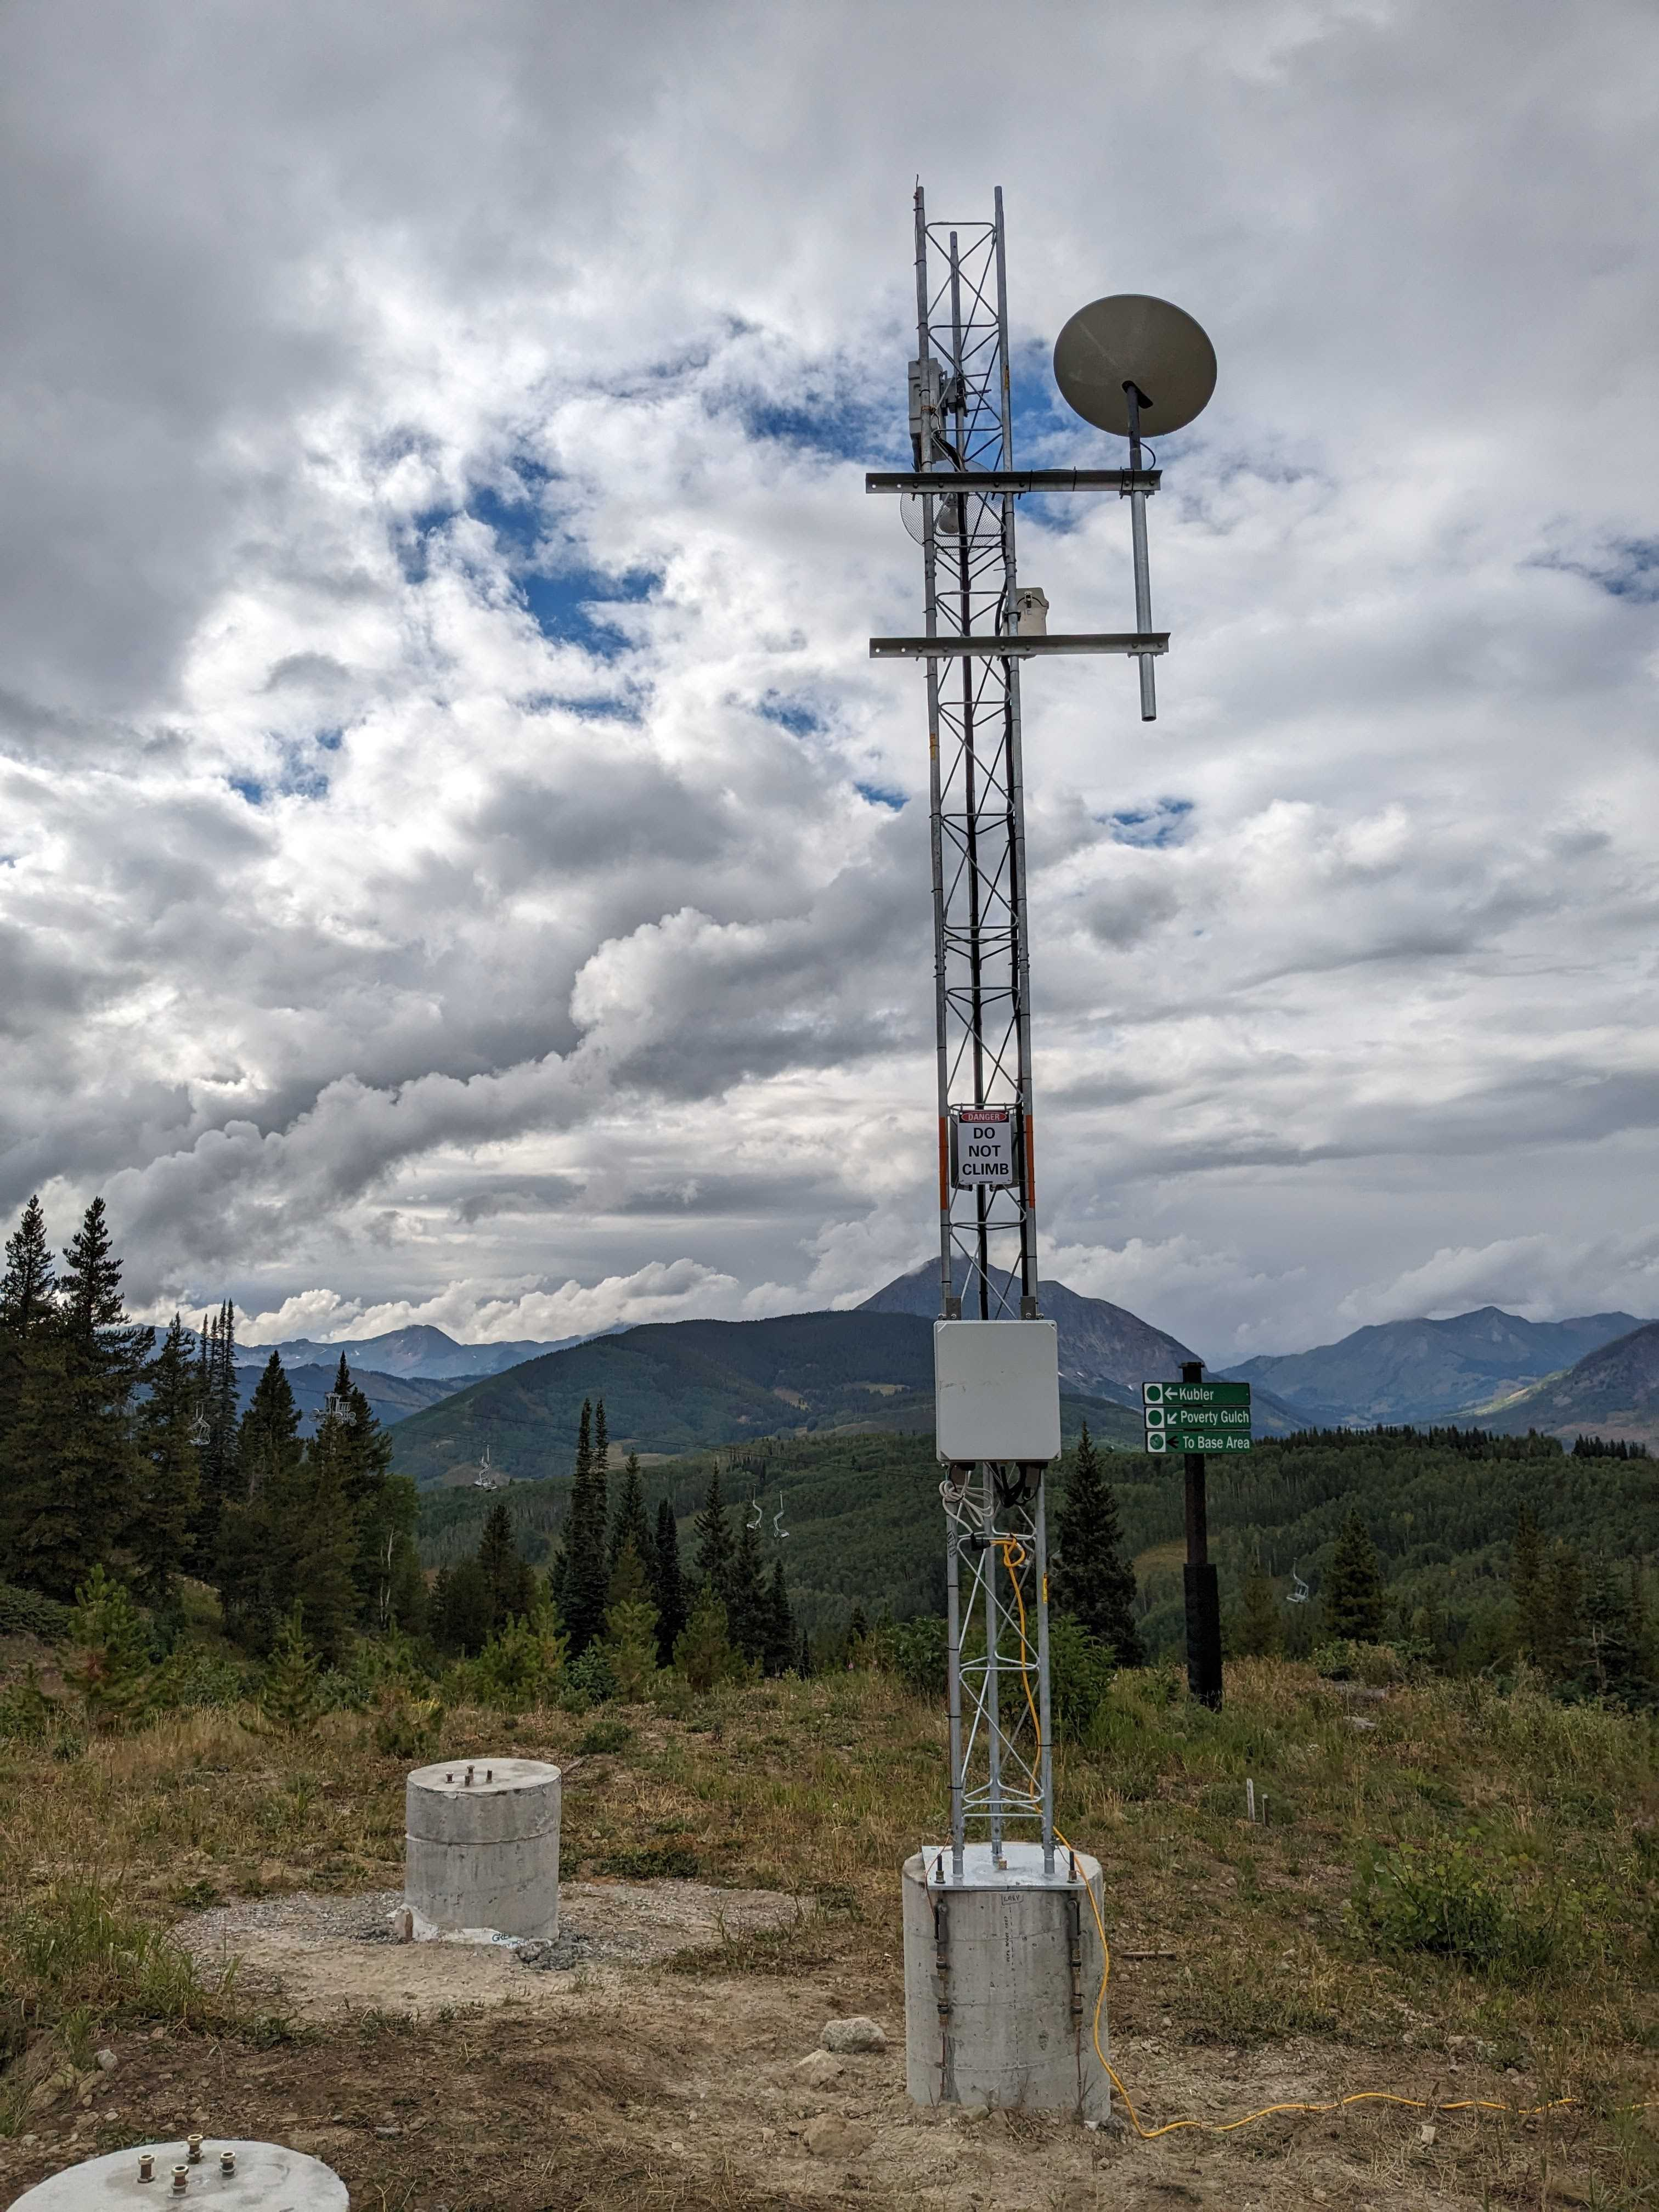
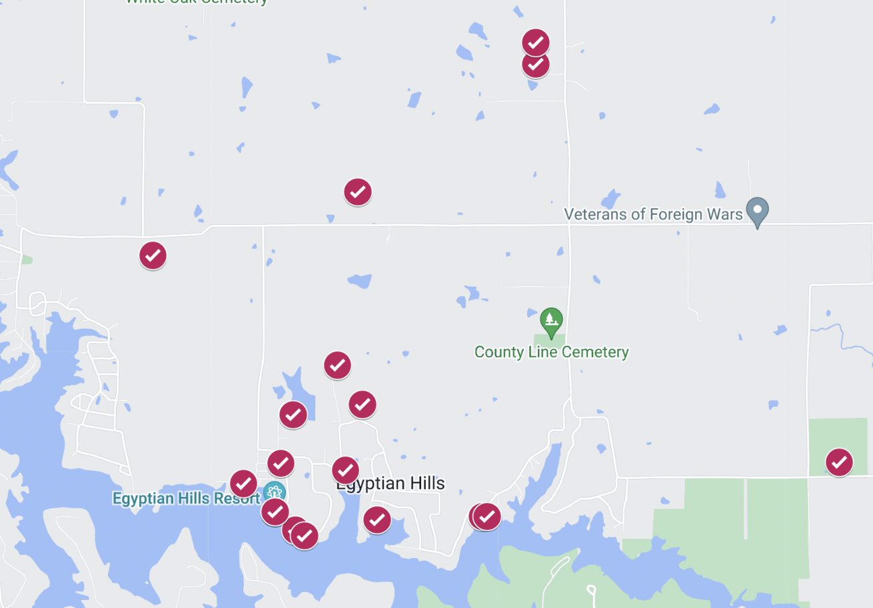
FLOTO DEPLOYMENTS and applications
Chicago, IL
  Logan Square and South Shore
Milwaukee, WI
  Franklin Heights and Muskego Way neighbourhoods
San Rafael, CA
Smaller deployments
  Marion County, IL
  University campuses
  CS research projects/testbeds
  Esnet/SAIL
Applications
  Netrics, MSAK, Radar, netUnicorn, I2 (network optimization), ARA (rural communities)

Slide 7
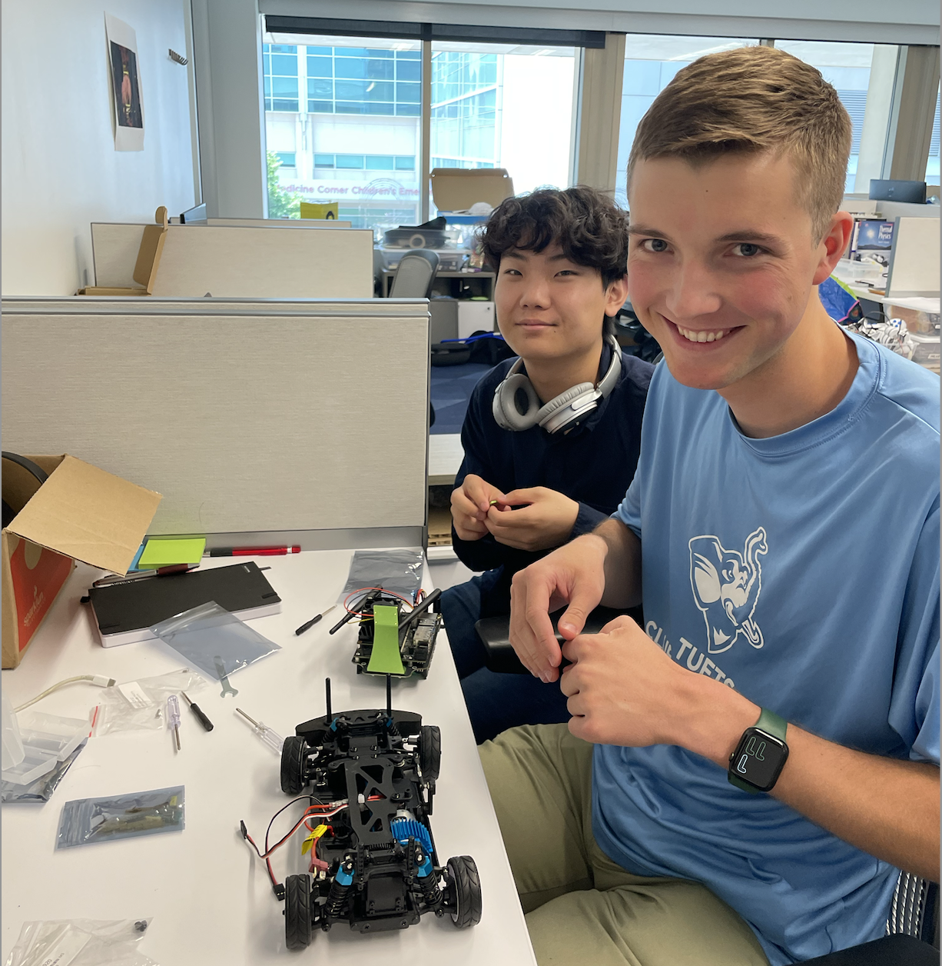
A few Application examples
Autonomous Driving (AutoLearn)
Data collection (sim and real)
Machine Learning
Verification (sim and real)
Digital Twin (combined)

Slide 8
A few thoughts
Dynamically changing space
  A lot of churn across emergent opportunities and requirements
  Objective-driven deployment: trad vs ”edge leverage” (ephemeral, rolling, mobile, etc.)
  Center for exploration versus specific solutions – sharing hardware versus hardware
Challenges
  Configuration and deployment
  Connectivity and networking, security
  Configuration continuum: from bare metal to VMs to containers and beyond
  Resource management (including data resources)
Research infrastructure
  Chameleon, CloudLab, FABRIC, PAWR projects, OCT, SPHERE, and others
Translational approach: working with an engaged CS community
Notes:
Cloud to IoT is a massive opportunity that challenges many assumptions we were making about infrastructure

Slide 9

We’re here to change
www.chameleoncloud.org

Slide 10
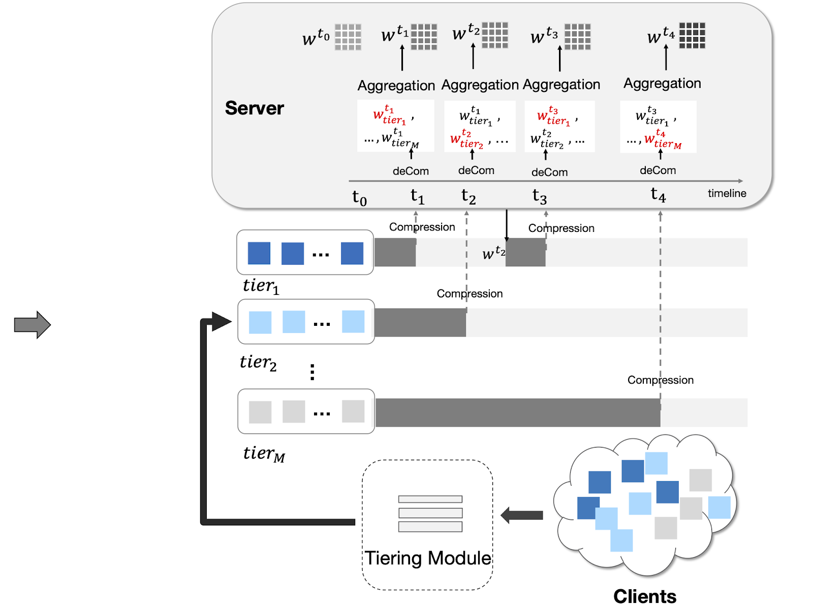
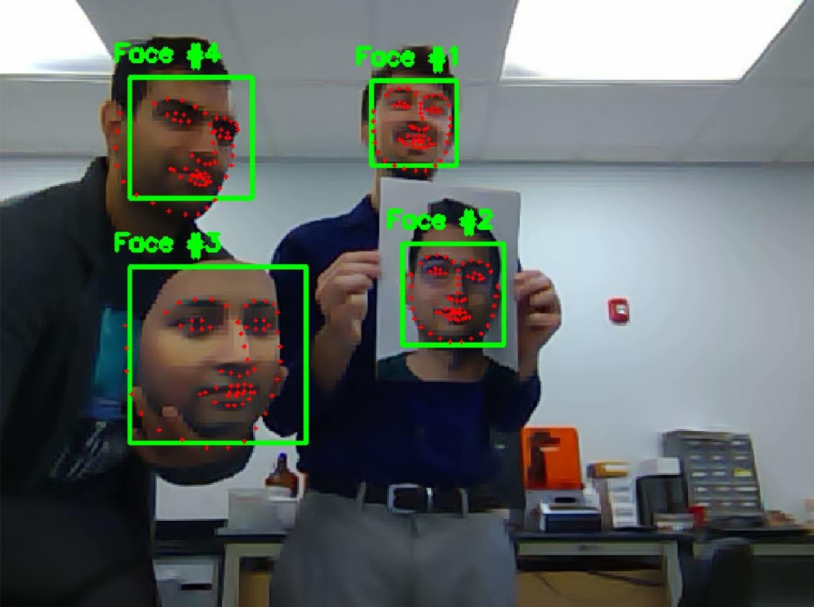
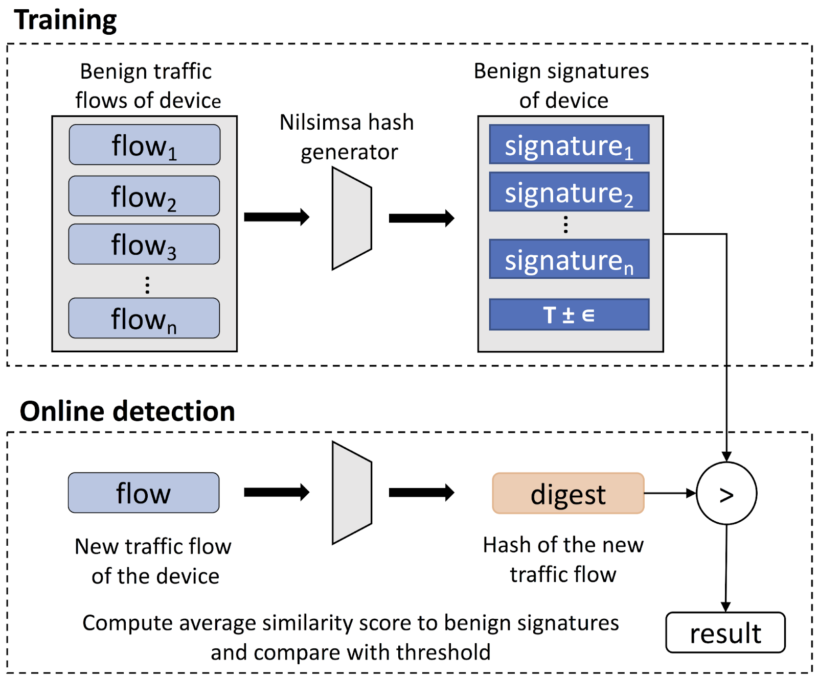

Exploration AT THE EDge
federated learning
biometrics
traffic fingerprinting
autonomous driving
Bring Your Own Device (BYOD) – together with its IoT friends

