Slide 1
Chameleon: An Edge to cloud Testbed for Computer Science Systems Research
Kate Keahey
Mathematics and CS Division, Argonne National Laboratory
CS Department, University of Chicago
keahey@anl.gov

Slide 2
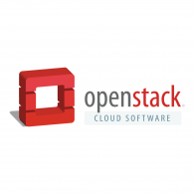
Chameleon in a nutshell
From large to small – diversity and scale in hardware:
Supercomputing datacenters (UC, TACC) over 100G network – to edge devices
Diverse: FPGAs, GPUs, NVMe, NVDIMMs, Corsa switches, edge devices via CHI@Edge, etc.
Distributed: CHI-in-a-Box sites at IIT, NCAR, Northwestern, and UIC – and more
Chameleons like to change – testbed that adapts to your experimental needs
From bare metal reconfigurability/isolation -- KVM cloud – to containers for edge
Capabilities: power on/off, reboot, custom kernel boot, serial console access, etc.
Based on mainstream open source – proud to be cheap!
50% leveraging and influencing OpenStack + 50% “special sauce”
Promoting disruption in digital artifact sharing
Integration with Jupyter for non-transactional experiment packaging
Trovi for experiment sharing and discovery, Chameleon Daypass for access sharing
Reproducibility and education: digital sharing killer apps!

Slide 3
testbed BY THE NUMBERS
600+ Papers published
1,000+
Unique projects
95
Countries
9,000+
Users
350+
Institutions
+3 More Years to Grow!
Notes:
635 publications as of current counting – NOT including any publications from the Chameleon team

Slide 4
Chameleon hardware
Notable still to come:
disaggregated hardware (GigaIO)
CHI@UC
Skylake, CascadeLake, IceLake, and AMD nodes GPUs (A100, V100, RTX6000), FPGAs (Xilinx Alveo U280)
Storage (NVMe SSD, NVDIMM)
Network (Corsa SDN, 25G Ethernet, 200G InfiniBand)
Chameleon Volunteer Sites
Storage
~0.5 PB
CHI@Edge
Raspberry Pi, Jetson Nano, Jetson Xavier NX, AGX Orin
+ User-added devices
Network
100Gbps public network
Chicago
Austin
CHI@TACC
Haswell, SkyLake, CascadeLake, Fugaku (ARM64 + HBM), AMD nodes, and LIQID disaggregated hardware
GPU (K80, M40, P100, MI100), FPGAs (Altera)
Storage (NVMe, SSD, NVDIMM)
Network (Corsa SDN, 25G Ethernet, 200G InfiniBand)
Commercial Clouds via CloudBank
Storage
~3.5PB
FABRIC, FAB
and other partners
Notes:
UC
42x Intel nodes with 48 cores and 192GB of RAM, 10x AMD Epyc with 48 cores, 256GB of RAM, and a 960GB NVMe root disk. Additionally, a subset:
2 nodes, each with 2x Intel D7-P5510 7.68TB datacenter SSDs
2 nodes, each with 2x Samsung PM1733 7.68TB datacenter SSDs
2 nodes, each with 4x Samsung PM1733 1.92TB datacenter SSDs
2 nodes, each with 2x Corsair Force MP600 2TB consumer SSDs
2x: Intel Optane nodes with 112 Cores, 768GB of RAM, and 3TB of NVDIMMs
3x: Intel nodes with 4x Nvidia V100 GPUs connected by NVLink
1x: Intel node with 4x Nvidia V100 GPUs connected by PCIe
16x of the regular compute nodes have HDR100 (100gb/s) InfiniBand, as do all of the Optane and GPU nodes. All the SSD nodes have HDR (200gb/s) InfiniBand.
At TACC
32x compute_zen3: AMD nodes, each with 2x two AMD EPYC 7763 (128c / 256t), 256GB RAM, 480GB ssd storage.
8x gpu_mi100: same specs as compute_zen3, with addition of 2x AMD MI100 GPUs each
All 40 are connected via HDR100 Infiniband.
Volunteer sites:
NCAR: ARM Thunder Nodes
IIT, Northwestern, & UIC: Chameleon Legacy program
Purdue: ~400 of their own Haswells added on an ephemeral basis to support IndySCC specifically

Slide 5
ChI Experimental workflow
discover
resources
allocate
resources
configure and interact
monitor
- Fine-grained
- Complete
- Up-to-date
- Versioned
- Verifiable
- Allocatable resources: nodes, VLANs, IPs
- Advance reservations and on-demand
- Fungible/non-fungible interface
- Isolation
- Bare metal, KVM, containers for edge
- Image catalog
- Snapshotting
- Orchestration (Heat)
- Jupyter integration
- Networks: stitching and BYOC
- Hardware metrics
- Fine-grained data
- Aggregate
- Archive
Authentication via federated identity, accessed via GUI, CLI and python/Jupyter (python-chi)
Paper: “Lessons Learned from the Chameleon Testbed”, USENIX ATC 2020
Notes:
Highlight:
Interfaces – everything goes via OpenStack-based API (even if it is just a veneer as for CHI@Edge)
Emphasis on *programmatic interfaces* with python-chi and Jupyter – they can be easily scripted/repeated (unlike GUI), preferred by most users

Slide 6
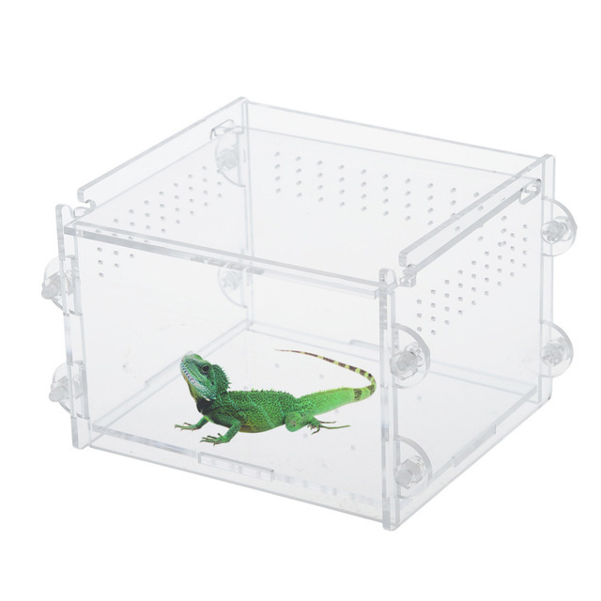
Highlight: Chi-in-a-box
CHI-in-a-box: packaging of CHameleon Infrastructure (CHI)
Internal packaging of a commodity-based testbed
Packages the system as well as the operations model
Hub and spoke management, version-controlled site configuration management as code, containerization, monitoring, detection, and remediation tools
Support for Bring Your Own Device (BYOD) model: Doni allows administrators to dynamically enroll resources, define availability windows, and streamline operations
Deployment
Deployed Associate/Volunteer Sites: IIT, NCAR, Northwestern, and UIC
Ephemeral sites to support specific projects, including reproducibility
Independent testbed: ARA
In conversation/progress: SDSC, OCT/U Mass, FIU, ORNL, KTH (edge/wireless only), NUS, and others
Paper: “CHI-in-a-Box: Reducing Operational Costs of Research Testbeds ”, PEARC’22
Notes:
New testbed: you even get base images – ultimately also Prometheus and Swift

Slide 7
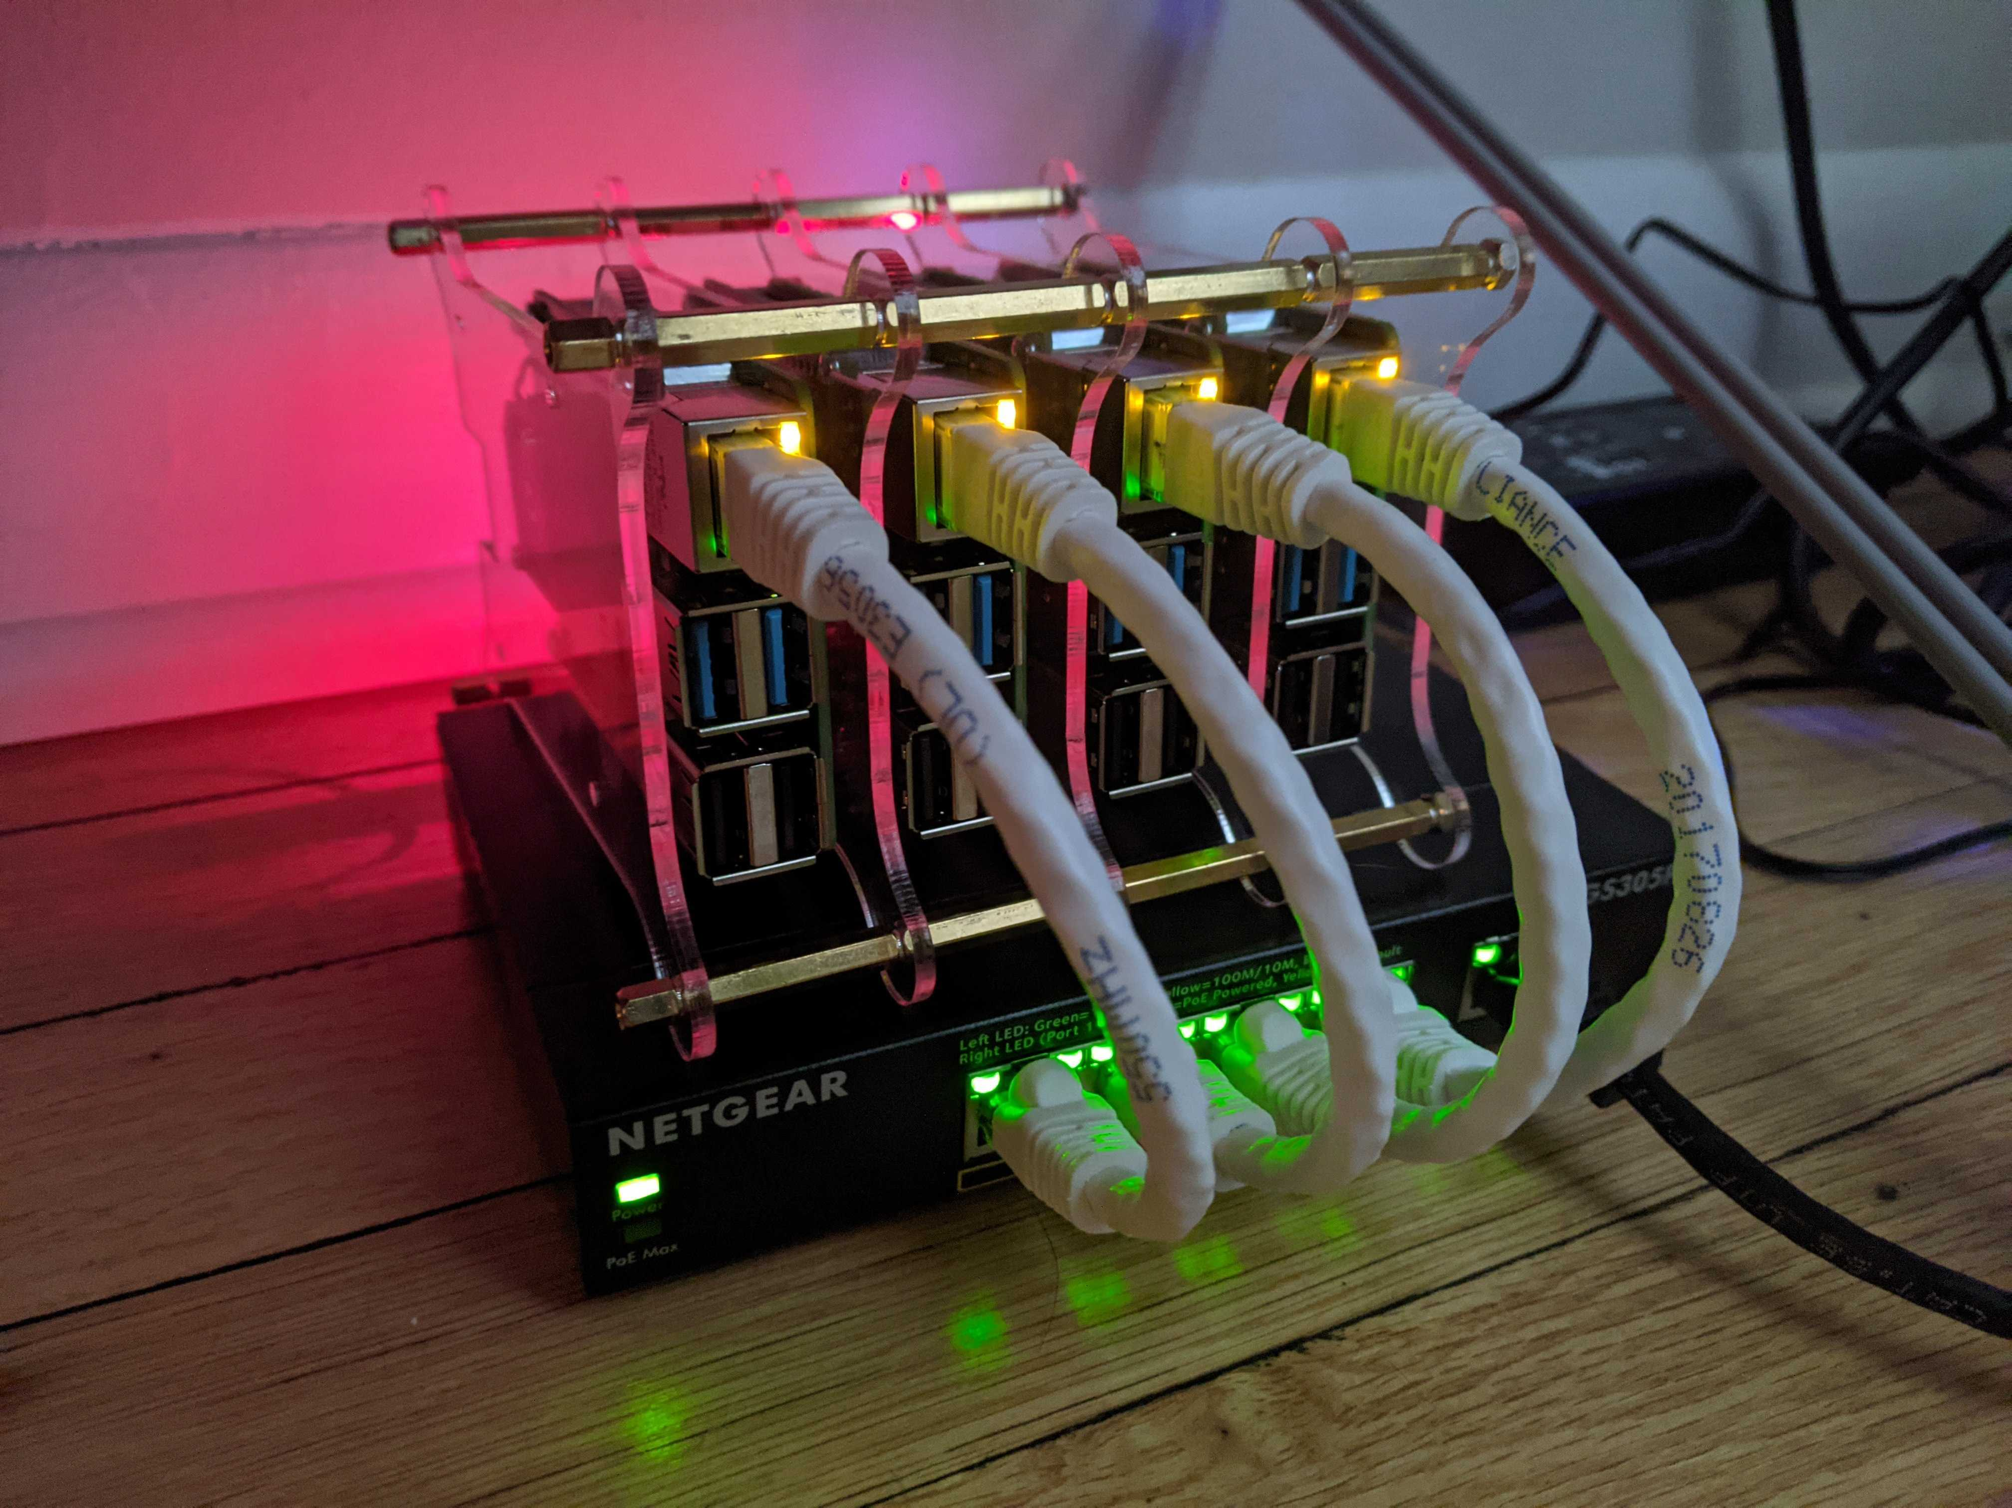
Highlight: CHI@Edge
A lot like a cloud!
All the features we know and love – but for edge!
“Edge to cloud from one Jupyter notebook.”
Not at all like a cloud!
Location, location, location!
IoT: cameras, actuators, SDRs!
Not server-class!
And many other challenges!
CHI@Edge: all the features you love in CHI, plus:
Reconfiguration through non-prescriptive container deployment via OpenStack interfaces (using K3 under the covers)
Support for “standard” IoT peripherals (camera, GPIO, serial, etc.) + easy for you to add support for your own peripherals
Bring Your Own Device (BYOD): Mixed ownership model via an SDK with devices, virtual site, and restricted sharing – building on OpenBalena
Paper: “Chameleon@Edge Community Workshop Report”, 2021
Notes:
Non-prescriptive!

Slide 8
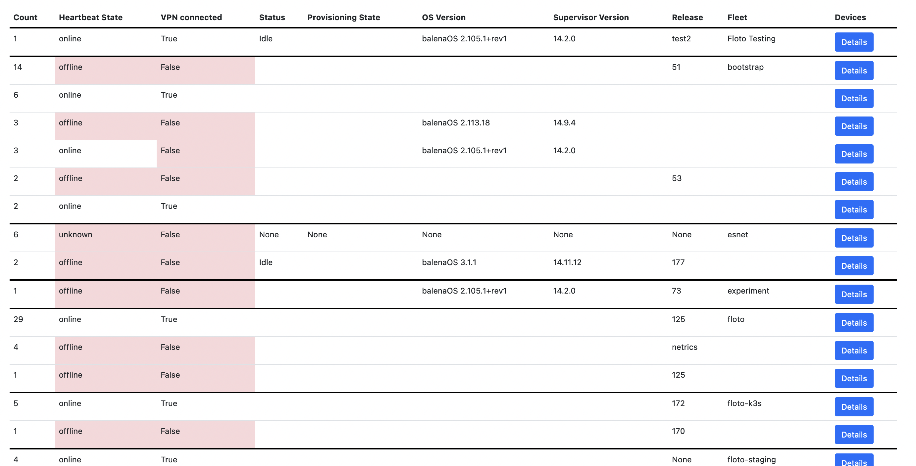
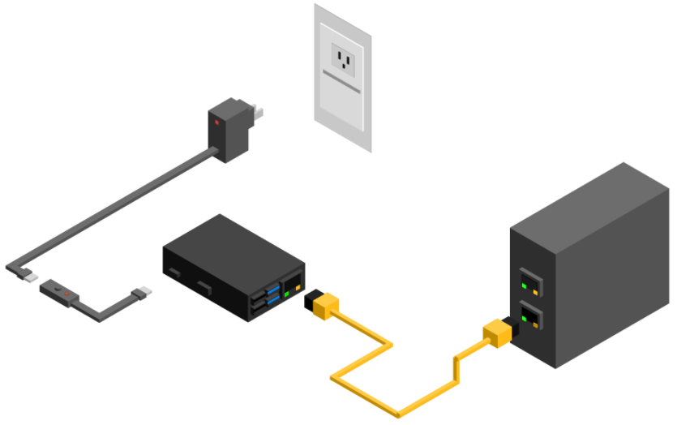
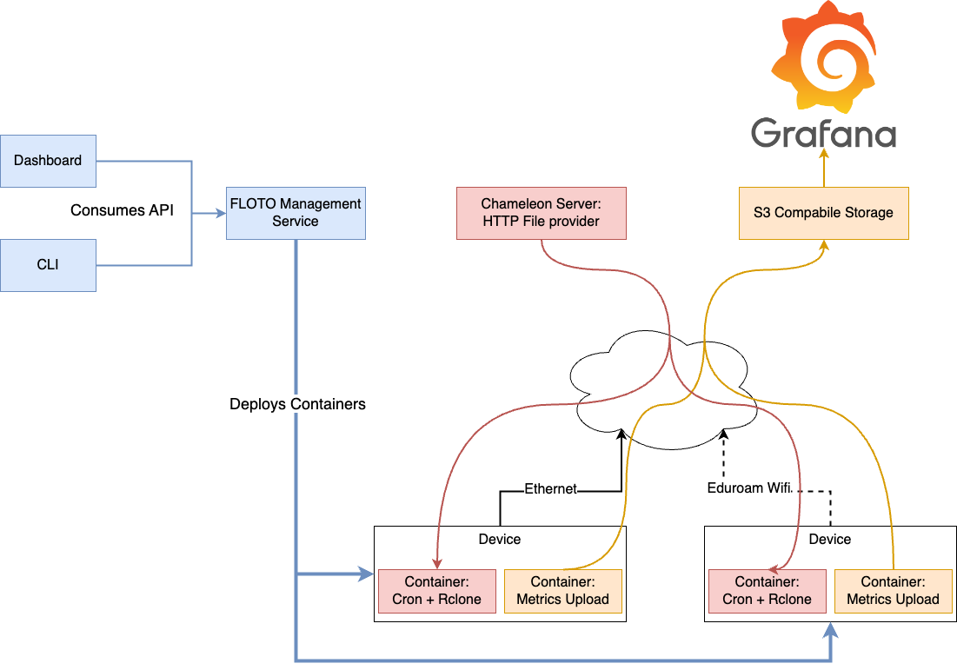
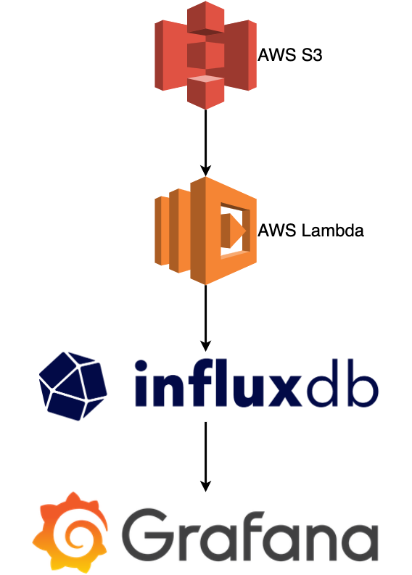
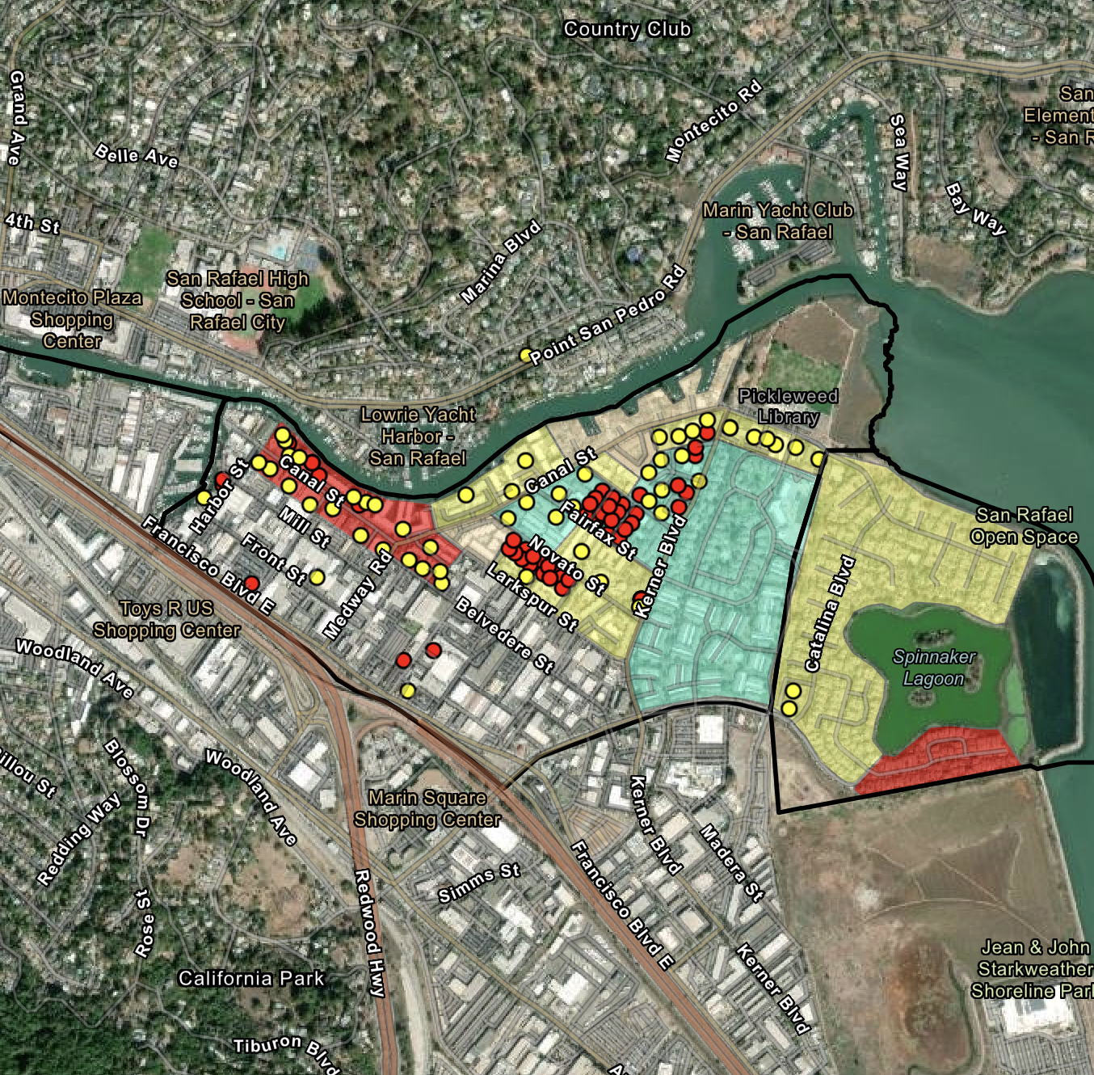
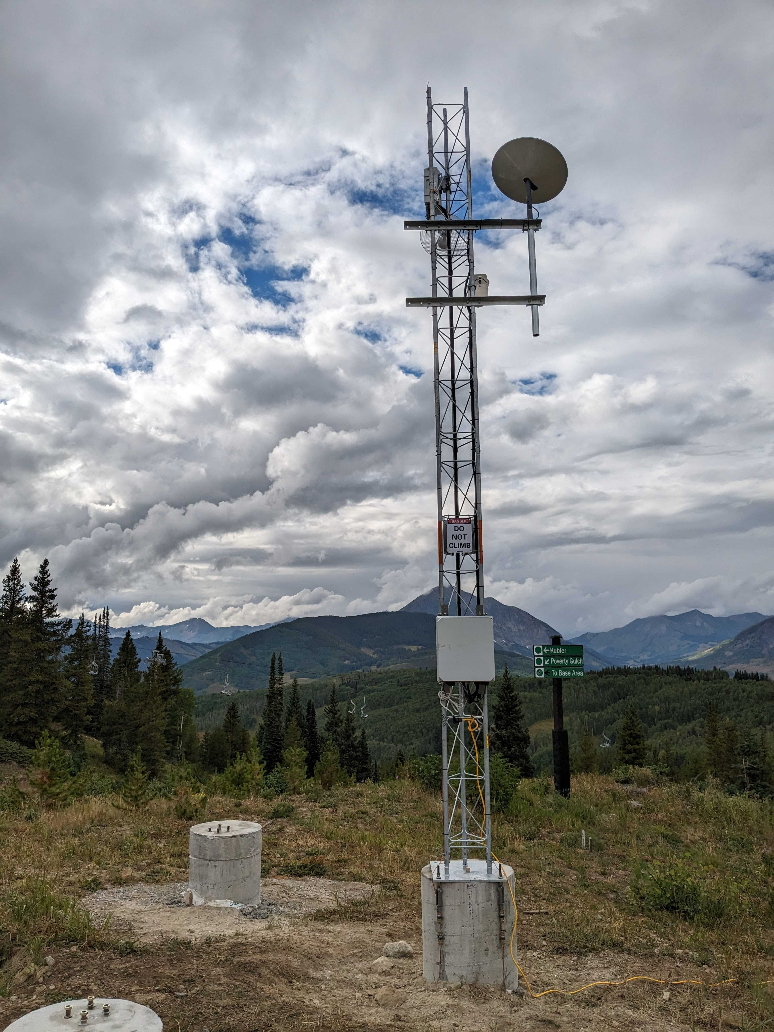
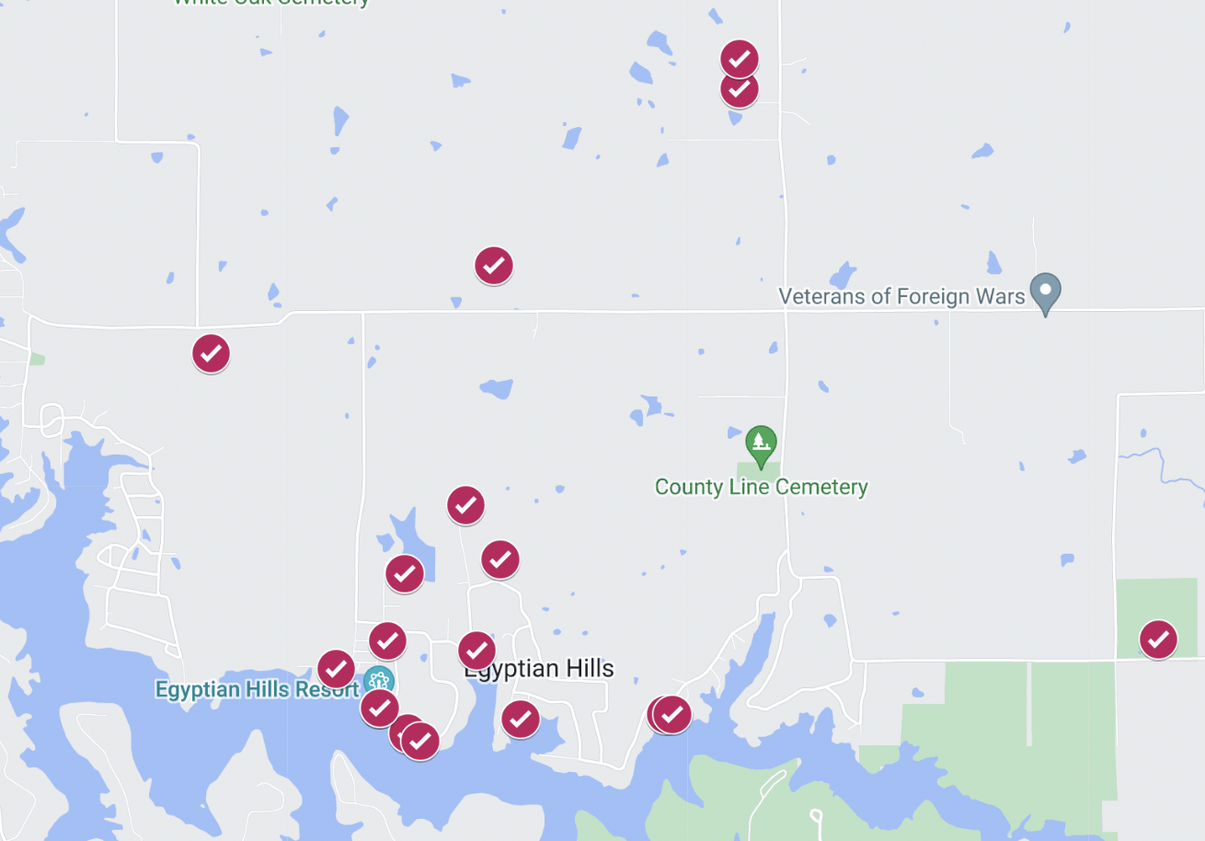
From CHI@Edge to Floto
Broadband monitoring: connect a “measurement box” to the network and run tests
Features
0 touch, non-invasive device enrollment
Support for operations without physical access
Scalable: ~1,000 devices is the starting point
Data aggregation, preservation, and presentation services
Adaptable: multiple applications and aggregation services
Deployment
Municipalities: Chicago, IL (200 devices), Milwaukee, WI (300 devices), San Rafael, CA (300 devices), Marion County, IL (20-30 devices)
University campuses (Uchicago, Chicago State University)
Other research projects
Paper: “Discovery Testbed: An Observational Instrument
for Broadband Research”, eScience 2023

Slide 9
Highlight: Practical Reproducibility
Practical reproducibility:
cost-effective enough to be mainstream
End-to-end packaging with literate programming
Credential integrated JupyterLab environment: convenience of notebook + power of testbed
Imperative, non-transactional, annotated
Trovi: an experiment sharing repository
Portal to present, browse, filter, and find
Integrated with Jupyter/Chameleon, Swift, Zenodo, and github
Open APIs: FABRIC, Jetstream2, and others
Chameleon daypass
Reproducibility initiatives: >6x the usage 22/23
Effective packaging via a “compute capsule”
Finding and sharing experiments
integrated with platform
Open, integrated access to all aspects of experiment
Paper: “Three Pillars of Reproducibility”, ReWords’23
Notes:
2022: Middleware, ICSE, and SC (7846 SUs)
2023: ICPP, TPDS, SC23, FAST'23, OSDI'23, and Journal of Systems Research; 49,288 Sus)

Slide 10
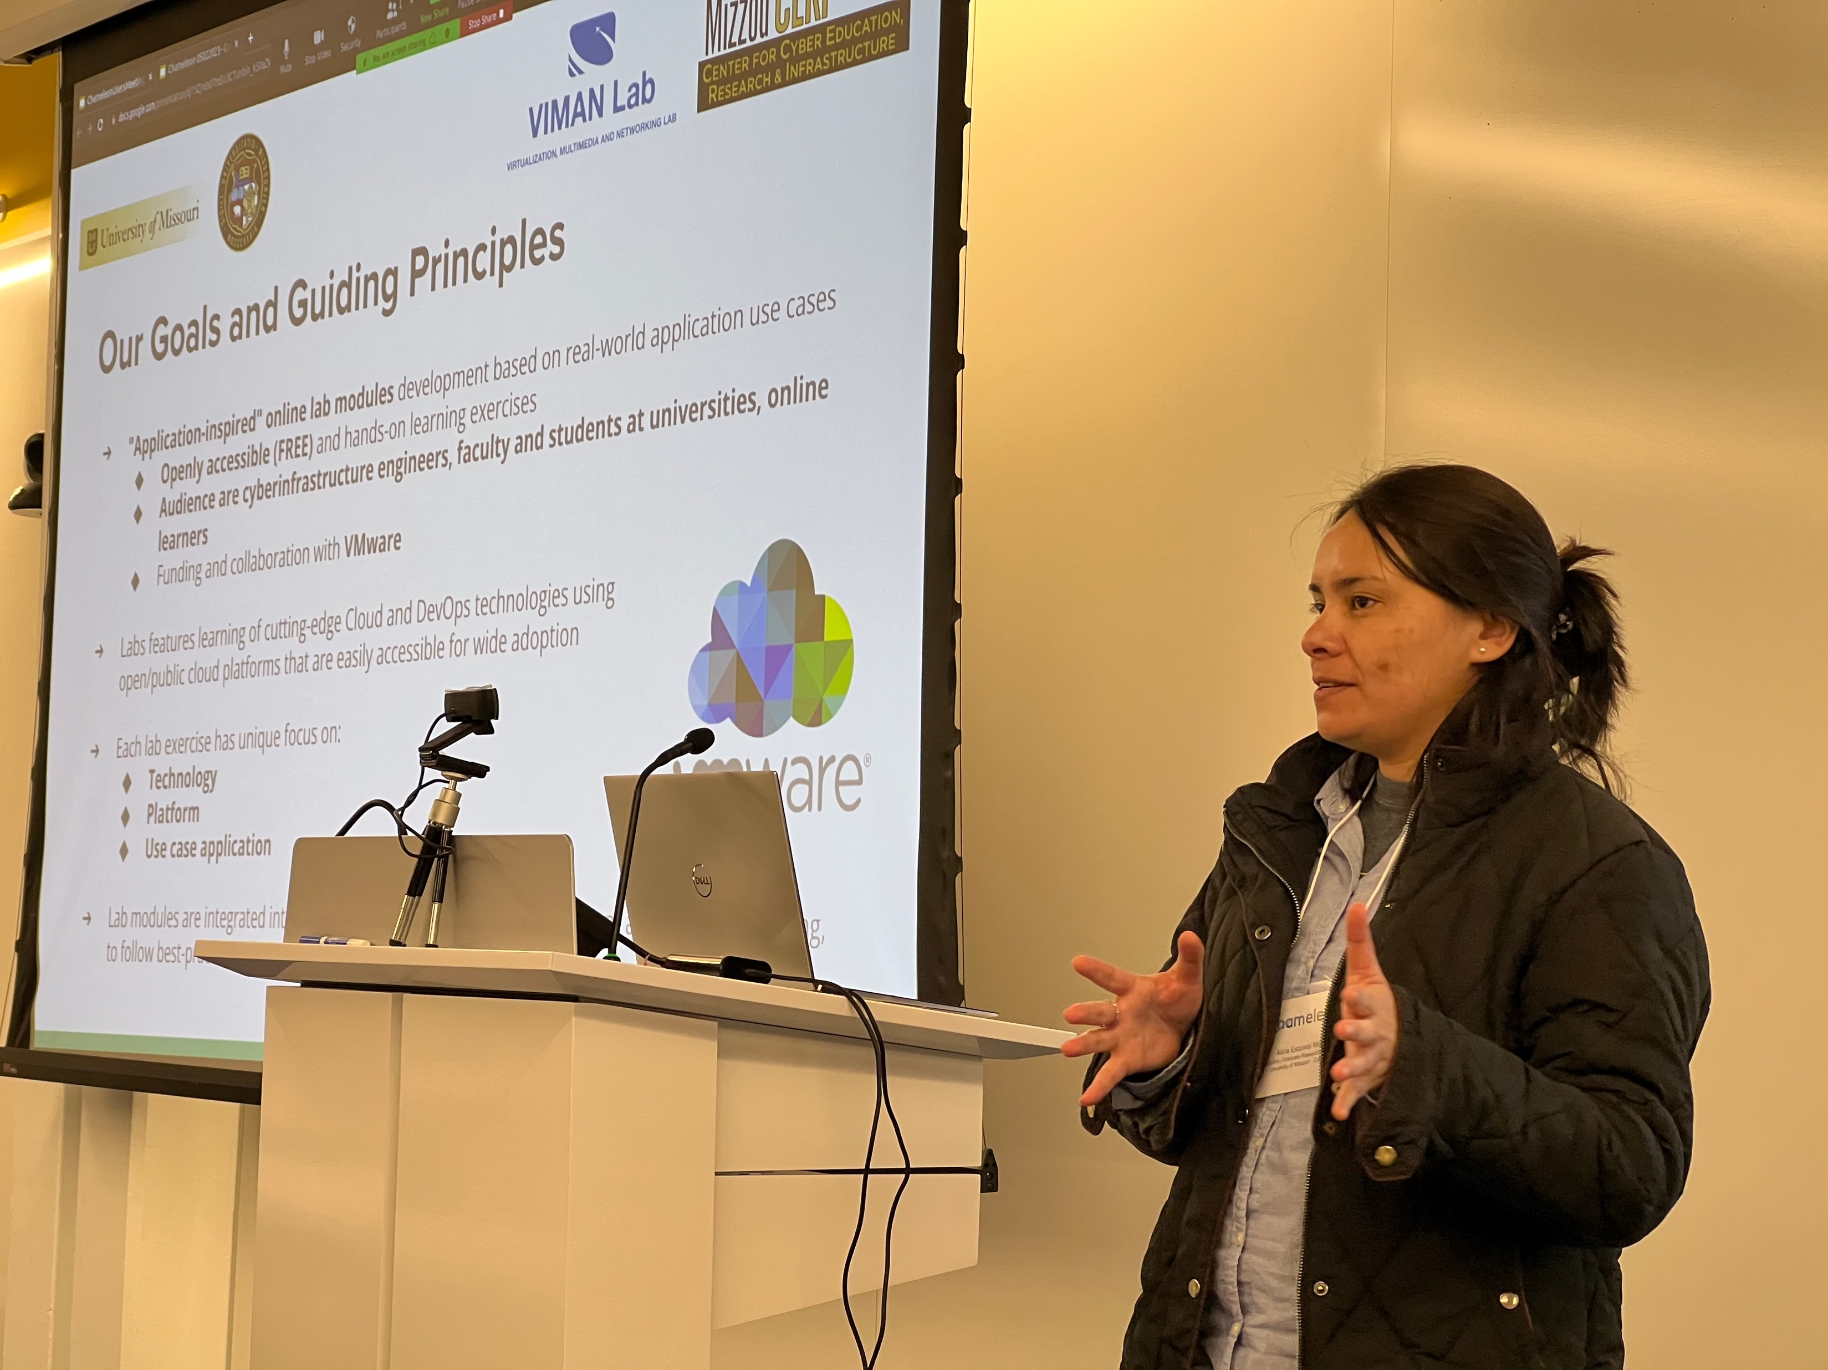
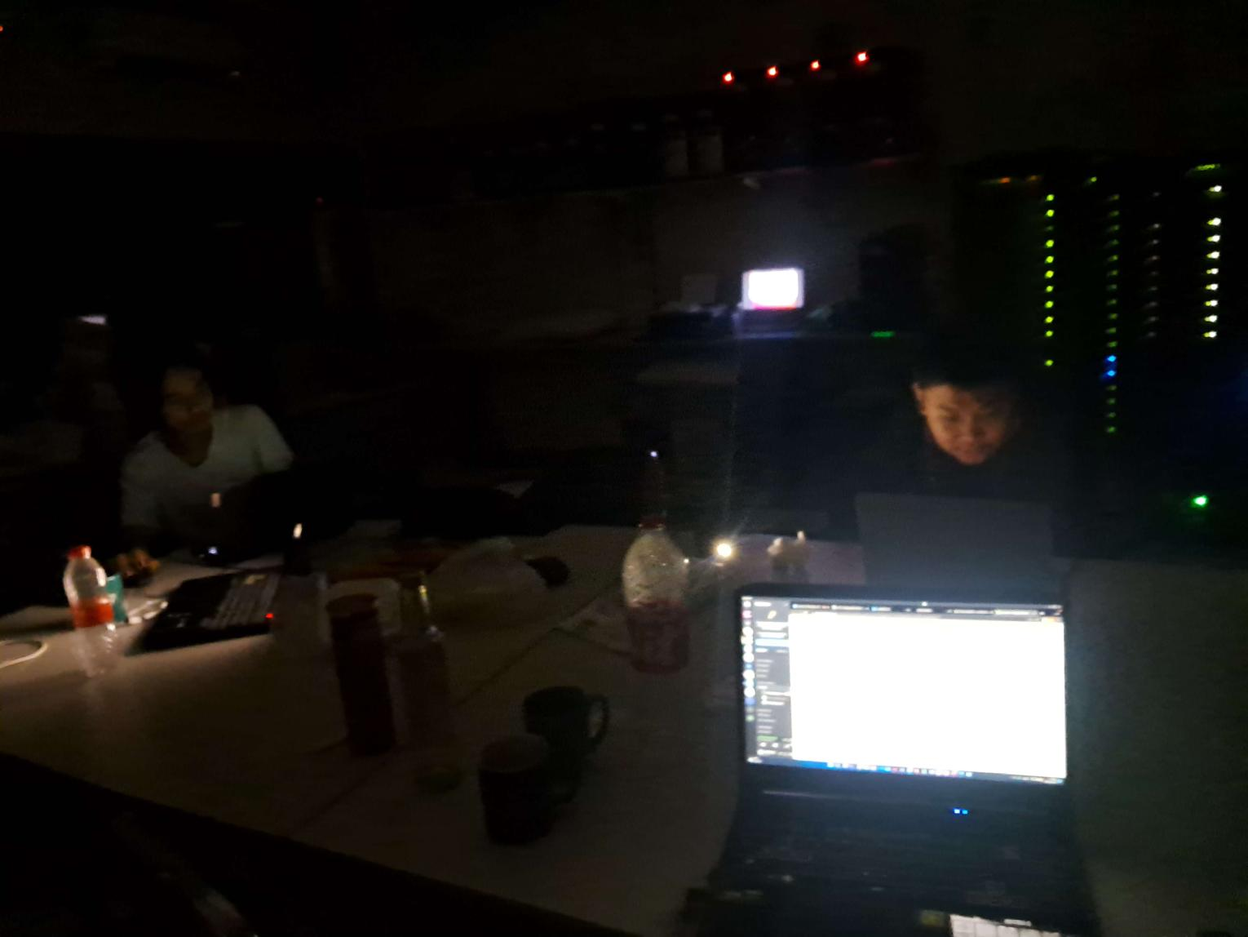
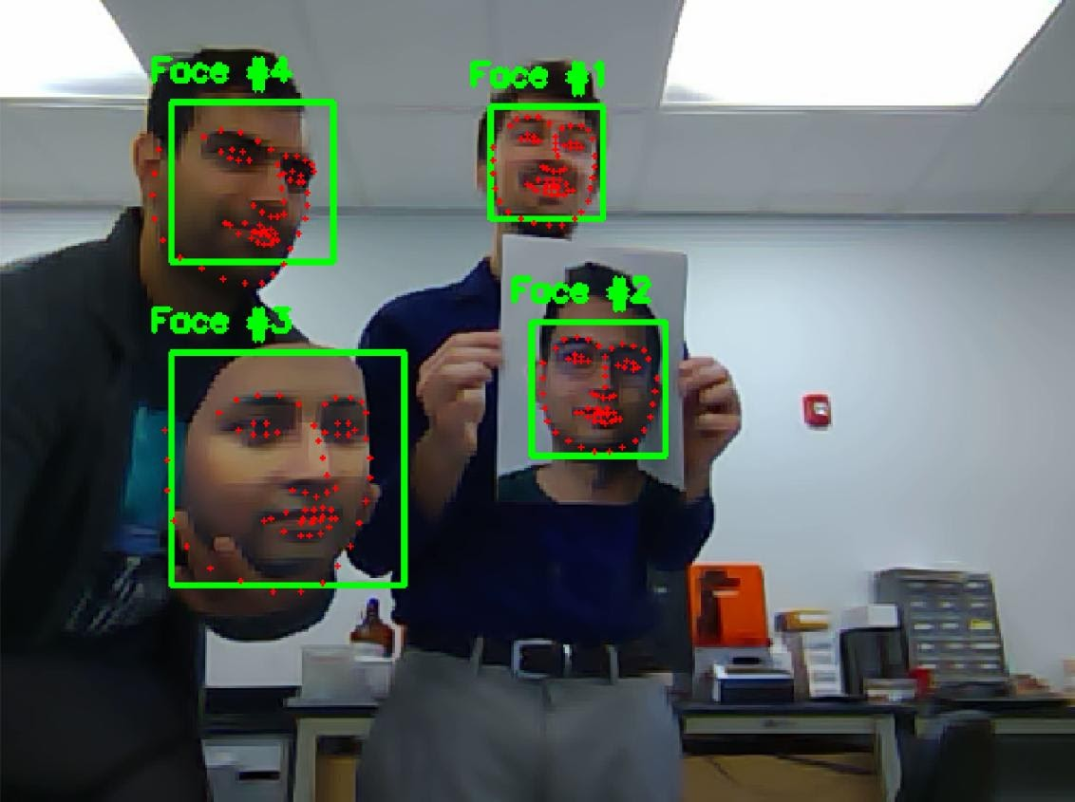
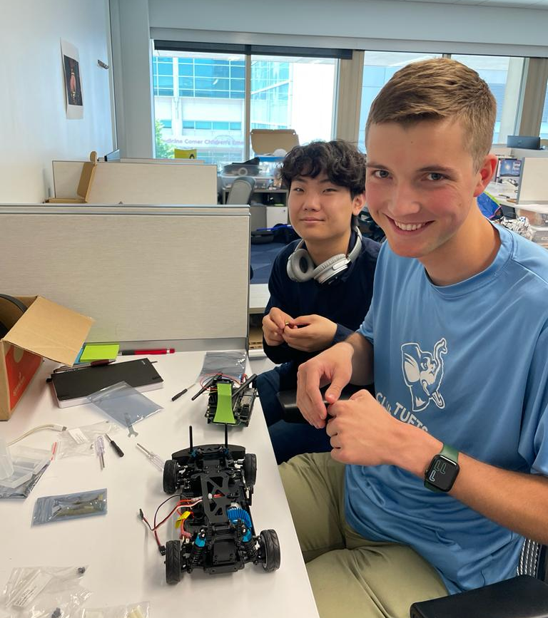
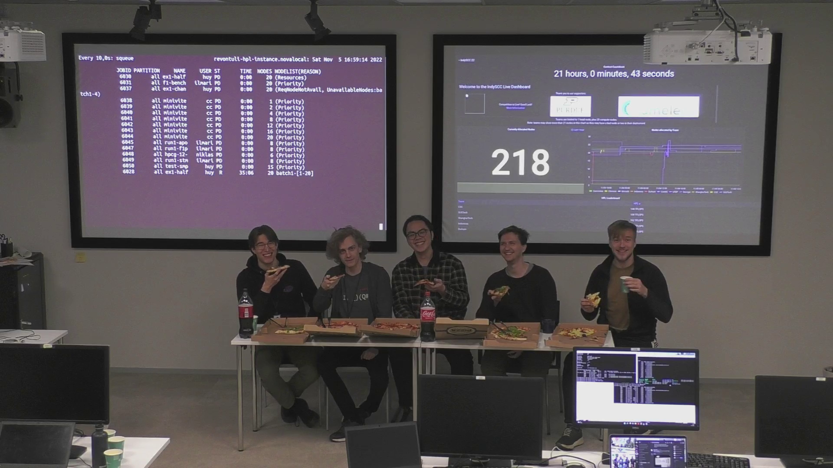
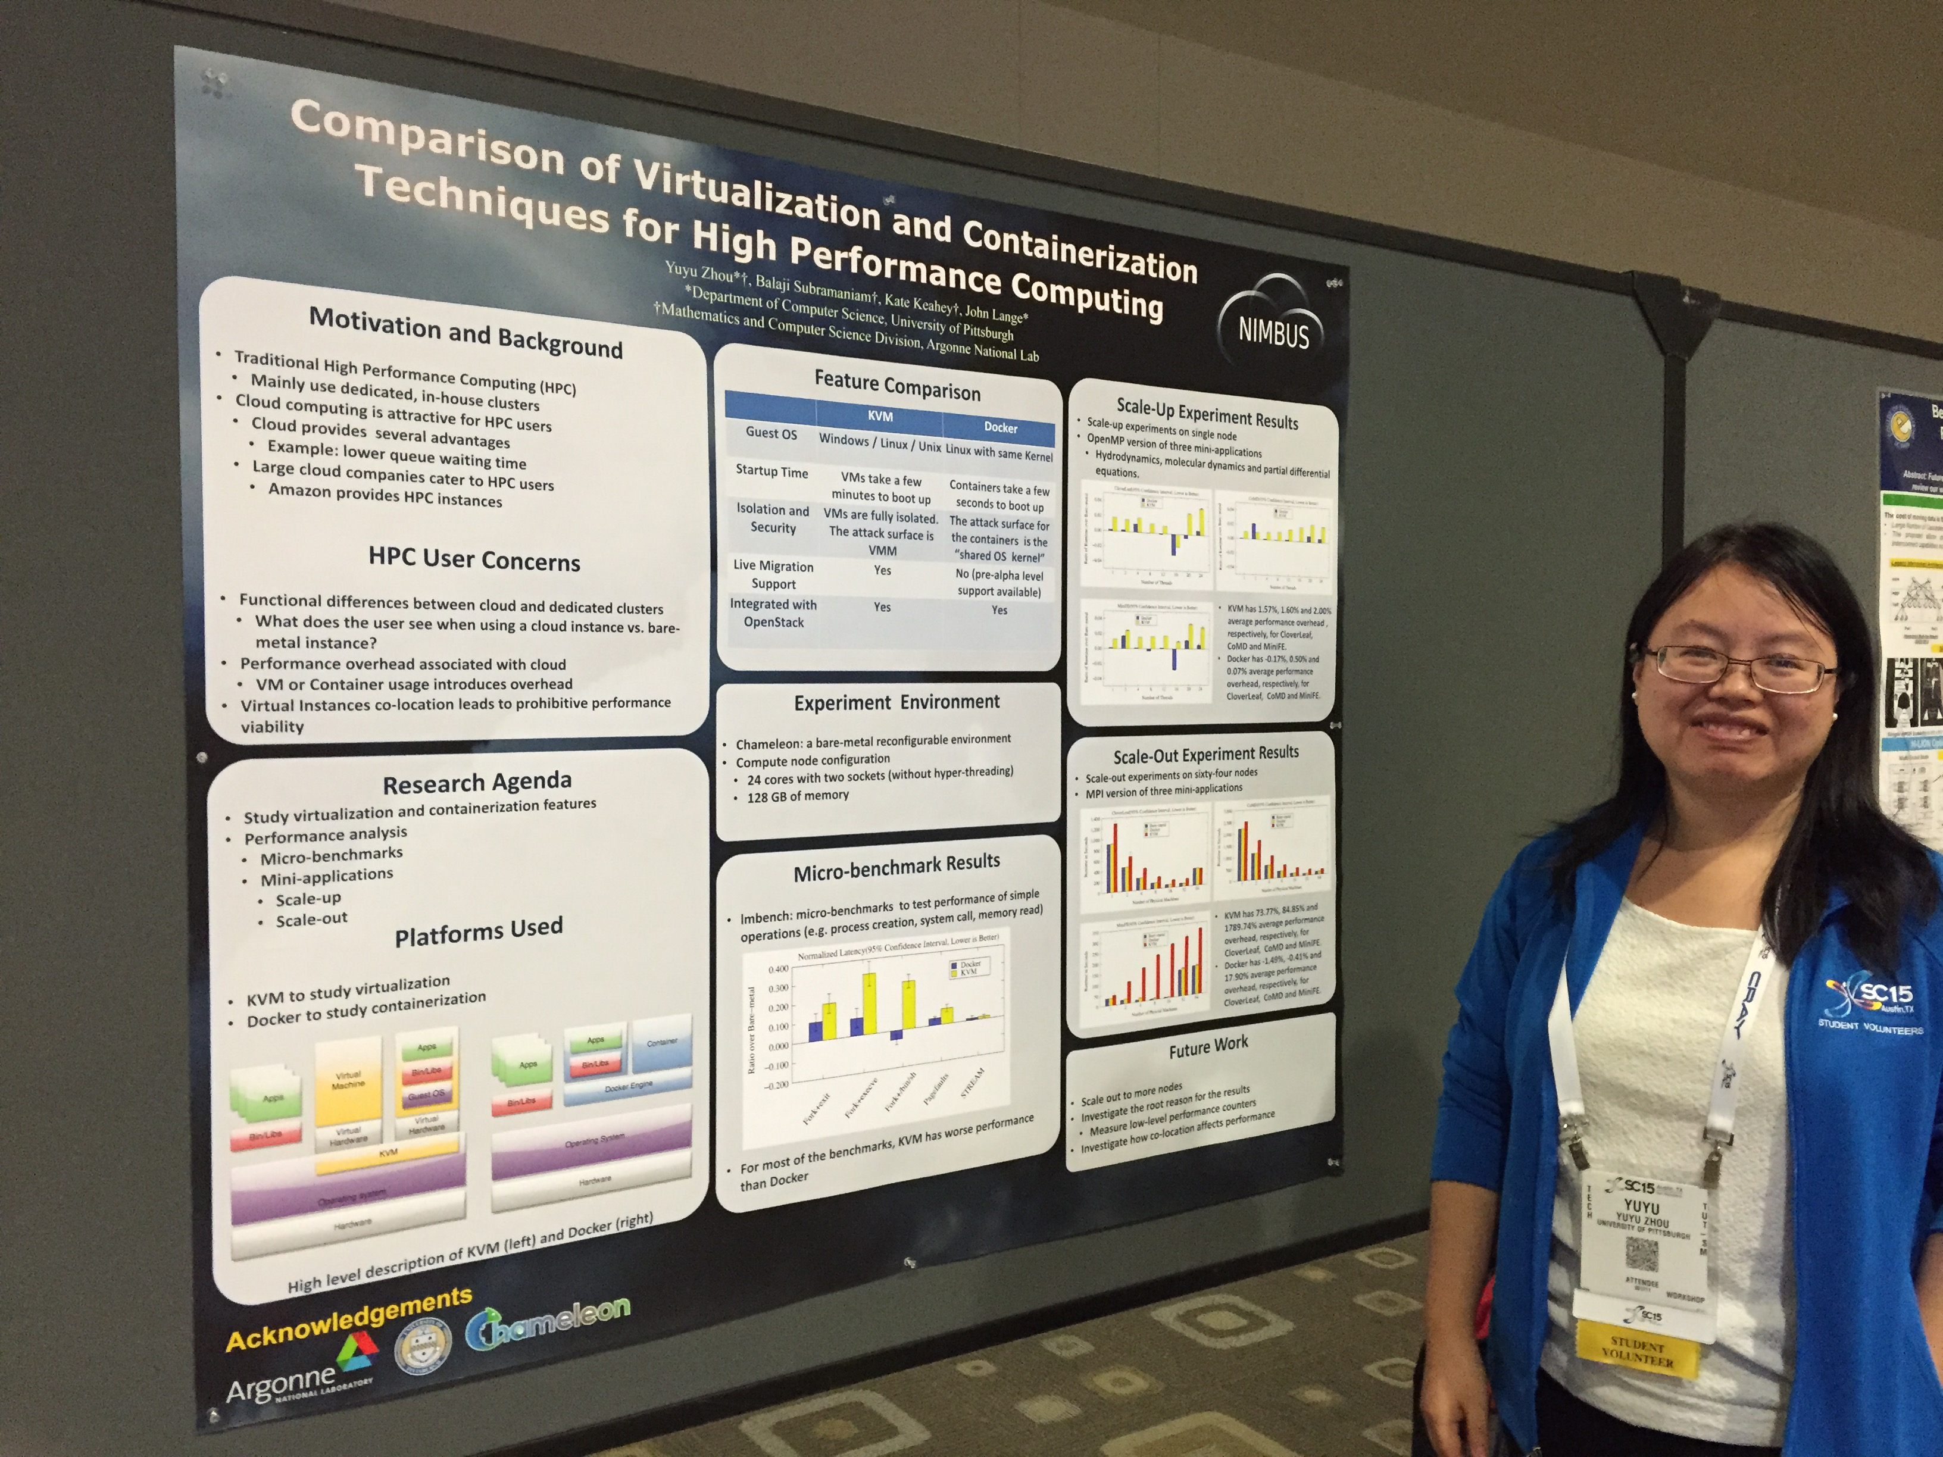
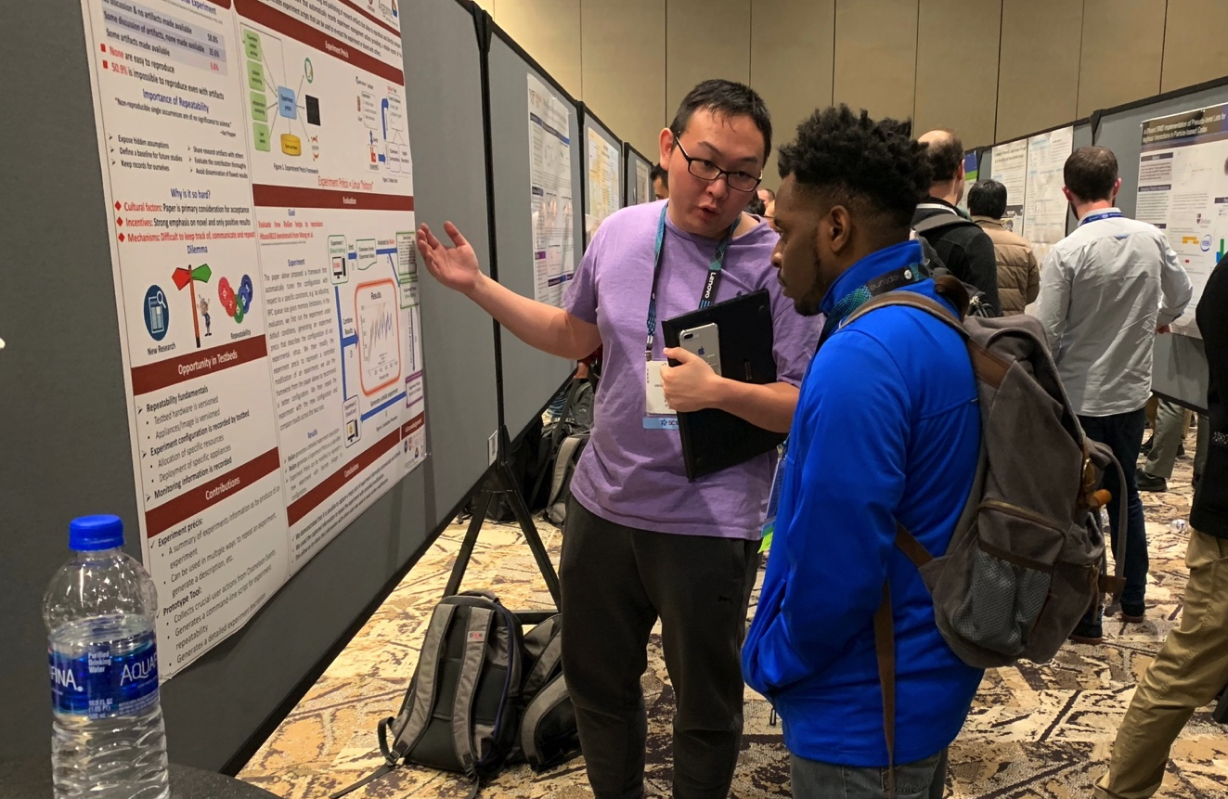
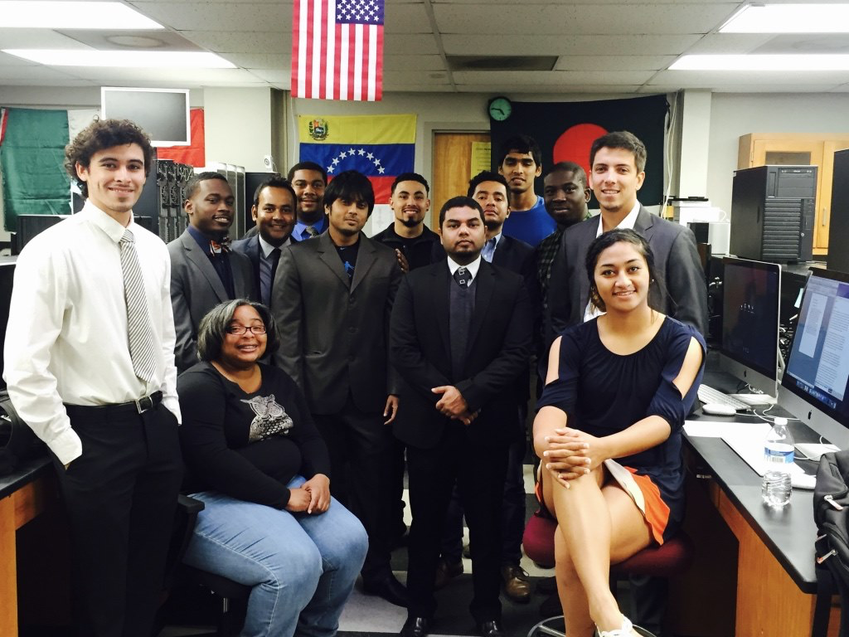
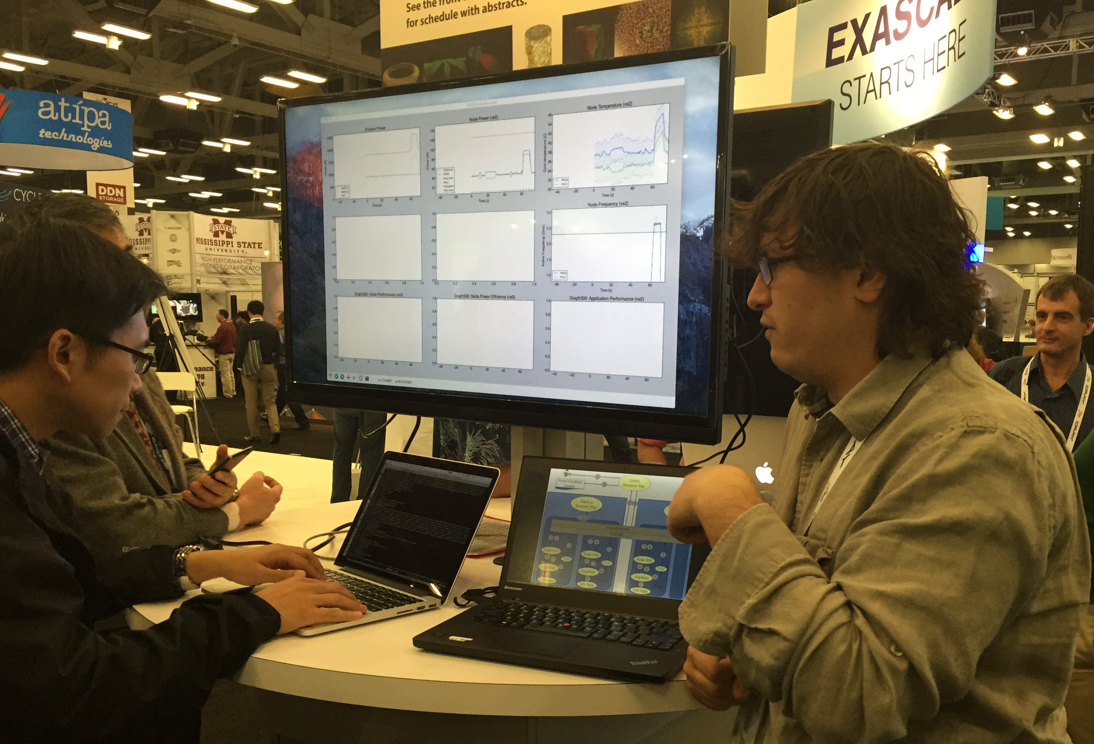
Not just a testbed, a community
Supporting research projects in architecture, operating systems design, virtualization, power management, real-time analysis, security, storage systems, databases, networking, machine learning, neural networks, data science, and many others.
Check out user experiment stories on our blog:
https://www.chameleoncloud.org/blog/category/user-experiments/
Notes:
Anybody wants to find out more it is under the user experiments tab on our blog

Slide 11
Summary
Chameleon is a cloud that evolves as the scientific frontier advances
Bare metal reconfiguration, direct resource access
Diverse range of hardware including innovative offerings in disaggregated hardware
An open platform for reproducible systems research
Support for practical reproducibility including programmatic interface to the testbed via Jupyter, an experiment sharing hub (Trovi), and Chameleon daypass for access supporting reproducibility
Not just a testbed, a community of users
9,000+ users, 1,000+ projects, 642 publications (lower bound) and counting
New research constitutes the most significant use of the testbed
New focus on pioneering digital content use especially in education and reproducibility
Notes:
Cloud to IoT is a massive opportunity that challenges many assumptions we were making about infrastructure

Slide 12
We’re here to change
www.chameleoncloud.org

Slide 13
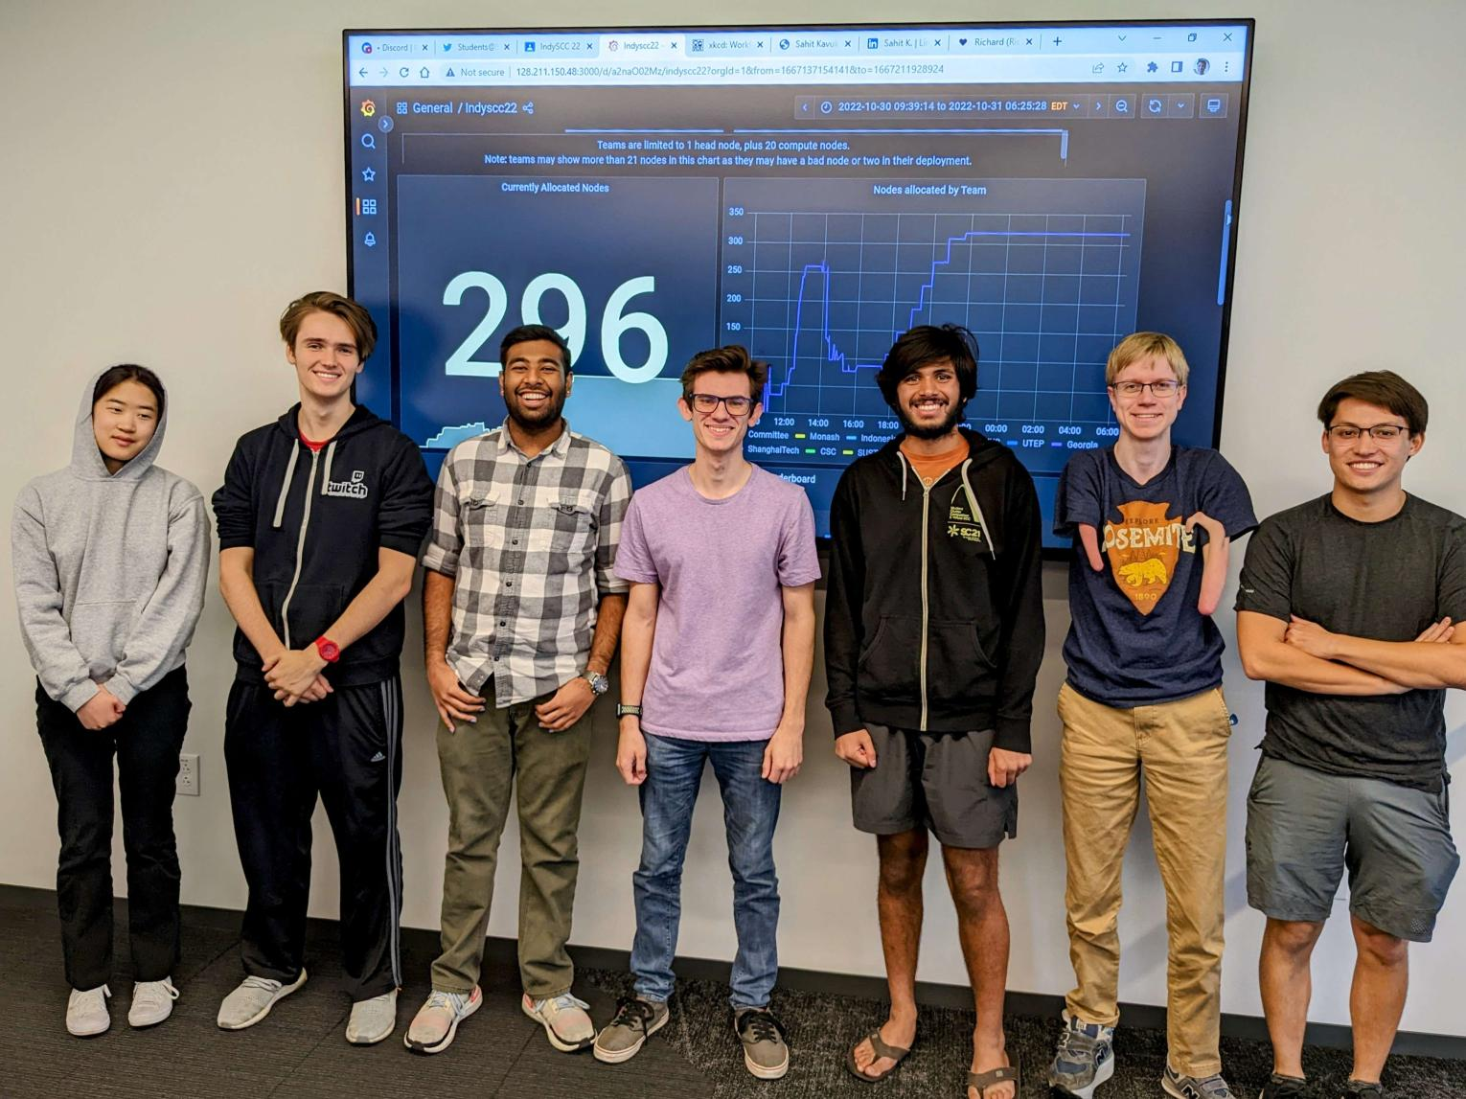
Highlight: InDYSCC
Educational projects over the last 2 years
’21/’22: 76 projects total / 30 teaching a class/course
’22/’23: 91 projects total / 32 teaching a class/course
Educational projects include: exploration/developing educational materials, use in classes, targeted training/one-off education events (e.g., summer schools), tutorials, hackathons, student competitions
IndySCC: a non-course educational use example
IndySCC: major International student competition held annually at the Supercomputing conference, combined with instruction and skill development activities over the leading up period
Objective: achieve the best performance within a power budget over a 49 hour competition
Hosted on Chameleon since 2021: 5 teams (2021); 11 (out of 28) teams (2022), 15 teams (out of 34) teams (2023)
Blog: https://chameleoncloud.org/blog/category/education/
User videos: https://chameleoncloud.org/chameleon-cloud-users-meeting/user-meeting-2023/
Team Indonesia competing during a power outage at SC’22
Georgia Tech team showing off their HPL run at SC’22

