Slide 1
Scientific Instruments from Edge to Cloud:
a Tale of Two Projects
Kate Keahey
Mathematics and CS Division, Argonne National Laboratory
CS Department, University of Chicago
keahey@anl.gov

Slide 2
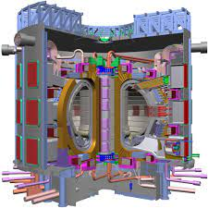
Testbeds as Scientific Instruments
Research Infrastructure: a tool for computational experimentation
The experiments we can think about are unlimited…
…but in practice we can carry out only those that are supported by an instrument that allows us to deploy, capture (observe and measure), and record relevant scientific information
Of Telescopes and Tokamaks
Exploratory instruments (tokamaks): deploy then measure -- Chameleon
Discovery/observational instruments (telescopes): measure – FLOTO infrastructure
Challenges in scaling and adaptability

Slide 3
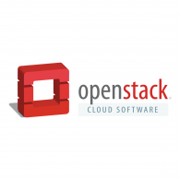
Chameleon in a nutshell
From large to small – diversity and scale in hardware:
Supercomputing datacenters (UC, TACC) over 100G network – to edge devices
Diverse: FPGAs, GPUs, NVMe, NVDIMMs, Corsa switches, edge devices via CHI@Edge, etc.
Distributed: CHI-in-a-Box sites at IIT, NCAR, Northwestern, and UIC – more coming
Chameleons like to change – testbed that adapts to your experimental needs
From bare metal reconfigurability/isolation -- KVM cloud – to containers for edge
Capabilities: power on/off, reboot, custom kernel boot, serial console access, etc.
Based on mainstream open source – proud to be cheap!
50% leveraging and influencing OpenStack + 50% “special sauce”
Promoting disruption in digital artifact sharing
Integration with Jupyter for non-transactional experiment packaging
Trovi for experiment sharing and discovery, Chameleon Daypass for access sharing
Reproducibility and education: digital sharing killer apps!

Slide 4
testbed BY THE NUMBERS
700+ Papers published
1,100+
Unique projects
95
Countries
10,000+
Users
350+
Institutions
+3 More Years to Grow!
Notes:
635 publications as of current counting – NOT including any publications from the Chameleon team

Slide 5
Chameleon hardware
Notable still to come:
disaggregated hardware (GigaIO)
CHI@UC
Skylake, CascadeLake, IceLake, and AMD nodes GPUs (A100, V100, RTX6000), FPGAs (Xilinx Alveo U280)
Storage (NVMe SSD, NVDIMM)
Network (Corsa SDN, 25G Ethernet, 200G InfiniBand)
Chameleon Volunteer Sites
Storage
~0.5 PB
CHI@Edge
Raspberry Pi, Jetson Nano, Jetson Xavier NX, AGX Orin
+ User-added devices
Network
100Gbps public network
Chicago
Austin
CHI@TACC
Haswell, SkyLake, CascadeLake, Fugaku (ARM64 + HBM), AMD nodes, and LIQID disaggregated hardware
GPU (K80, M40, P100, MI100), FPGAs (Altera)
Storage (NVMe, SSD, NVDIMM)
Network (Corsa SDN, 25G Ethernet, 200G InfiniBand)
Commercial Clouds via CloudBank
Storage
~3.5PB
FABRIC, FAB
and other partners
Notes:
UC
42x Intel nodes with 48 cores and 192GB of RAM, 10x AMD Epyc with 48 cores, 256GB of RAM, and a 960GB NVMe root disk. Additionally, a subset:
2 nodes, each with 2x Intel D7-P5510 7.68TB datacenter SSDs
2 nodes, each with 2x Samsung PM1733 7.68TB datacenter SSDs
2 nodes, each with 4x Samsung PM1733 1.92TB datacenter SSDs
2 nodes, each with 2x Corsair Force MP600 2TB consumer SSDs
2x: Intel Optane nodes with 112 Cores, 768GB of RAM, and 3TB of NVDIMMs
3x: Intel nodes with 4x Nvidia V100 GPUs connected by NVLink
1x: Intel node with 4x Nvidia V100 GPUs connected by PCIe
16x of the regular compute nodes have HDR100 (100gb/s) InfiniBand, as do all of the Optane and GPU nodes. All the SSD nodes have HDR (200gb/s) InfiniBand.
At TACC
32x compute_zen3: AMD nodes, each with 2x two AMD EPYC 7763 (128c / 256t), 256GB RAM, 480GB ssd storage.
8x gpu_mi100: same specs as compute_zen3, with addition of 2x AMD MI100 GPUs each
All 40 are connected via HDR100 Infiniband.
Volunteer sites:
NCAR: ARM Thunder Nodes
IIT, Northwestern, & UIC: Chameleon Legacy program
Purdue: ~400 of their own Haswells added on an ephemeral basis to support IndySCC specifically

Slide 6
ChI Experimental workflow
discover
resources
allocate
resources
configure and interact
monitor
- Fine-grained
- Complete
- Up-to-date
- Versioned
- Verifiable
- Allocatable resources: nodes, VLANs, IPs
- Advance reservations and on-demand
- Fungible/non-fungible interface
- Isolation
- Bare metal, KVM, containers for edge
- Image catalog
- Snapshotting
- Orchestration (Heat)
- Jupyter integration
- Networks: stitching and BYOC
- Hardware metrics
- Fine-grained data
- Aggregate
- Archive
Authentication via federated identity, accessed via GUI, CLI and python/Jupyter (python-chi)
Paper: “Lessons Learned from the Chameleon Testbed”, USENIX ATC 2020
Notes:
Highlight:
Interfaces – everything goes via OpenStack-based API (even if it is just a veneer as for CHI@Edge)
Emphasis on *programmatic interfaces* with python-chi and Jupyter – they can be easily scripted/repeated (unlike GUI), preferred by most users

Slide 7
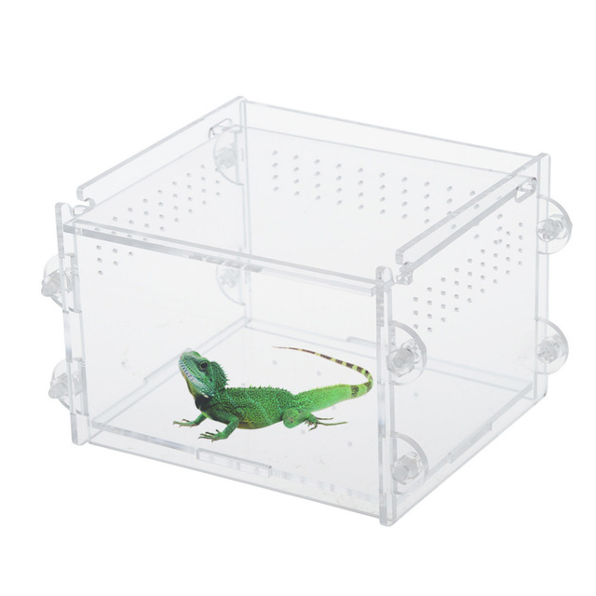
Chi-in-a-box: chameleon near you!
CHI-in-a-box: packaging of CHameleon Infrastructure (CHI)
Internal packaging of a commodity-based testbed
Packages the system as well as the operations model
Hub and spoke management, version-controlled site configuration management as code, containerization, monitoring, detection, and remediation tools
Support for Bring Your Own Device (BYOD) model: Doni allows administrators to dynamically enroll resources, define availability windows, and streamline operations
Deployment
Deployed Associate/Volunteer Sites: IIT, NCAR, Northwestern, Purdue, and UIC
Independent testbed: ARA
In conversation/progress: SDSC, OCT/U Mass, FIU, ORNL, KTH (edge/wireless only), NUS, and others
Paper: “CHI-in-a-Box: Reducing Operational Costs of Research Testbeds ”, PEARC’22

Slide 8
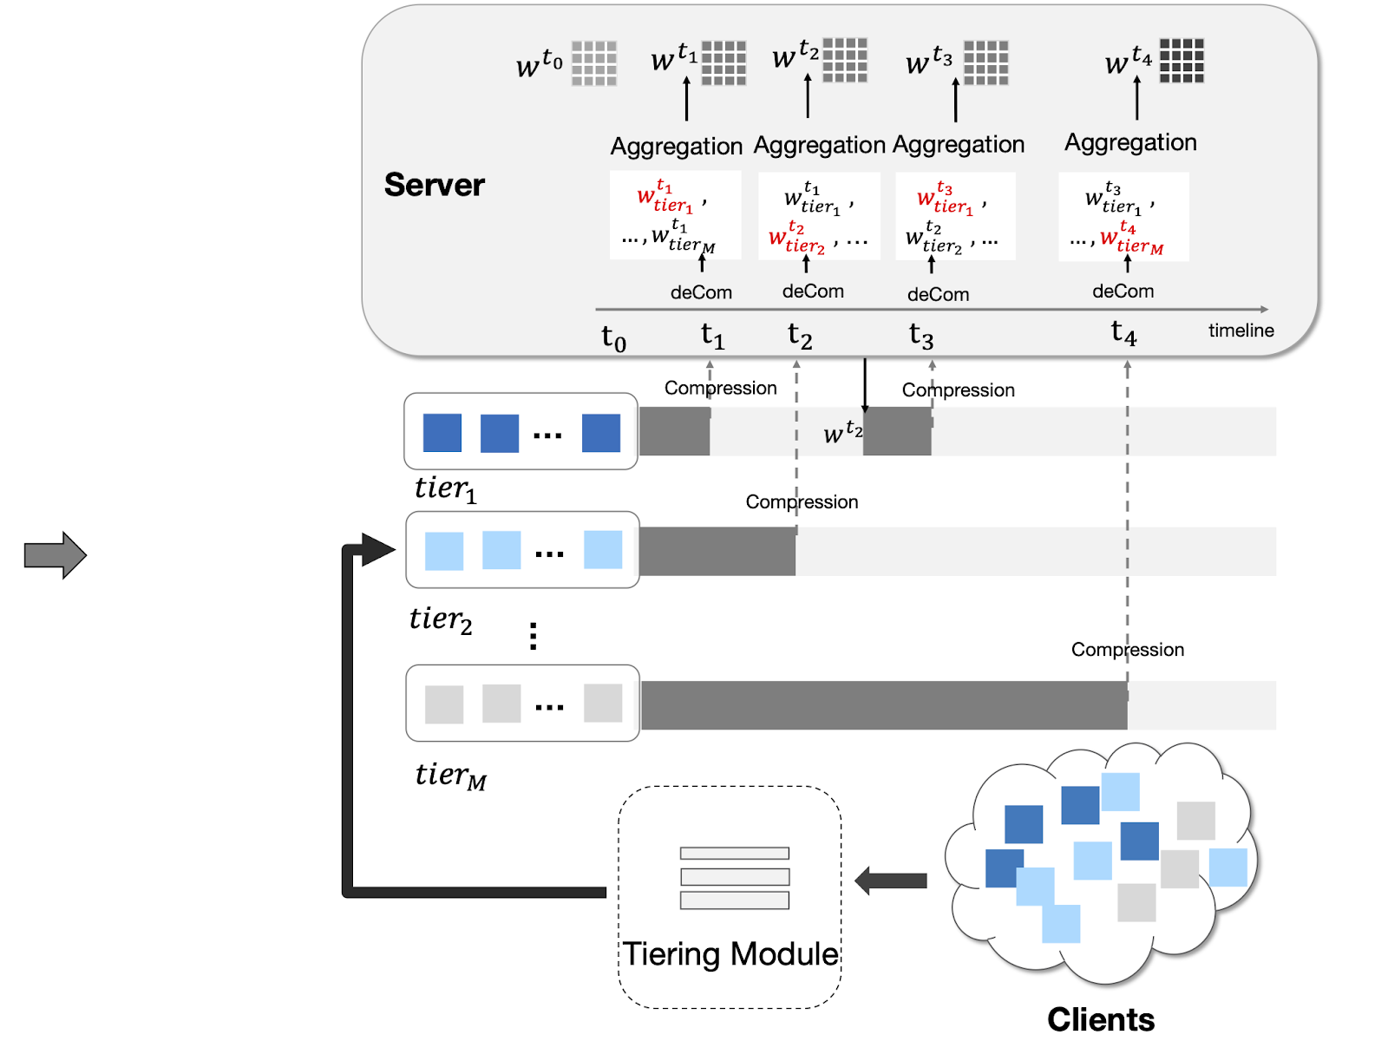
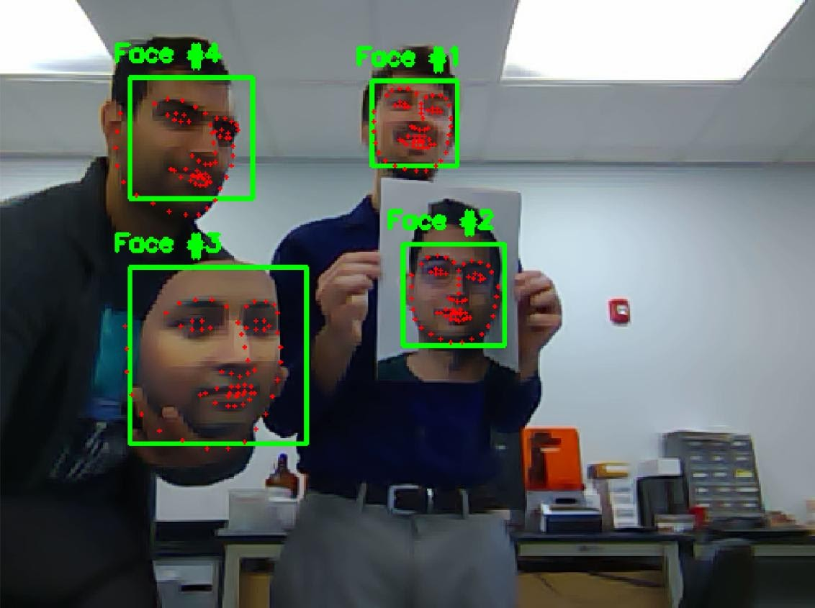
From cloud to edge with chameleon
federated learning
biometrics
network traffic fingerprinting for IoT devices
Increasingly more Chameleon project applications working on IoT/edge
Simulation/emulation don’t always provide the answer: What are the impacts of this approach on power management on edge device? How will the performance transfer to edge? Can we measure the impact of distribution/networking for edge/cloud applications?
Goal: “realistic edge to cloud experiments from one Jupyter notebook”
Notes:
Those were experiments that our users were interested in even BEFORE we did CHI@Edge (and to a large extent inspired CHI@Edge)
https://www.chameleoncloud.org/blog/2021/07/19/network-traffic-fingerprinting-iot-devices/
https://www.chameleoncloud.org/blog/2021/05/17/high-performance-federated-learning-systems/
https://www.chameleoncloud.org/blog/2021/01/21/biometric-research-cloud/

Slide 9
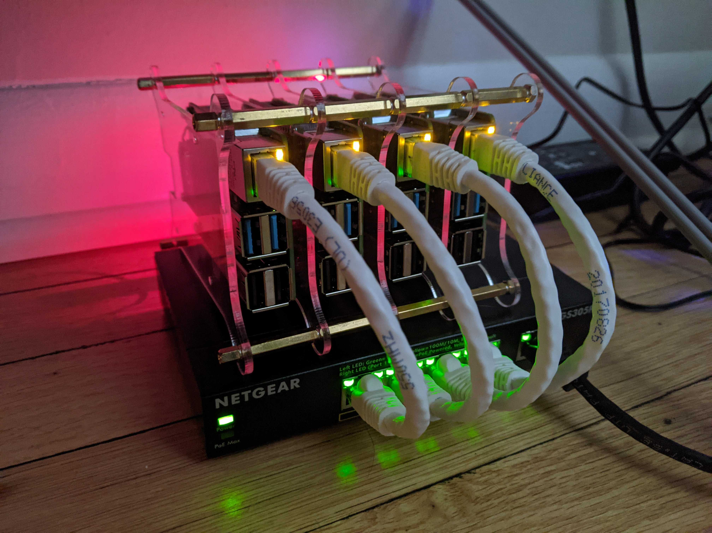
Highlight: CHI@Edge
A lot like a cloud!
All the features we know and love – but for edge!
“Edge to cloud from one Jupyter notebook.”
Not at all like a cloud!
Location, location, location!
IoT: cameras, actuators, SDRs!
Not server-class!
And many other challenges!
CHI@Edge: all the features you love in CHI, plus:
Reconfiguration through non-prescriptive container deployment via OpenStack interfaces (using K3 under the covers)
Support for “standard” IoT peripherals (camera, GPIO, serial, etc.) + easy for you to add support for your own peripherals
Bring Your Own Device (BYOD): Mixed ownership model via an SDK with devices, virtual site, and restricted sharing – building on OpenBalena
Paper: “Chameleon@Edge Community Workshop Report”, 2021
Notes:
Non-prescriptive!

Slide 10
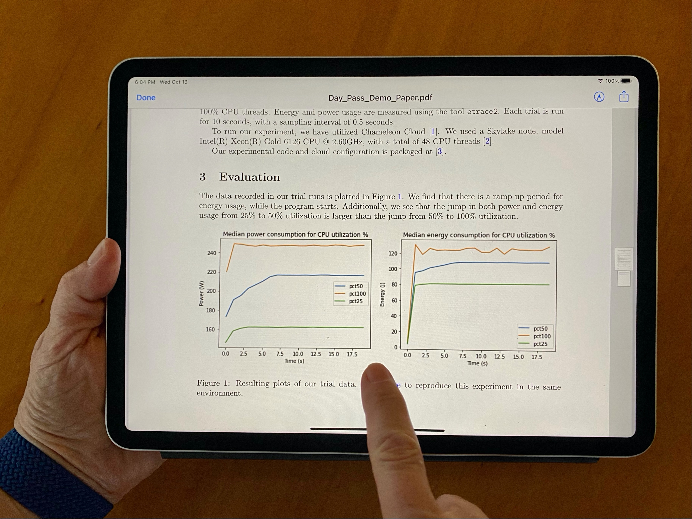
Sharing Science digitally
Can digital experiments be as sharable as papers are today?
Can I simply integrate somebody’s model into my research instead of reinventing the wheel and get to a new result faster?
Can I discover something new through playing with somebody else’s experiment?
Can I develop exercises for my class based on most recent research results?
Should our next Program Committee meeting be a reproducibility hackathon?
https://repeto.cs.uchicago.edu

Slide 11
DIGITAL content and infrastructure
Open platforms are essential for sharing – especially in computer science
Open, version-controlled hardware
Non-fungible resources
Sharing via cloud pattern
Disk images, orchestration templates, and other artifacts
Thousands of images, orchestration templates, digital artifacts of various kinds
Are we there yet?
A car without a road
Paper: “The Silver Lining”, IEEE Internet Computing 2020

Slide 12
What is missing?
Packaging: complete, imperative, non-transactional, integrated (literate programming)
Get access for reproducibility
Discover/find experiments through various channels
Package experiment in a way that is cost-effective but also user-friendly
Give access for reproducibility
Share work in progress, completed work, get credit

Slide 13
Highlight: Practical Reproducibility
Practical reproducibility:
cost-effective enough to be mainstream
End-to-end packaging with literate programming
Credential integrated JupyterLab environment: convenience of notebook + power of testbed
Imperative, non-transactional, annotated
Trovi: an experiment sharing repository
Portal to present, browse, filter, and find
Integrated with Jupyter/Chameleon, Swift, Zenodo, and github
Open APIs: FABRIC, Jetstream2, and others
Chameleon daypass
Reproducibility initiatives: >6x the usage 22/23
Effective packaging via a “compute capsule”
Finding and sharing experiments
integrated with platform
Open, integrated access to all aspects of experiment
Paper: “Three Pillars of Reproducibility”, ReWords’23
Notes:
2022: Middleware, ICSE, and SC (7846 SUs)
2023: ICPP, TPDS, SC23, FAST'23, OSDI'23, and Journal of Systems Research; 49,288 Sus)

Slide 14
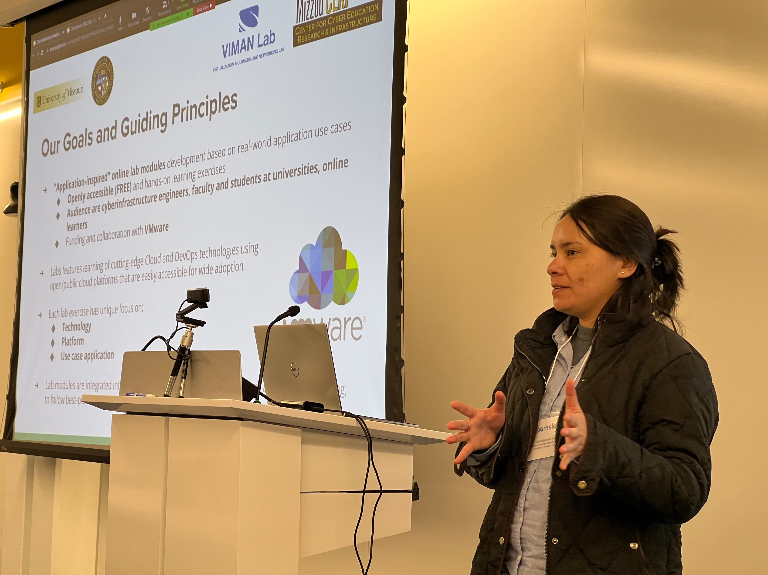
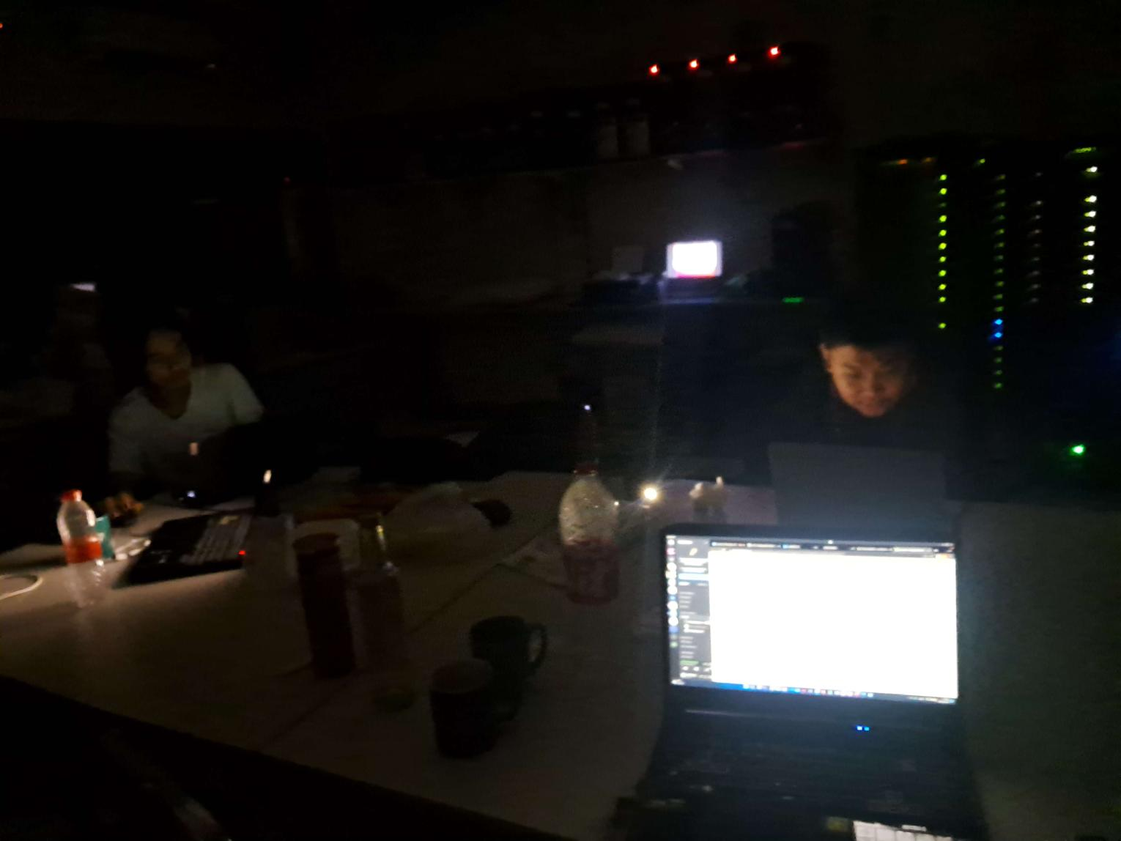
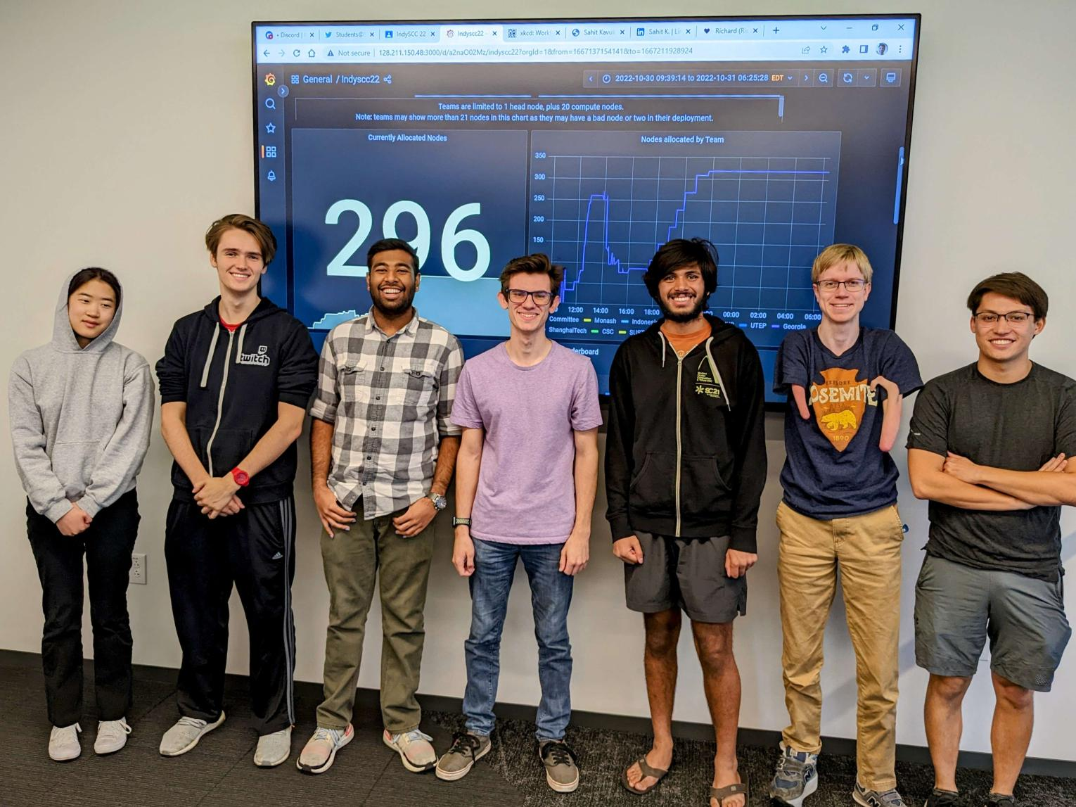
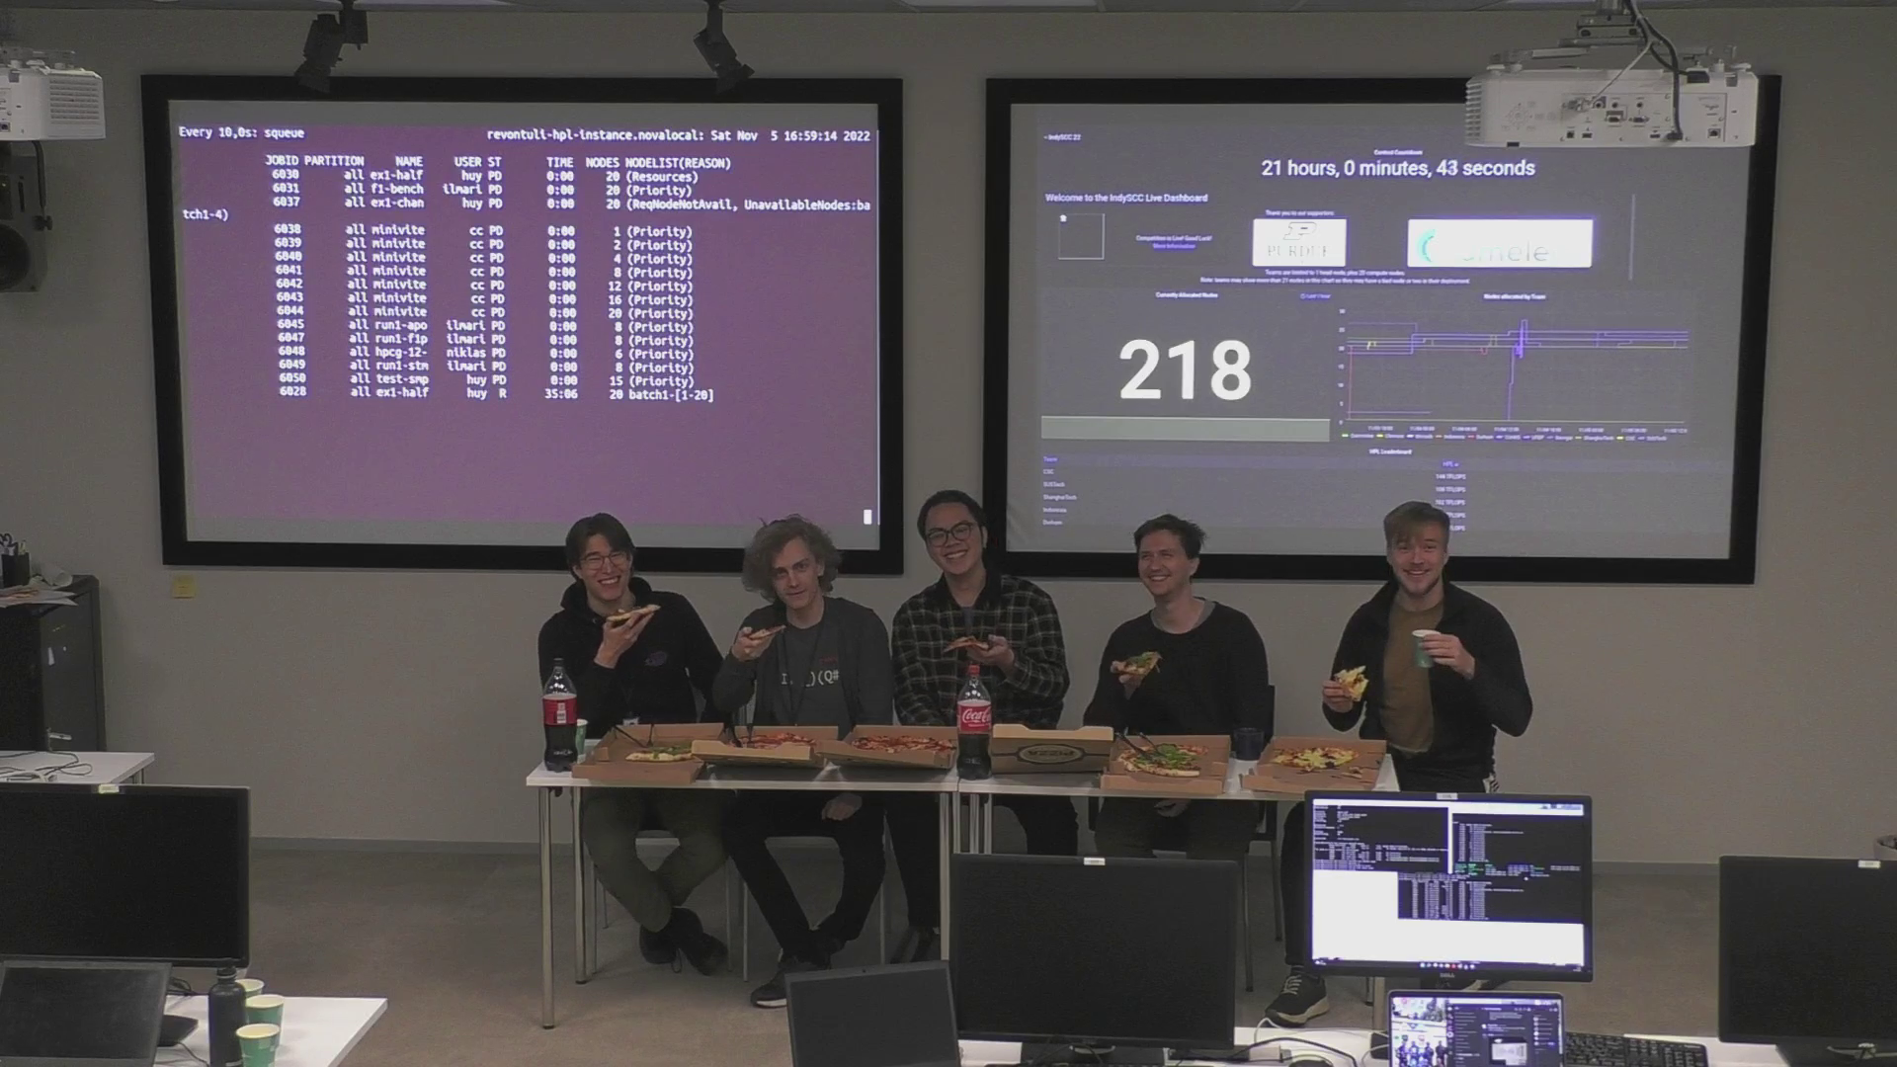
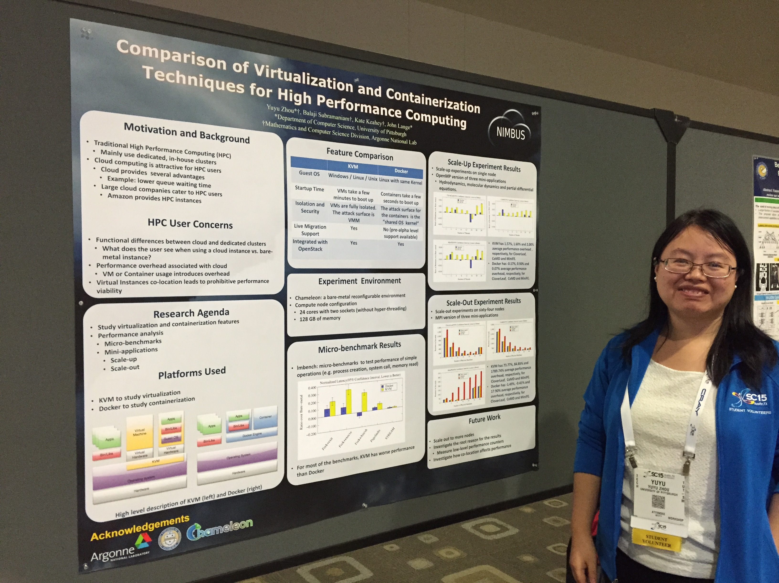
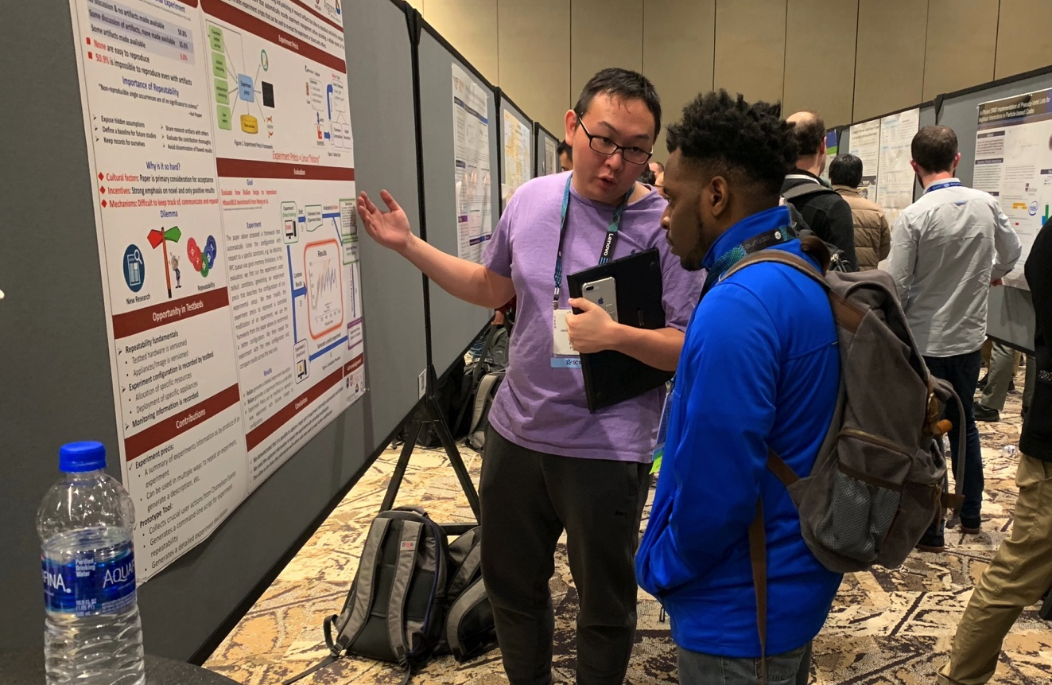
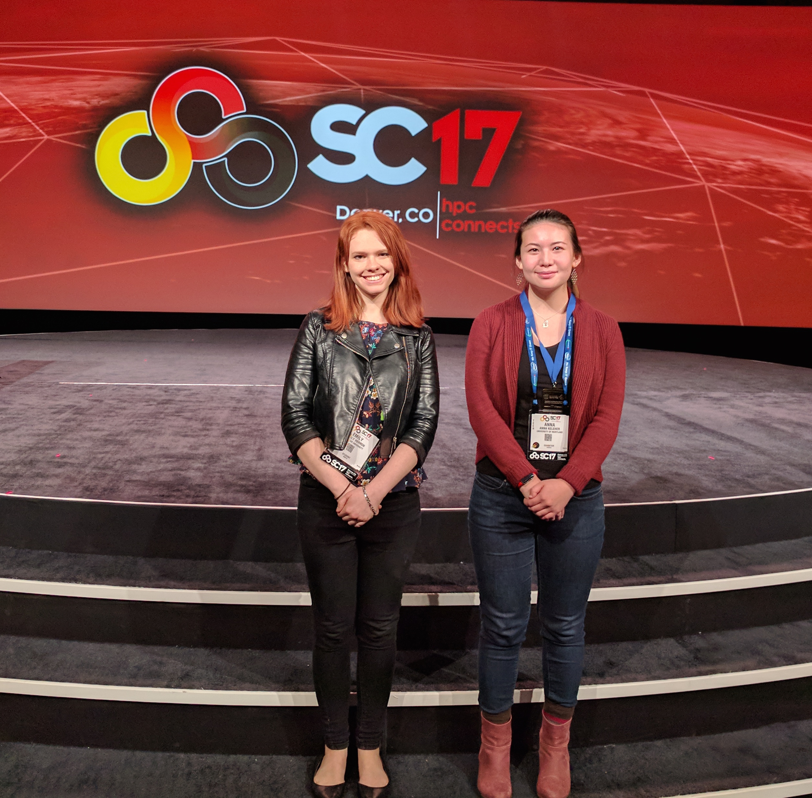
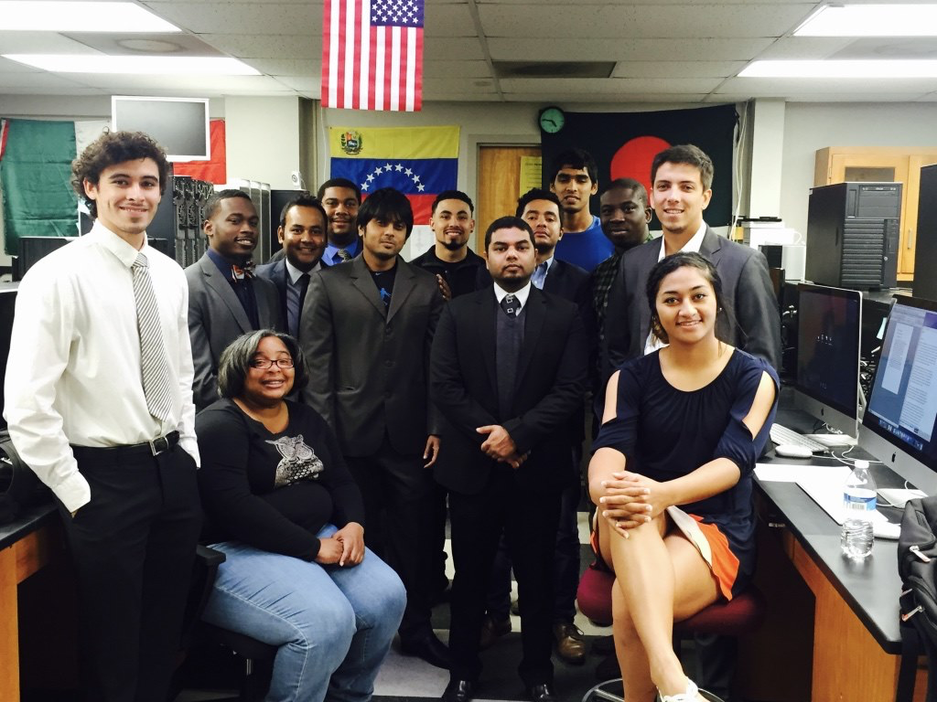
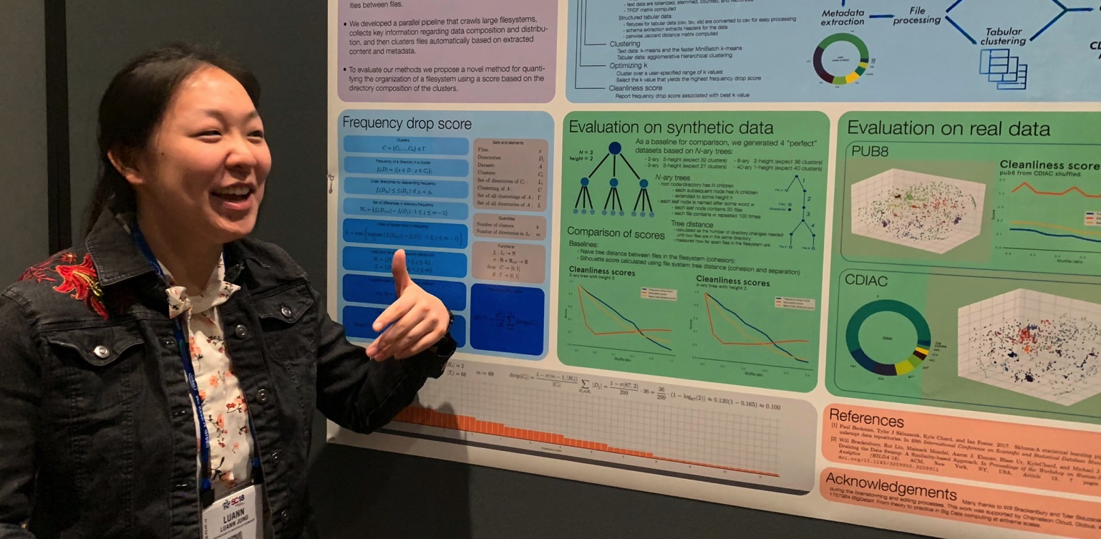
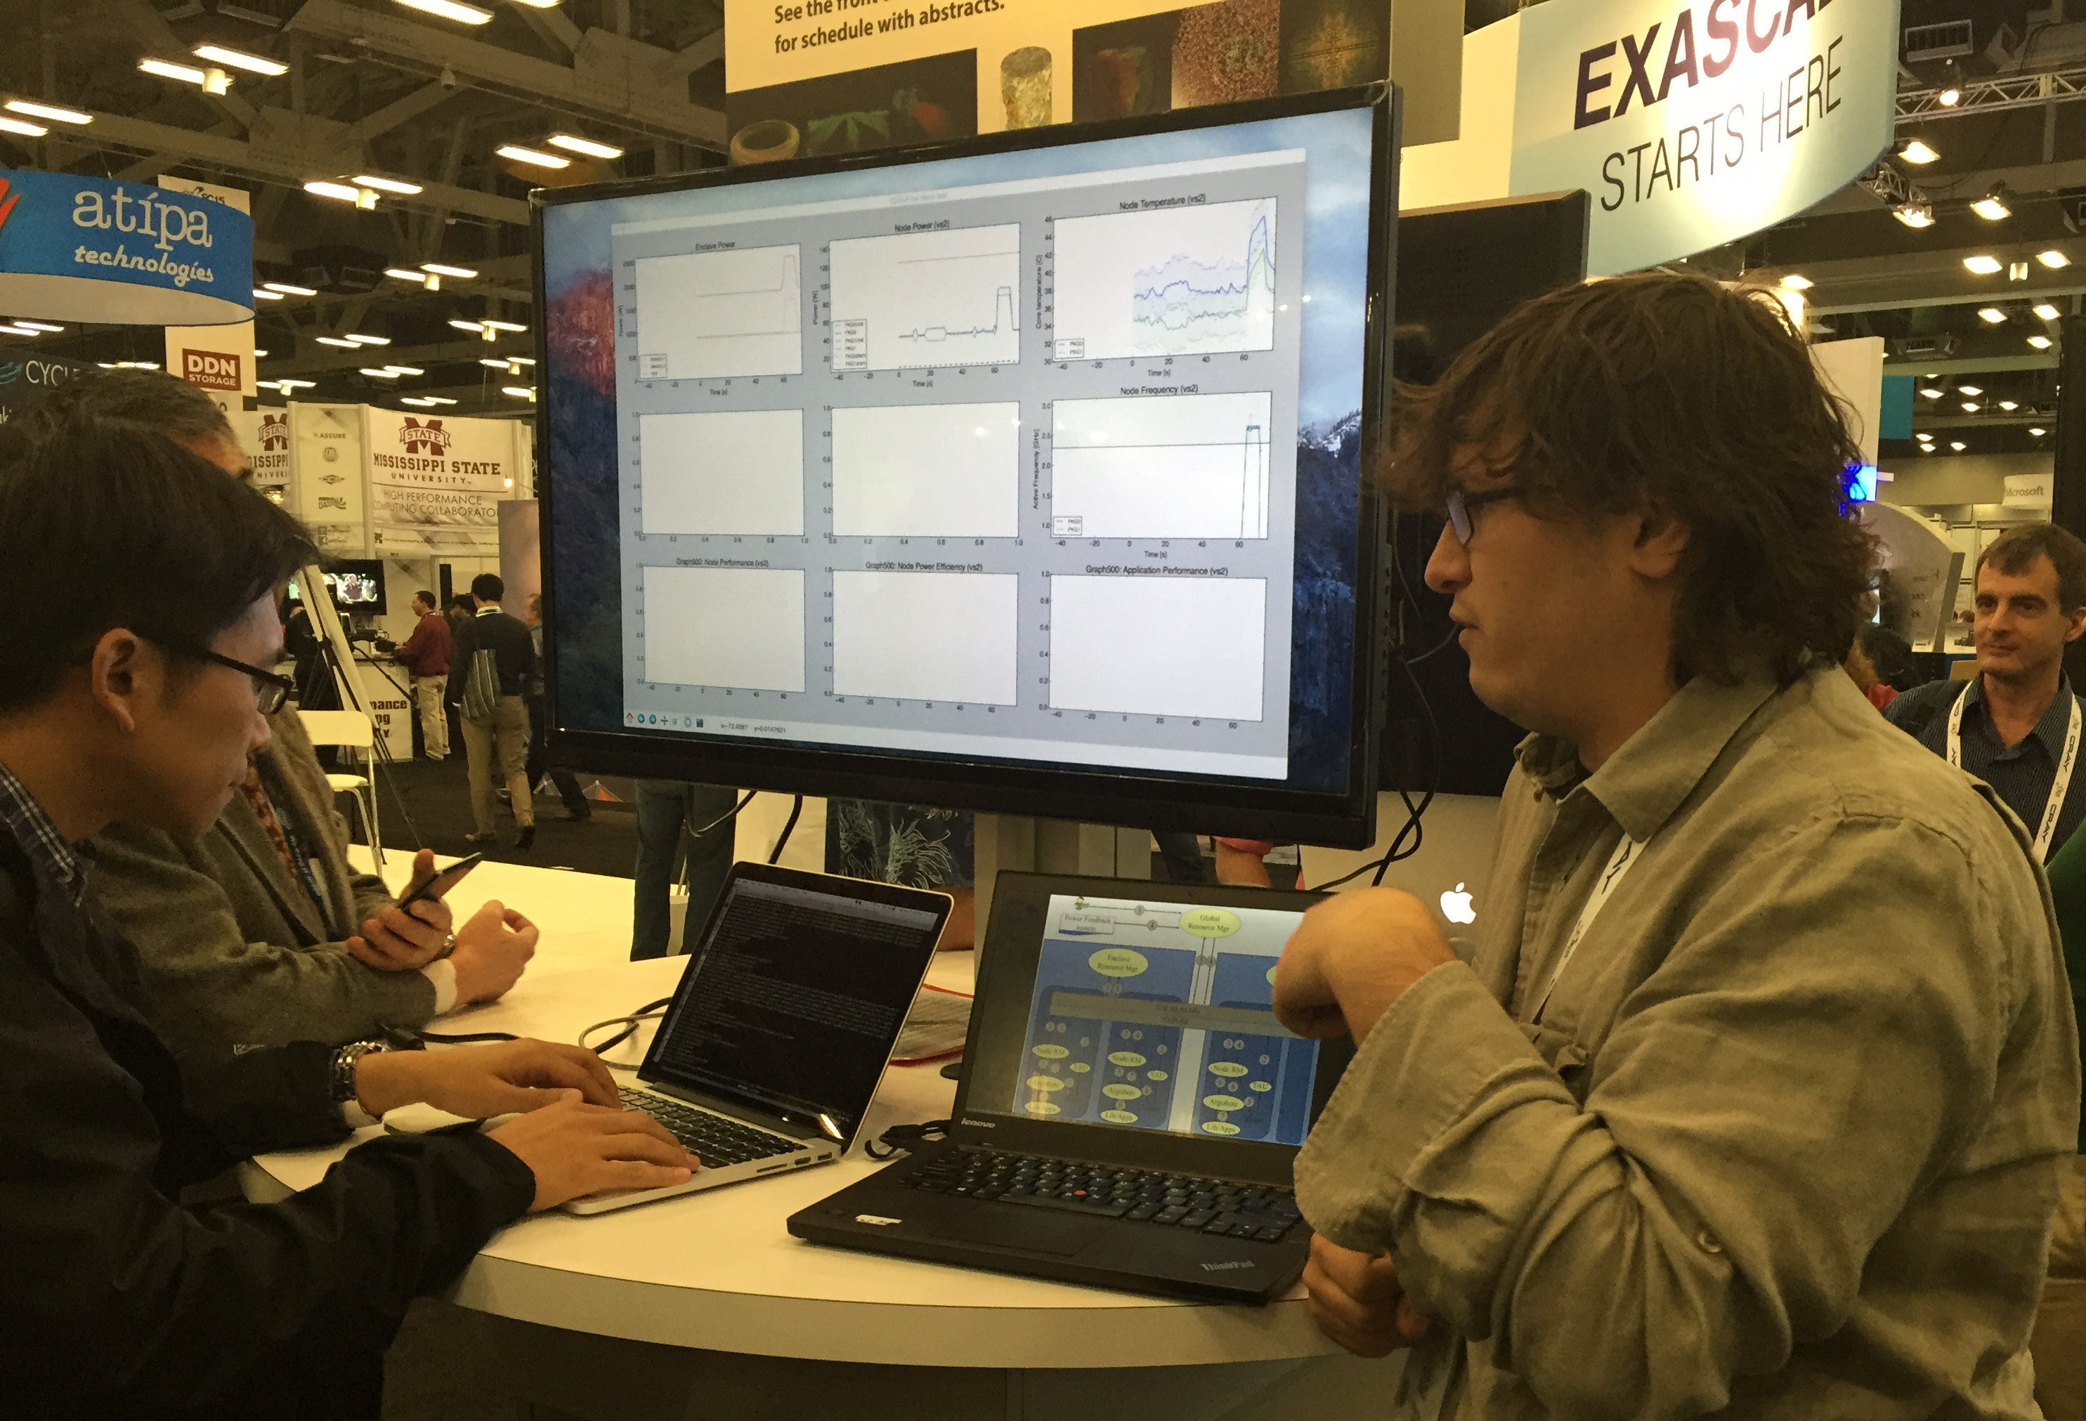
Not just a testbed, a community
Supporting research projects in architecture, operating systems design, virtualization, power management, real-time analysis, security, storage systems, databases, networking, machine learning, neural networks, data science, and many others.
Check out user experiment stories on our blog:
https://www.chameleoncloud.org/blog/category/user-experiments/
Notes:
Anybody wants to find out more it is under the user experiments tab on our blog

Slide 15
Encouraging Education
Overall: 158 unique educational projects (2,000+ users)
Educational projects over the last 2 years
’21/’22: 76 projects total / 30 teaching a class/course
’22/’23: 91 projects total / 32 teaching a class/course
Educational projects include: exploration/developing educational materials, use in classes, targeted training/one-off education events (e.g., summer schools), tutorials, hackathons, student competitions
IndySCC: a non-course educational use example
IndySCC: major International student competition held annually at the Supercomputing conference, combined with instruction and skill development activities over the leading up period
Objective: achieve the best performance within a power budget over a 49 hour competition
Hosted on Chameleon since 2021: 5 teams (2021); 11 (out of 28) teams (2022), 16 teams (out of 34) teams (2023)
Blog: https://chameleoncloud.org/blog/category/education/
User videos: https://chameleoncloud.org/chameleon-cloud-users-meeting/user-meeting-2023/
Team Indonesia competing during a power outage at SC’22
Georgia Tech team showing off their HPL run at SC’22
Notes:
(*) Projects that span time period boundaries are counted in both time periods

Slide 16
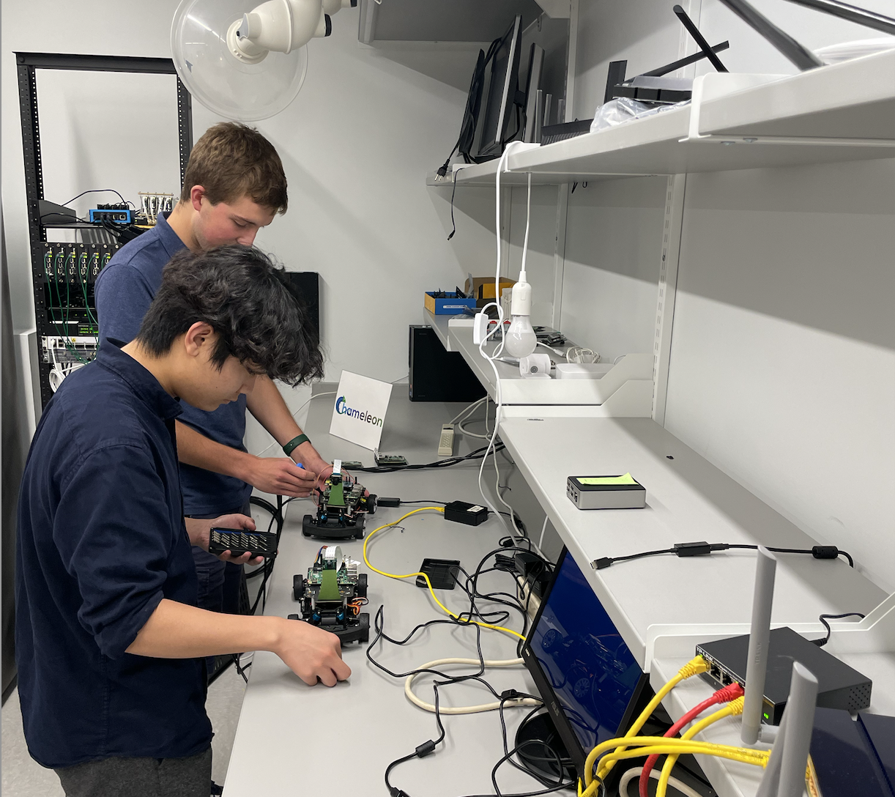
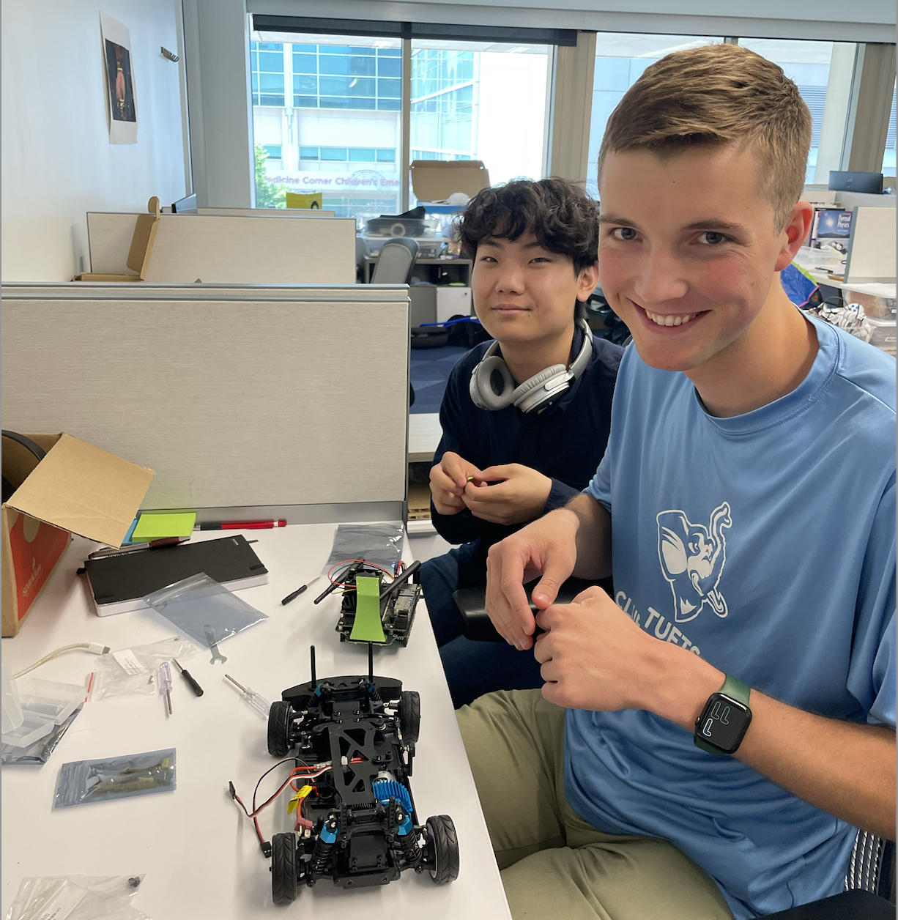
AutoLearn: A case study
A collection of courselets exploring concepts in autonomous driving
Contains three types of courselet layers:
Data collection (actual car versus simulator)
Machine Learning courselets training models
Verification via self-driving (actual car versus simulator)
Supports different emphasis and different pathways through the curriculum:
Introduction to engineering might emphasize driving the actual car
Machine learning focus might use the simulator
Contain suggestions for exercises and individual exploration:
E.g., digital twin combining simulator and experimental driving
Paper: “AutoLearn: Learning in the Edge to Cloud Continuum”, EduHPC’23
REU 2023 students working on hardware
setup for autonomous vehicles

Slide 17
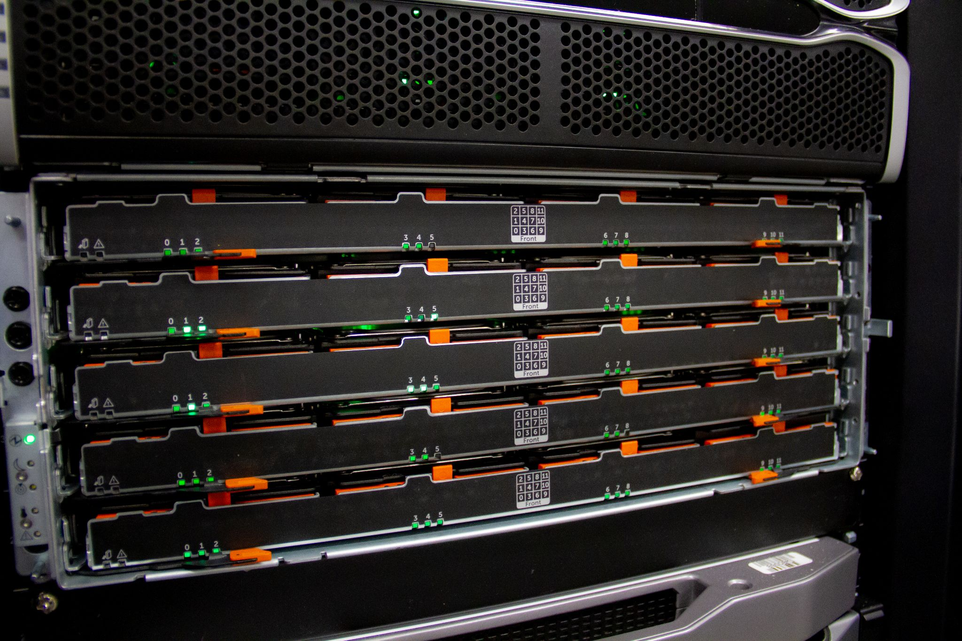
1,100+
Unique projects
700+ Papers published
10,000+
Users

Slide 18
From exploration to observation: the FLOTO project Case study
Can we use CHI@Edge as a large observatory instrument for broadband monitoring?
Why broadband monitoring?
Technical questions: what happens in conditions of oversubscription?
Policy questions: is there a “digital divide” in our society?
Modeling questions: what assumptions about broadband are realistic?
Measuring broadband – different approaches/applications depending on context, objective, use case, etc.
Netrics: open-source library of standard network diagnostic tools (ndt7, speedtest, ping, traceroute, etc.) for continuous, longitudinal network measurement
Others: e.g., residential versus rural broadband and other use cases
Approach: connect a “measurement box” to the router and run tests
Collaboration with Nick Feamster & his UChicago team

Slide 19
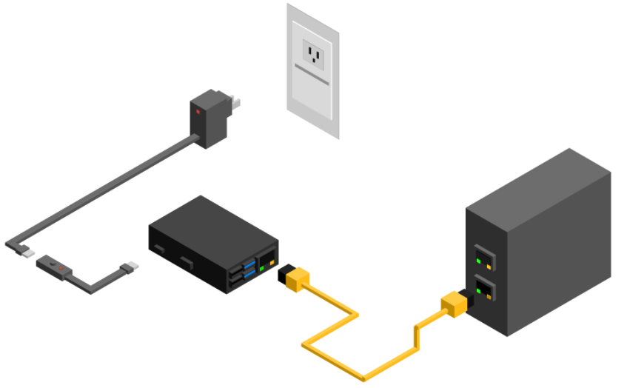
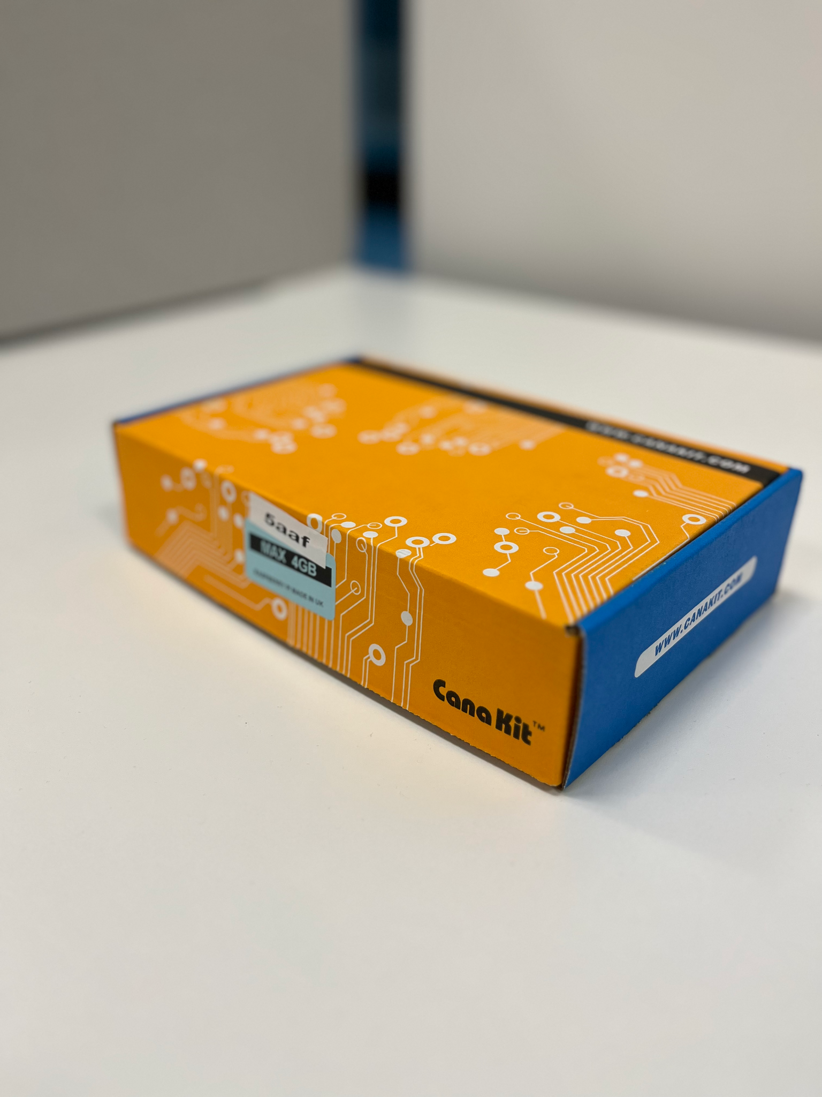
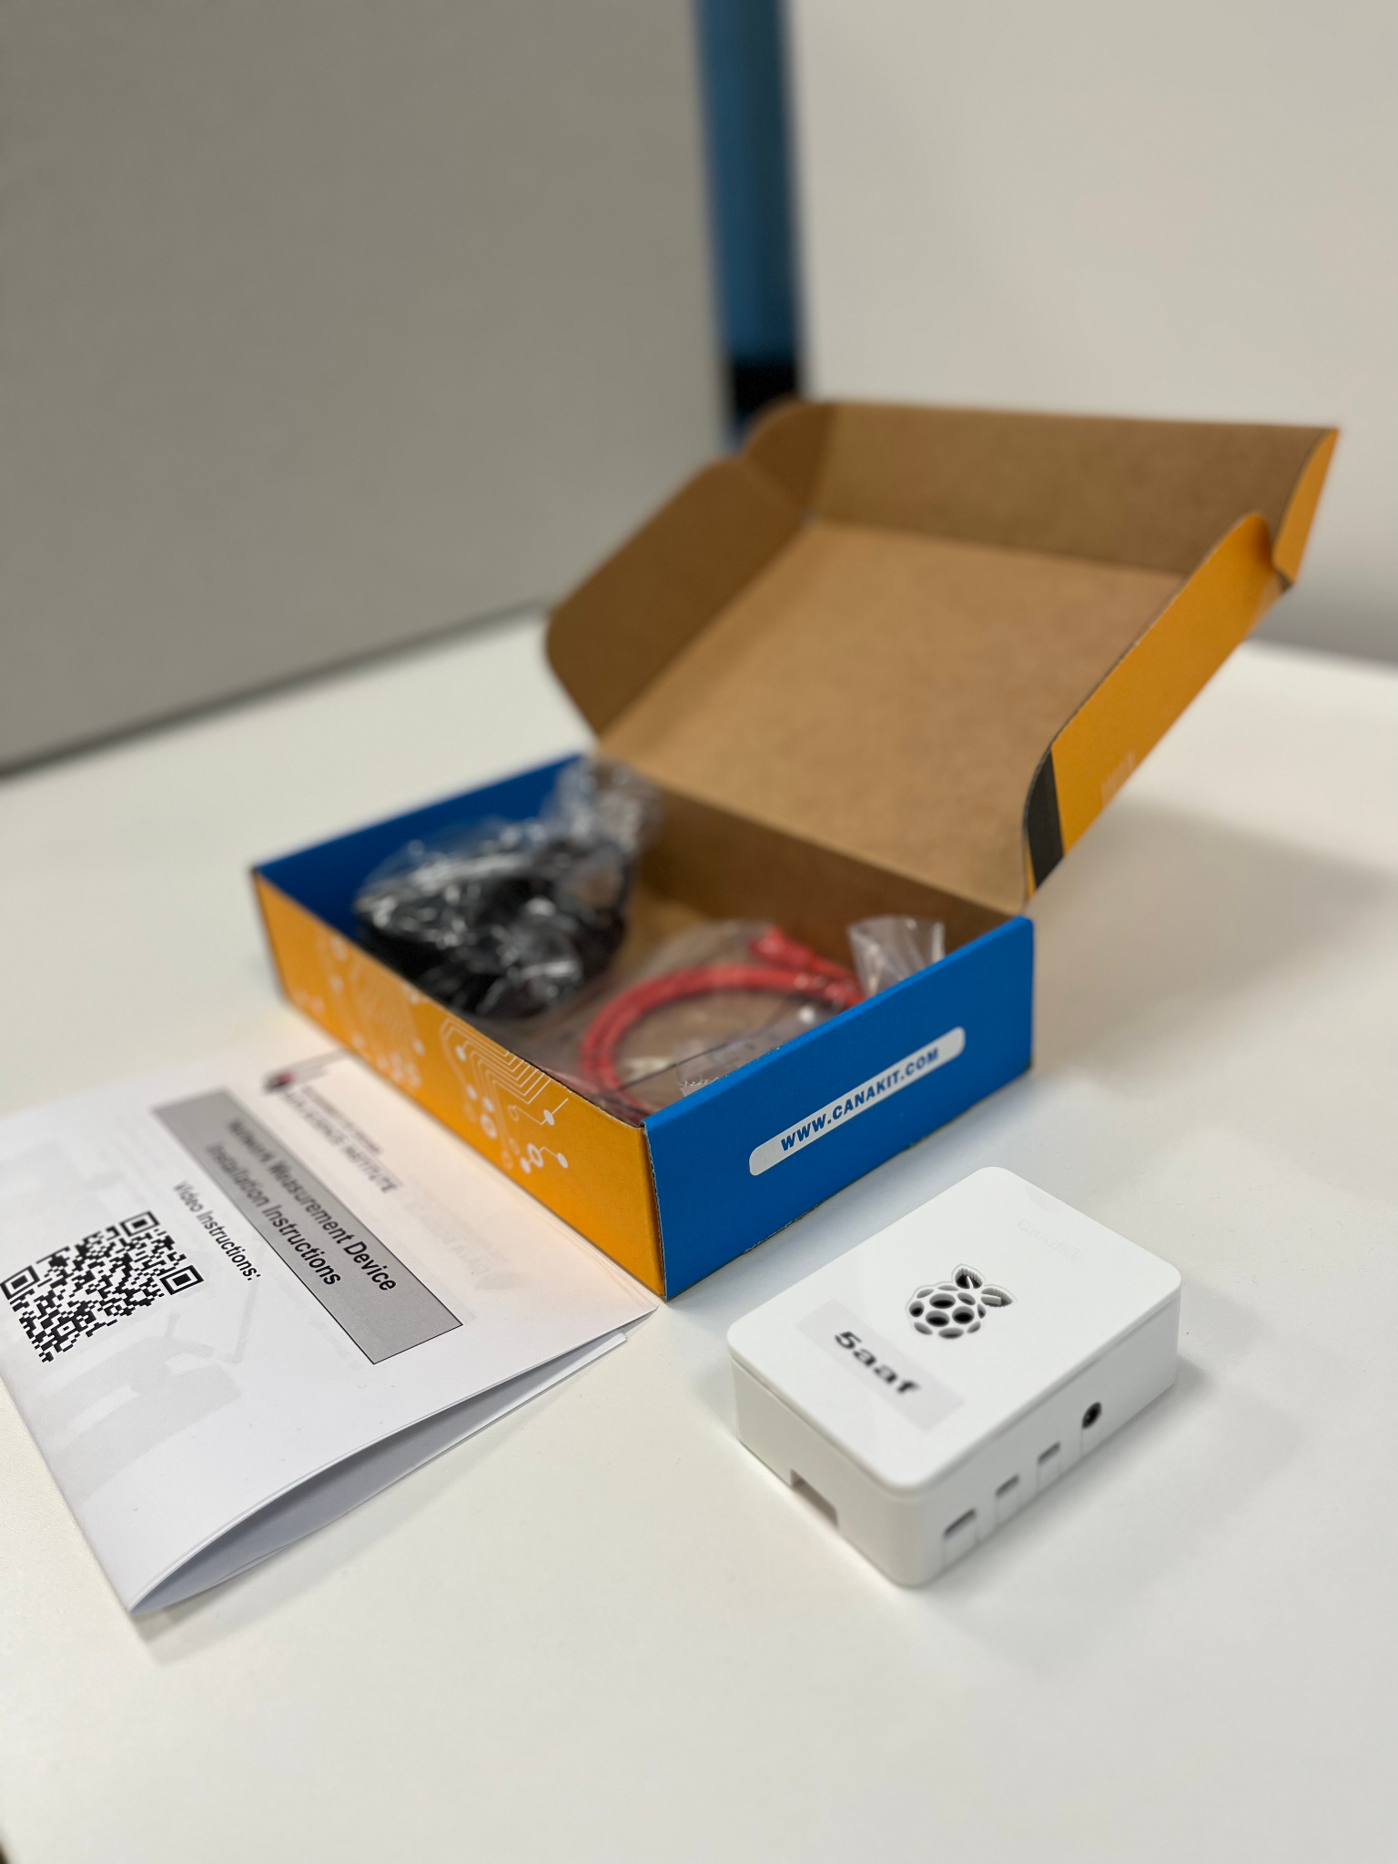
The Devices
Raspberry Pi 4 (8GB)
Additional Components
MicroSD Cards (32GB)
CAT 6 Ethernet Cable
Power Cord
Optional: PoE+ HATs to enable deployment in locations with scarce power sources
Inventory:
1,000 devices finished arriving at the end of June’23
In the process of deploying them for broadband research

Slide 20
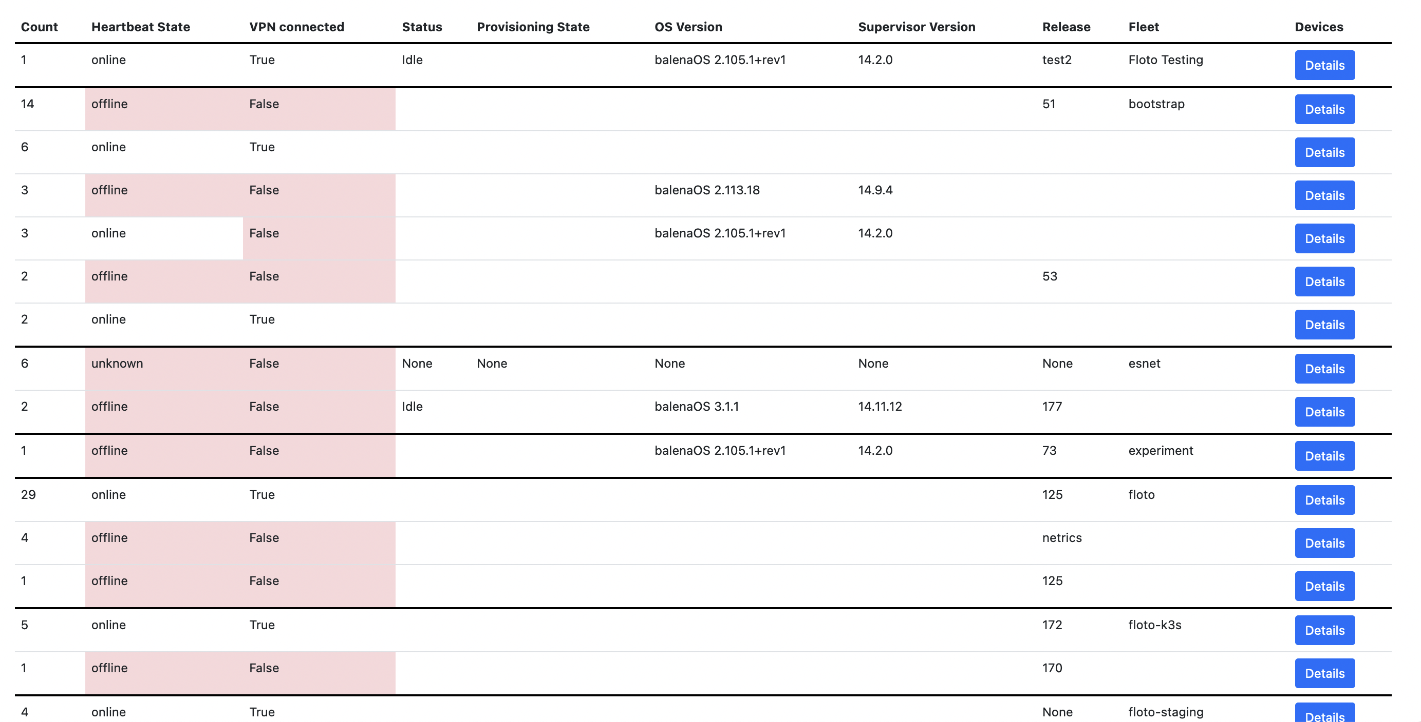
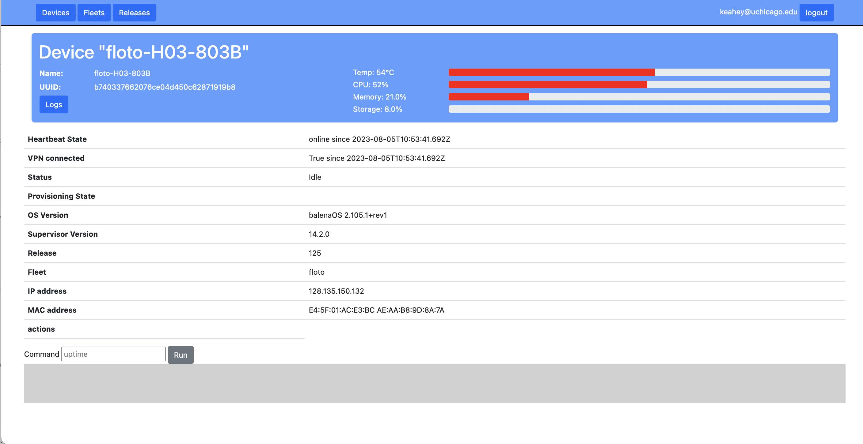
Device management layer
Onboard, offboard, and repurpose devices
Devices self-enroll
0 touch device enrollment (after imaging)
Alternatively, flash with our image to enroll your own device
Configuration management
Update and deploy without physical access, stateless operating system, includes software and device configuration, can be pinned to releases
Robust remote management features
View status and statistics, create and manage deployments, trigger appropriate actions (e.g., send mail)

Slide 21
Device Management layer implementation
Federated Identity login (via GlobusAuth)
Based on openBalena (open source project underlying BalenaCloud platform)
Extensions include support for federated identity, managing device collections, ability to execute ad-hoc shell commands on device system containers, and others
Dashboard to expose management functions
Control and data services deployed on AWS EC2
With thanks to CloudBank!
Devices run minimal, stateless, vetted images with the application management layer software
Access via the dashboard or a CLI

Slide 22
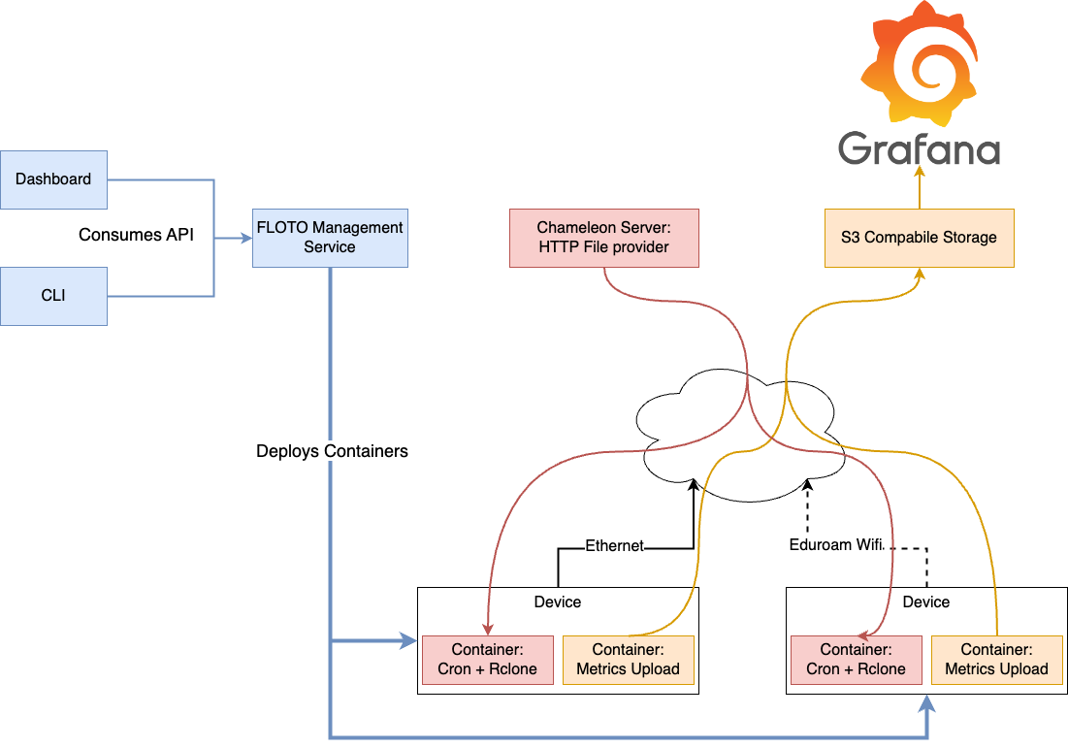
Application management layer
Supports deployment of applications on device fleets via a system container
Applications are packaged as Docker containers
Users can reserve overlapping or non-overlapping timeslots for application deployment so as not to conflict with other deployments
Generic data streaming implemented as a “system application”
Multi-container applications deployed via docker-compose syntax

Slide 23
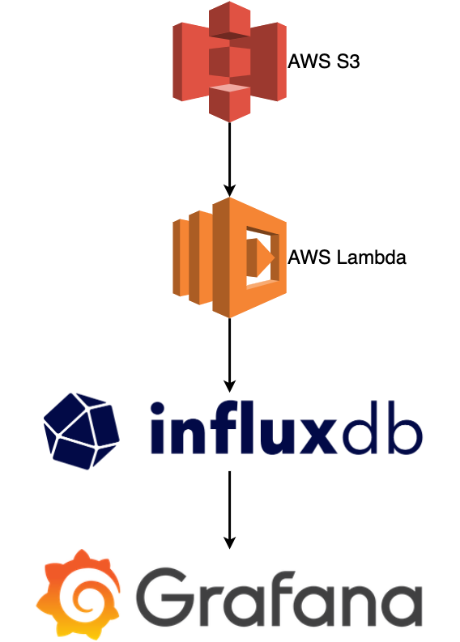
Data collection and analytics
Software on devices uploads results directly to cloud storage
Data curation and analysis pipelines process raw data for investigation
Raw and processed data available for use (after anonymization)
Current, small scale, using AWS Lambda for analysis
After scale up, use Apache Kafka as message broker, data consumers will subscribe to real time topics for up to date results
Grafana dashboards with time-series visualizations to monitor data in near real-time
Paper: “Discovery Testbed: An Observational Instrument
for Broadband Research”, eScience’23

Slide 24
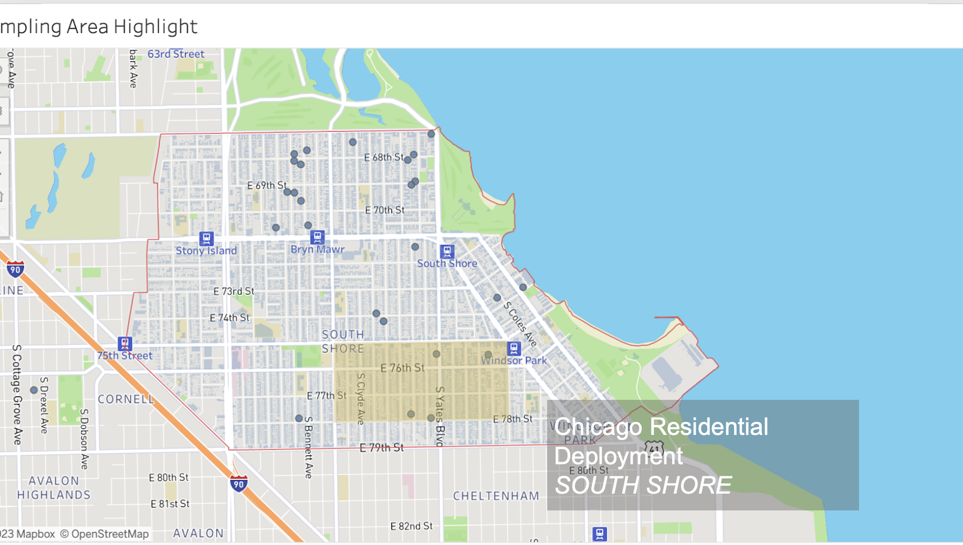
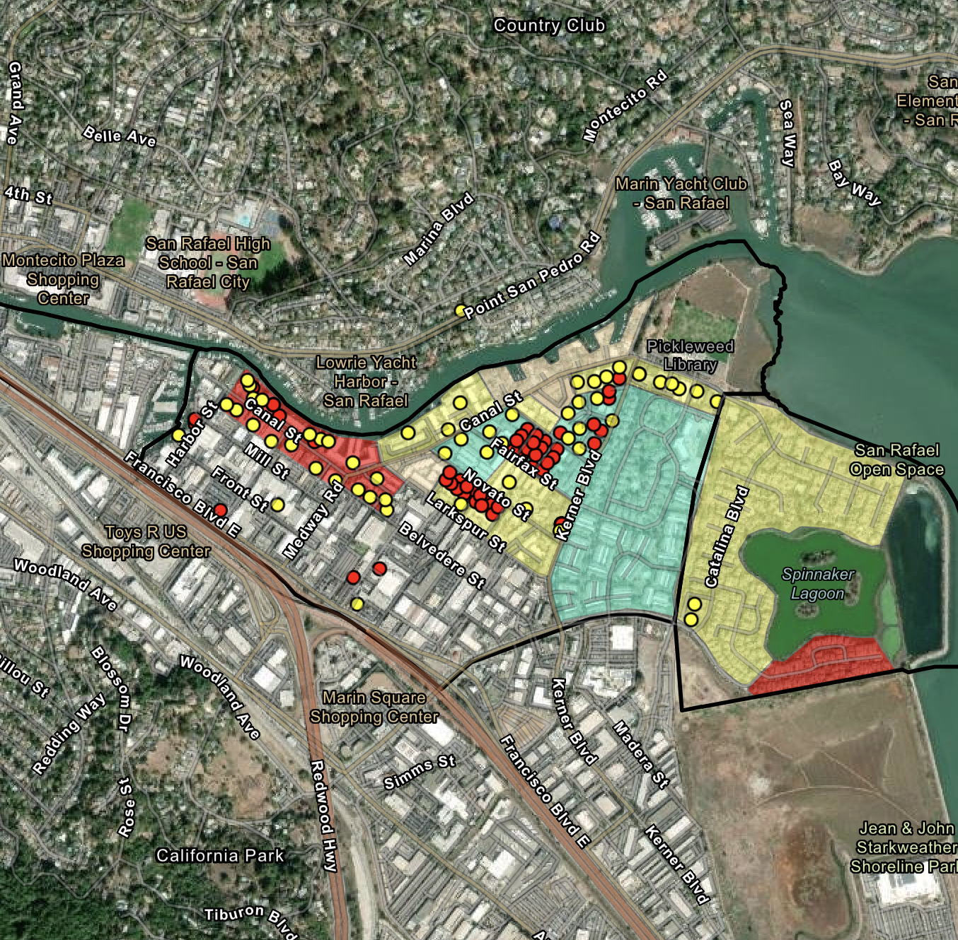
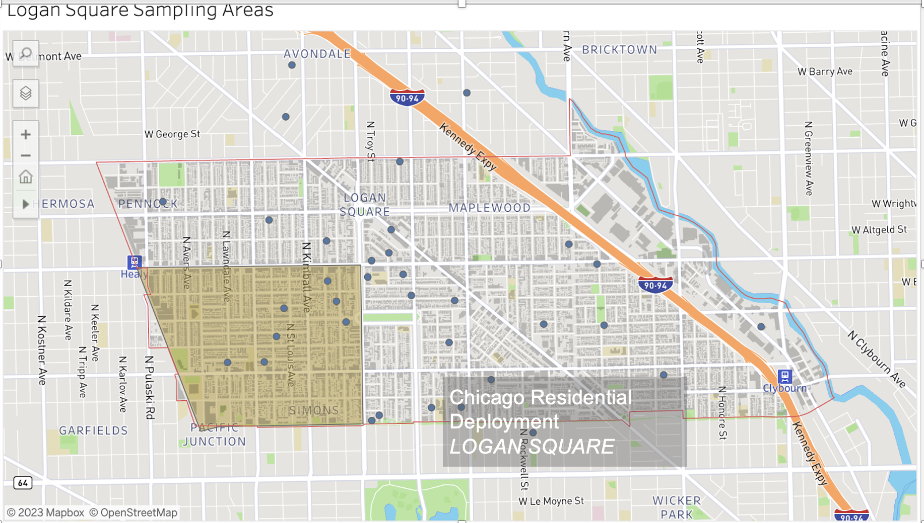
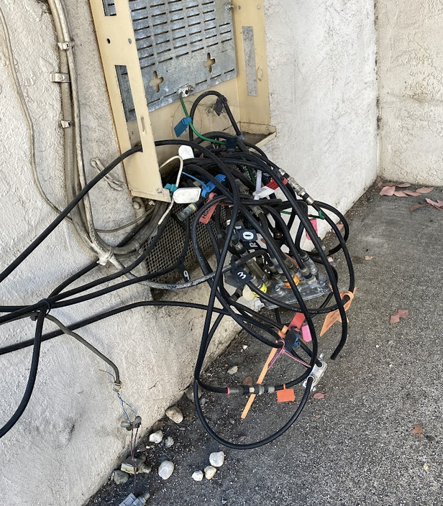
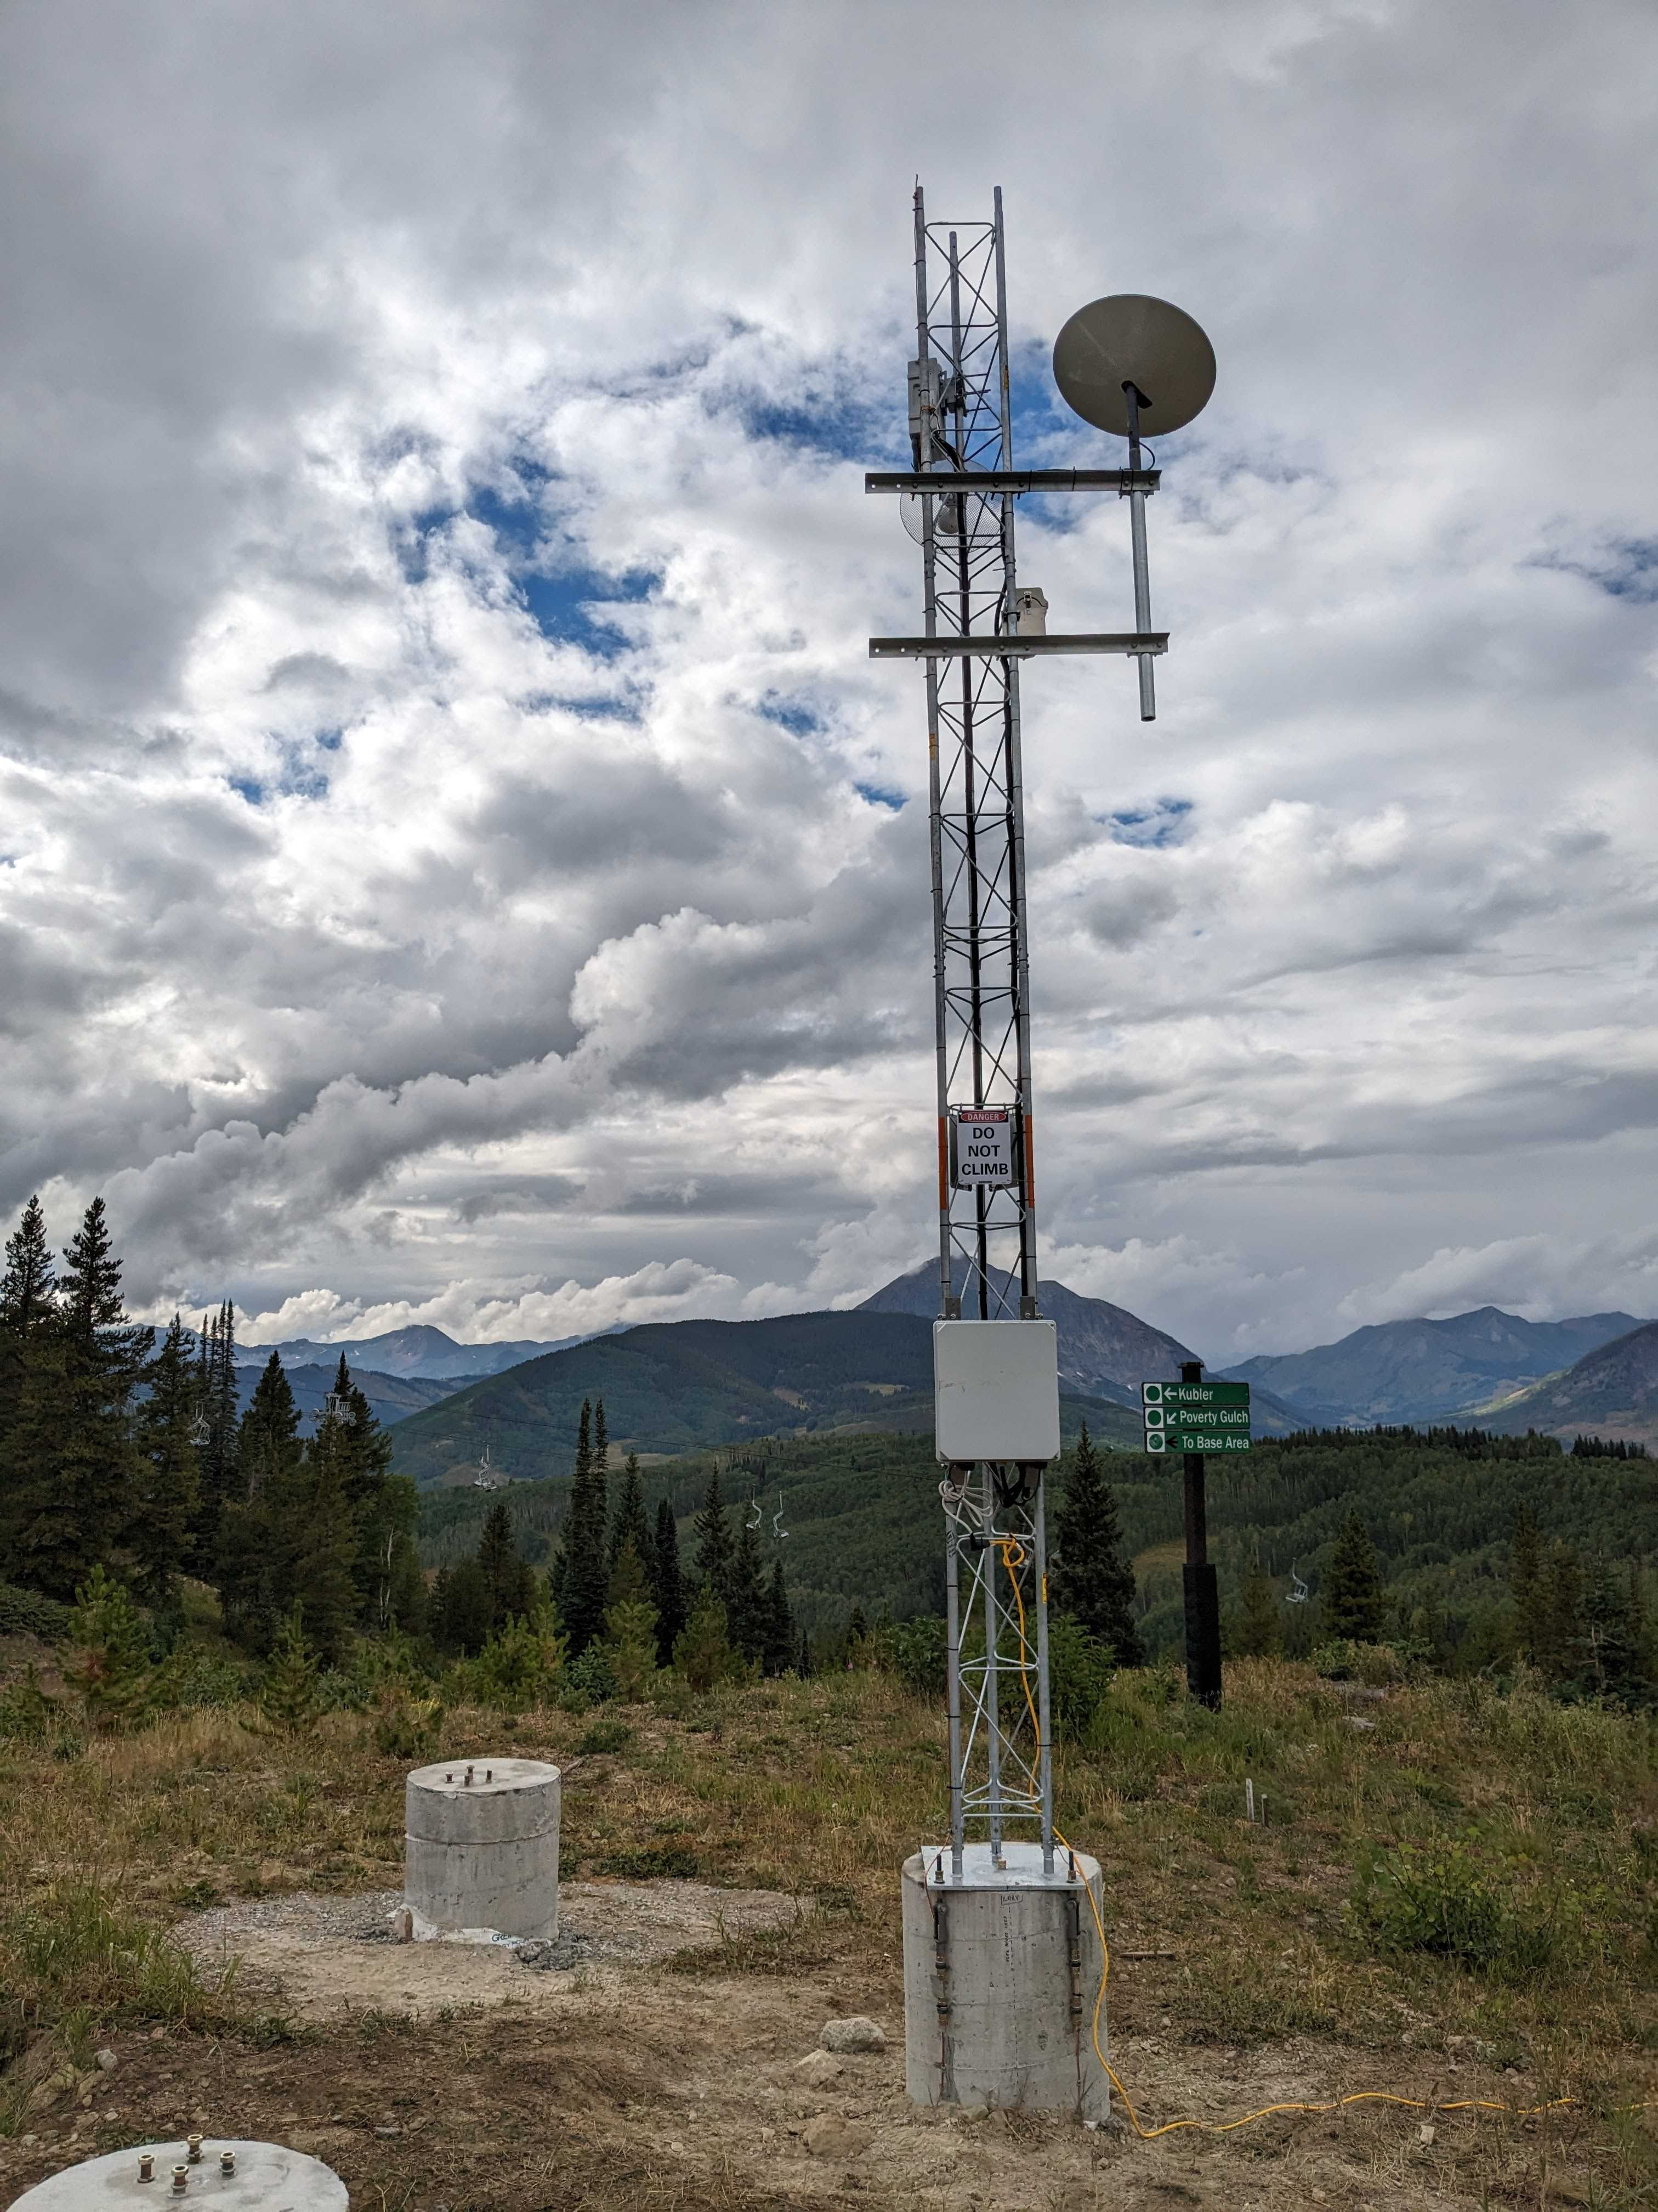
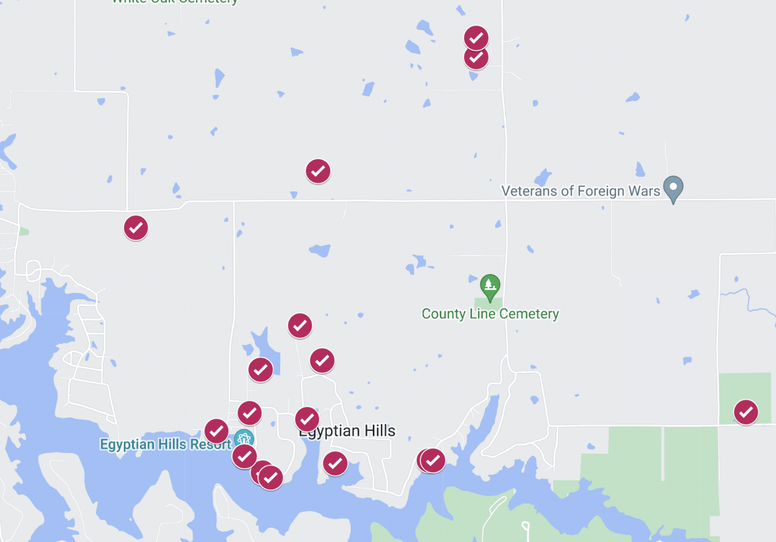
FLOTO Deployments
Chicago, IL (200 devices)
Logan Square and South Shore
Milwaukee, WI (300 devices)
Franklin Heights and Muskego Way neighborhoods
San Rafael, CA (300 devices)
Marion County, IL (20-30 devices)
University campuses
Uchicago, Chicago State University, UCSB
CS research projects
ESnet/SAIL – and other adaptations!
floto.cs.uchicago.edu

Slide 25
Instrument Adaptability
What knobs can I turn on this instrument?
Deployment scope: deploy the devices in a different area
Hardware: combine devices with different IoT peripherals (e.g., GPS)
Application: adapting “sensing abilities” programmatically
Data aggregation: different methods are possible
Data: ask different questions of the data

Slide 26
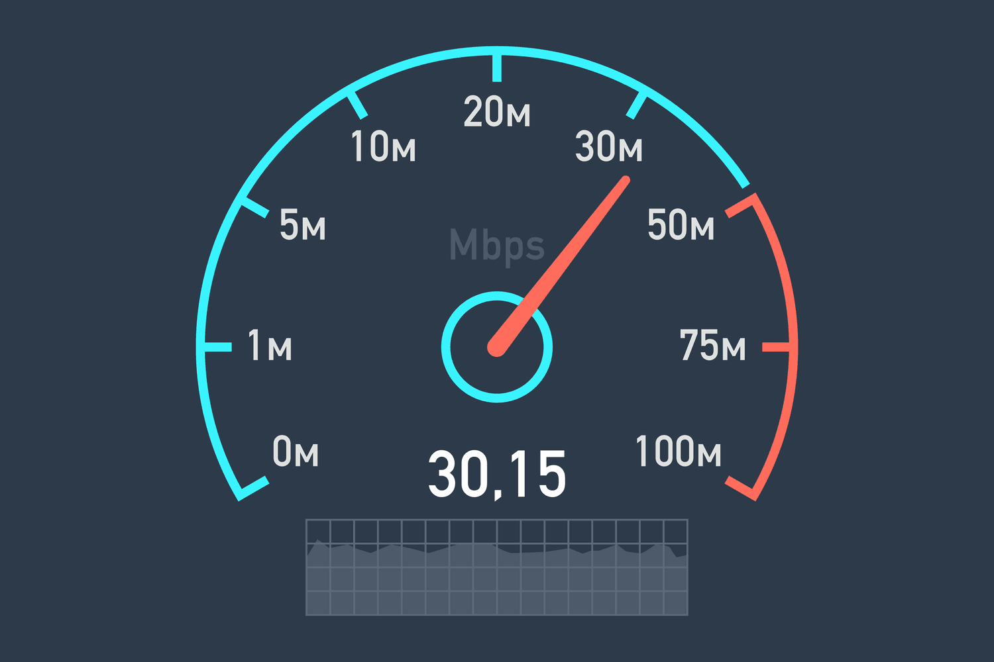
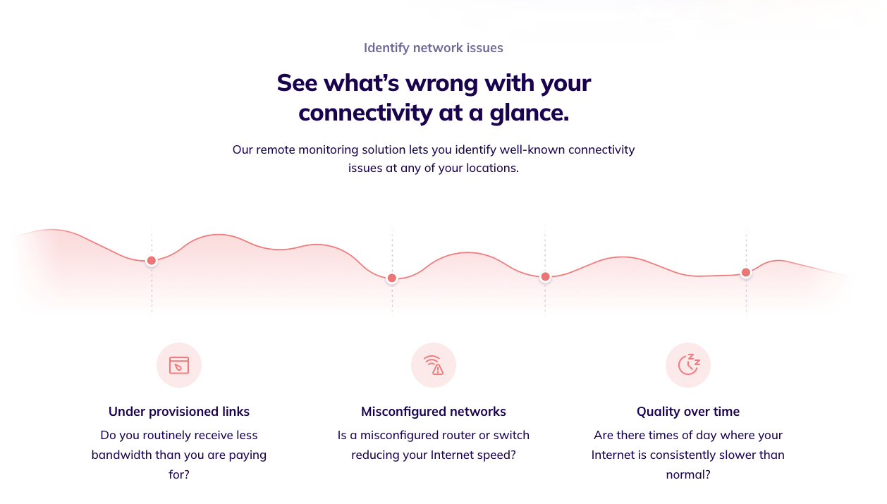
Broadband applications
Measurement Swiss Army Knife (MSAK): extends M-Lab’s testing suite for assessing broadband availability
Radar: Internet quality monitoring for telehealth in rural communities (X-Labs)
netUnicorn: a platform for building and running data pipelines on different nodes for network data collection experiments (UCSB)
Netrics: all-purpose framework for running, customizing, and scheduling network measurements for home internet (UChicago)
Network optimization: deployment on Internet 2’s network to assess network policy efficiency (I2)

Slide 27
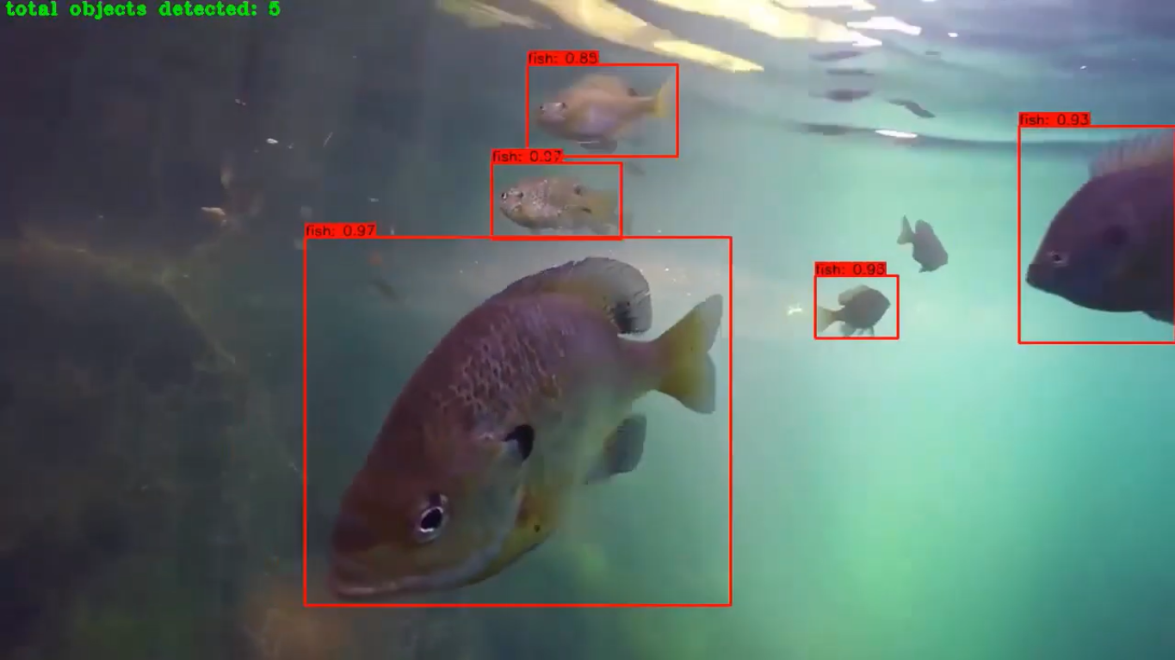
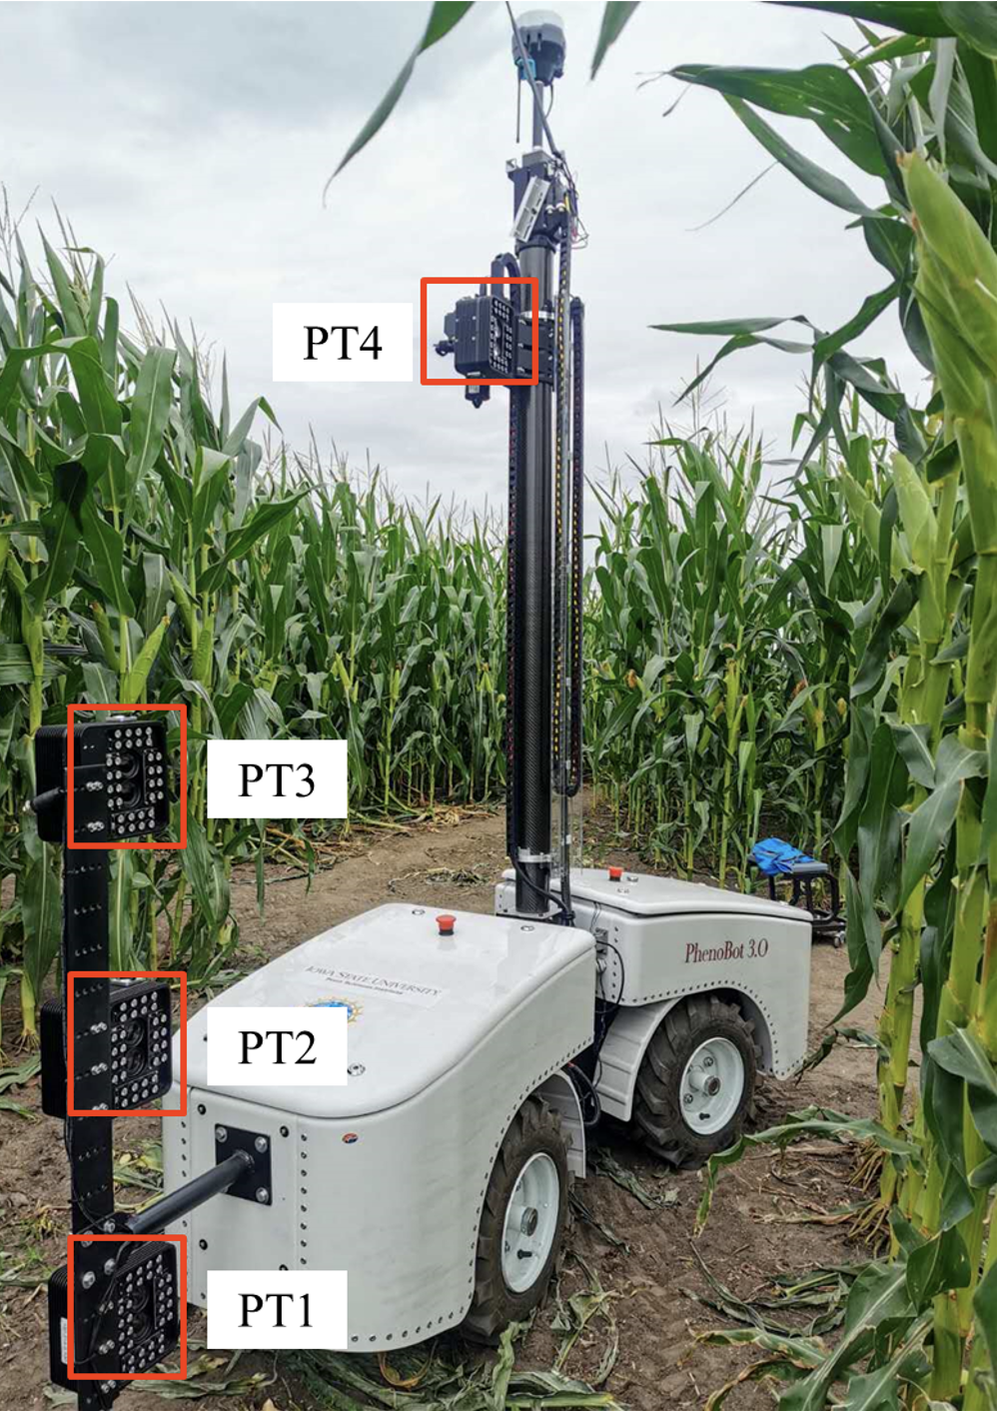
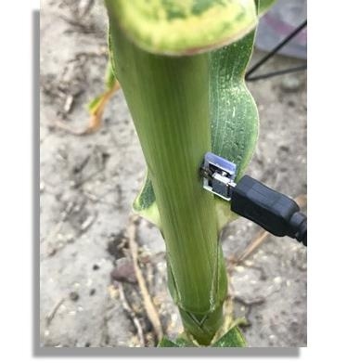
Emergent applications
Meteorological observation: using edge devices with barometers to detect anomalous weather and earthquake events (UMass CICS)
Oceanic measurement: deployment of sensor stations for oceanic data collection (water quality, water movement, water levels, etc.) (FIU)
Monitoring environmental sensor connectivity: evaluating connectivity between environmental sensor stations for precision agriculture (ARA, University of Missouri)

Slide 28
Summary
Building scientific instruments (infrastructure research)
Innovative, scalable, and adaptable
Chameleon
Configuration continuum (bare metal, VMs, containers), direct&interactive resource access
Innovative offerings: disaggregated hardware and edge computing
An open platform for reproducible systems research
Not just a testbed, a community of users: 10,000+ users, 700+ publications
FLOTO
Mainstream, scalable, adaptable
Deployment of 1,000 devices nationwide to measure broadband
Supporting multiple deployments, applications, and providing public datasets
Emergent uses in other areas
Notes:
Cloud to IoT is a massive opportunity that challenges many assumptions we were making about infrastructure

Slide 29
We’re here to change
www.chameleoncloud.org

