Slide 1
Introduction to Chameleon
Marc Richardson
CS Department, University of Chicago
mtrichardson@uchicago.edu
Webinar Series – Oct. 21, 2025
Notes:
Welcome everyone. Today, we are going to be giving a brief but expansive overview of Chameleon. This is primarily a demonstration of Chameleon, so I’ll be showing some of the capabilities of the system in real time, flipping back and forth between slides and the system. No need to have your computer ready or follow along. Almost all of what I’m going to cover today is available for you to try yourself by following our getting started guide on Chameleon Documentation.
We will also be recording today’s session and posting it on YouTube, so you can come back and rewatch at any time. I’ll share the slides as well. All of our webinar materials will be made available at chameleoncloud.org/learn/webinars
So let’s get started

Slide 2

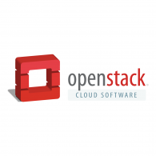
Chameleon: AN Edge To cloud testbed
From large to small – diversity and scale in hardware:
Supercomputing datacenters (UC, TACC) over 100G network – to edge devices
Diverse: FPGAs, GPUs, NVMe, NVDIMMs, Corsa switches, edge devices via CHI@Edge, etc.
Distributed: CHI-in-a-Box sites at NCAR, Northwestern, and UIC – and now also NRP!
Chameleons like to change – testbed that adapts to your experimental needs
From bare metal reconfigurability/isolation -- KVM cloud – to containers for edge (CHI@Edge)
Capabilities: power on/off, reboot, custom kernel boot, serial console access, etc.
Based on mainstream open source – proud to be cheap!
50% leveraging and influencing OpenStack + 50% “special sauce” (incl. fed id)
Promoting disruption in digital artifact sharing
Integration with Jupyter for non-transactional experiment packaging
Trovi for experiment sharing and discovery, Chameleon Daypass for access sharing
Reproducibility and education: digital sharing killer apps!
Notes:
So, first question is “what is Chameleon?” other than a reptile that can change colors.
To us Chameleon is a large-scale, deeply reconfigurable resource for computer science research, education, and emergent applications
What do I mean by resource? I mean we have supercomputing data centers, we have edge devices, we have networking components, storage, security, and we make all of this available to users.
But the resources that we make available are just part of the fun. We also give users bare metal reconfigurability and isolation for that hardware; or users can spin up some virtual machines on the KVM cloud that we provide; or maybe they want to run some edge-to-cloud workloads and need to deploy some containers on CHI@Edge, our edge computing site.
Whatever your research or education needs, you can come to Chameleon to find something that will work for you, or if not, you’ll find the solid foundation to build it and share it back with the community.
That leads into our next point, which is that we are proud to be open source. We leverage OpenStack cloud software to maximize our focus on the special features that our users request to support their projects on Chameleon. We are a user-first team, as we like to say. We also contribute components back to the OpenStack community.
And we’ll get into some of the exciting features that users can access on Chameleon to promote other valuable goals, like reproducibility and generating more educational content for critical CS skills.

Slide 3
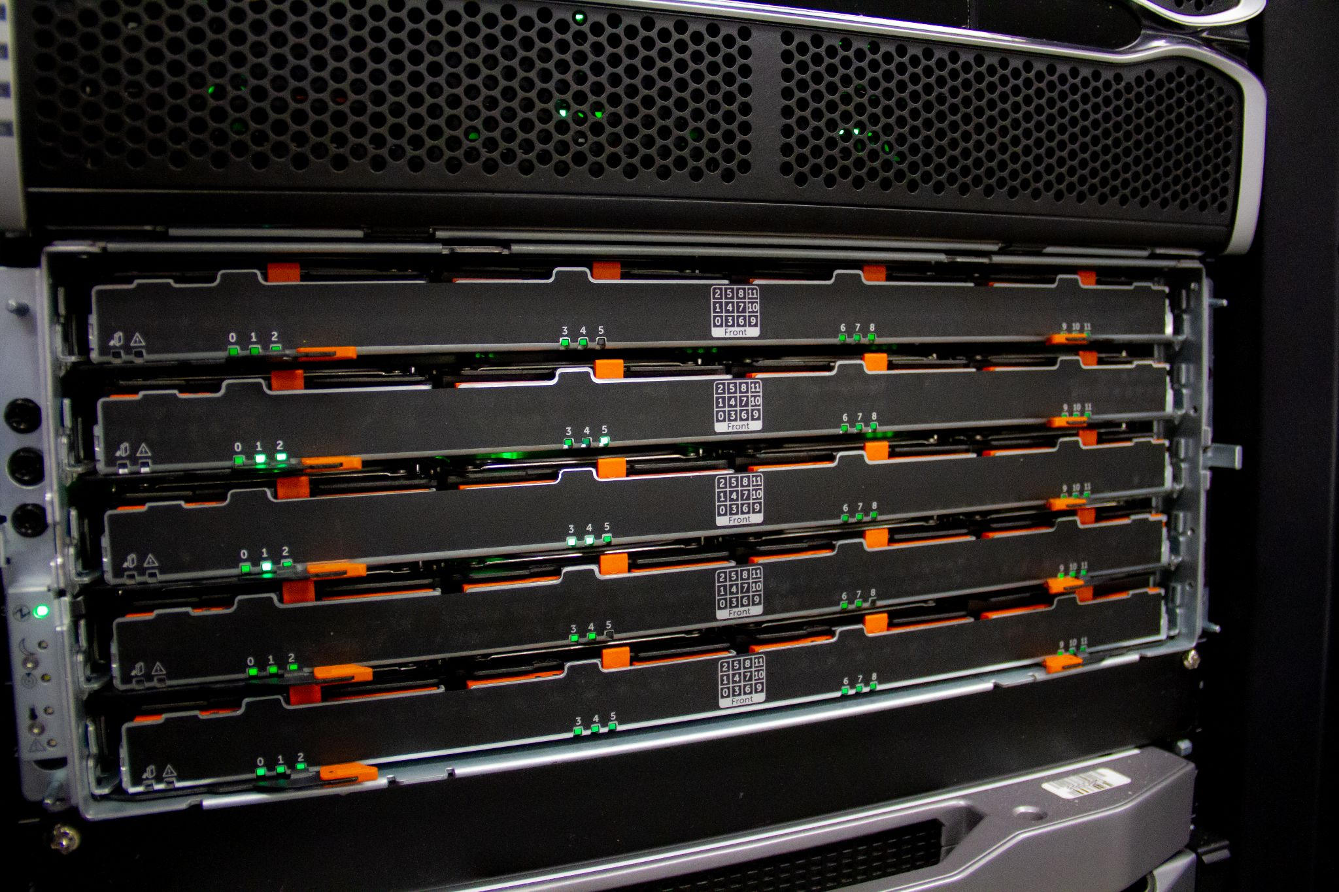
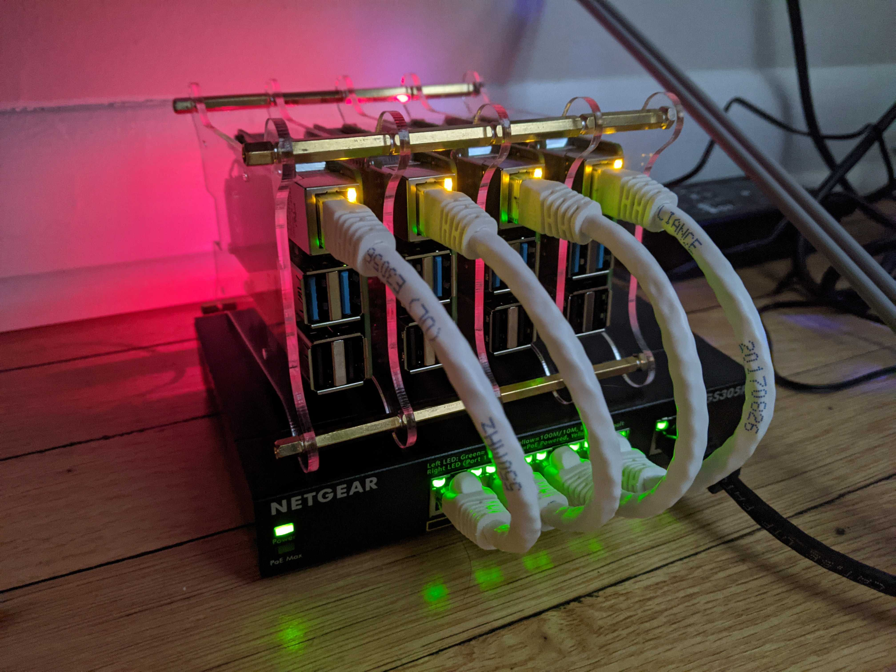


1,300+
Unique projects
830+ Papers published
13,000+
Users
Notes:
Chameleon has seen tremendous success in terms of the impact we have had so far
We have a growing community of over 13000 users across 1300 projects resulting in over 830 papers published since the project’s start (which just hit the 10-year anniversary!)

Slide 4
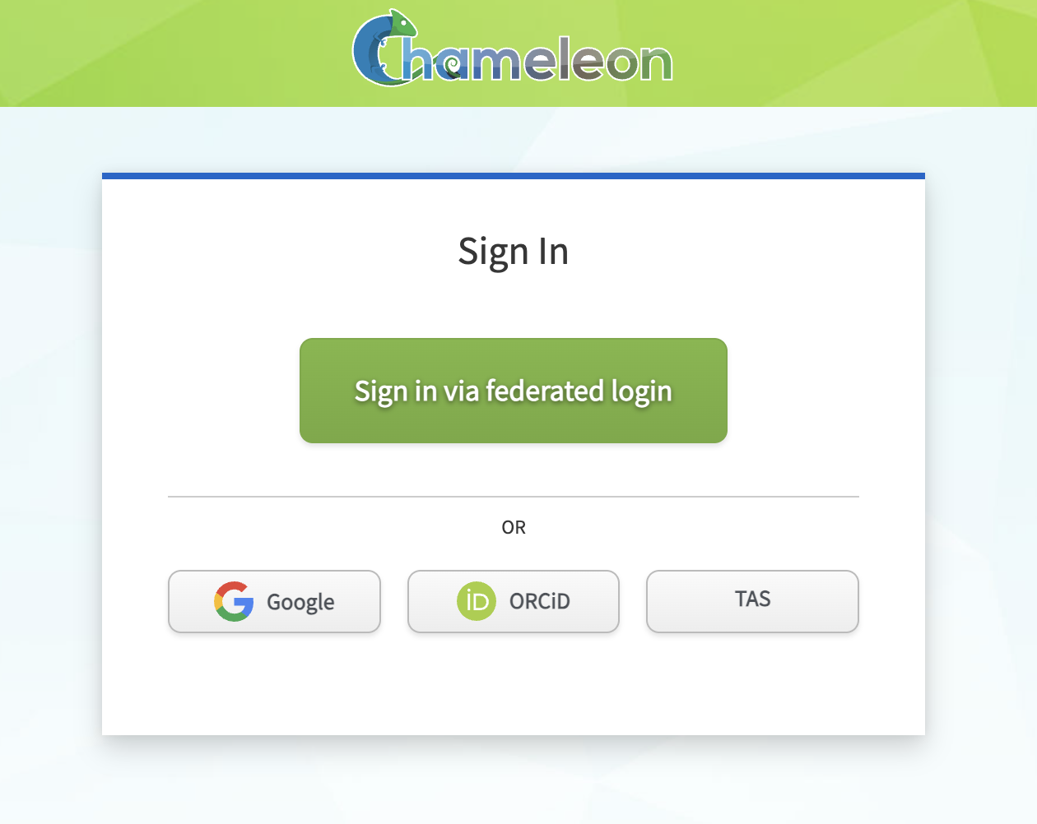
GETTING ACCESS: make a USER ACCOUNT
Log in with existing institution account or Google/GitHub
No new username/password to remember!
Federated authentication through Globus Auth
ANYONE can create a free user account on chameleoncloud.org
Usage Policies
Limited to CS research, education, emergent applications
Follow security best practices
No commercial/illegal use allowed

Slide 5
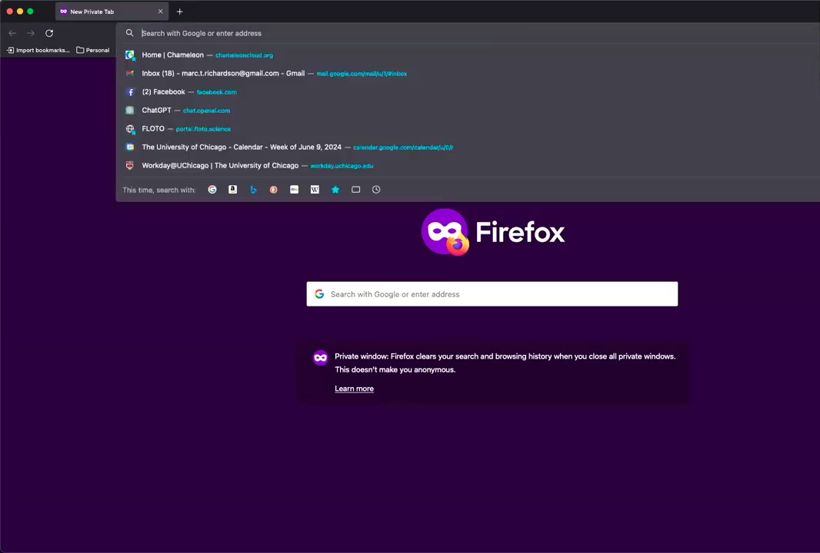

Slide 6
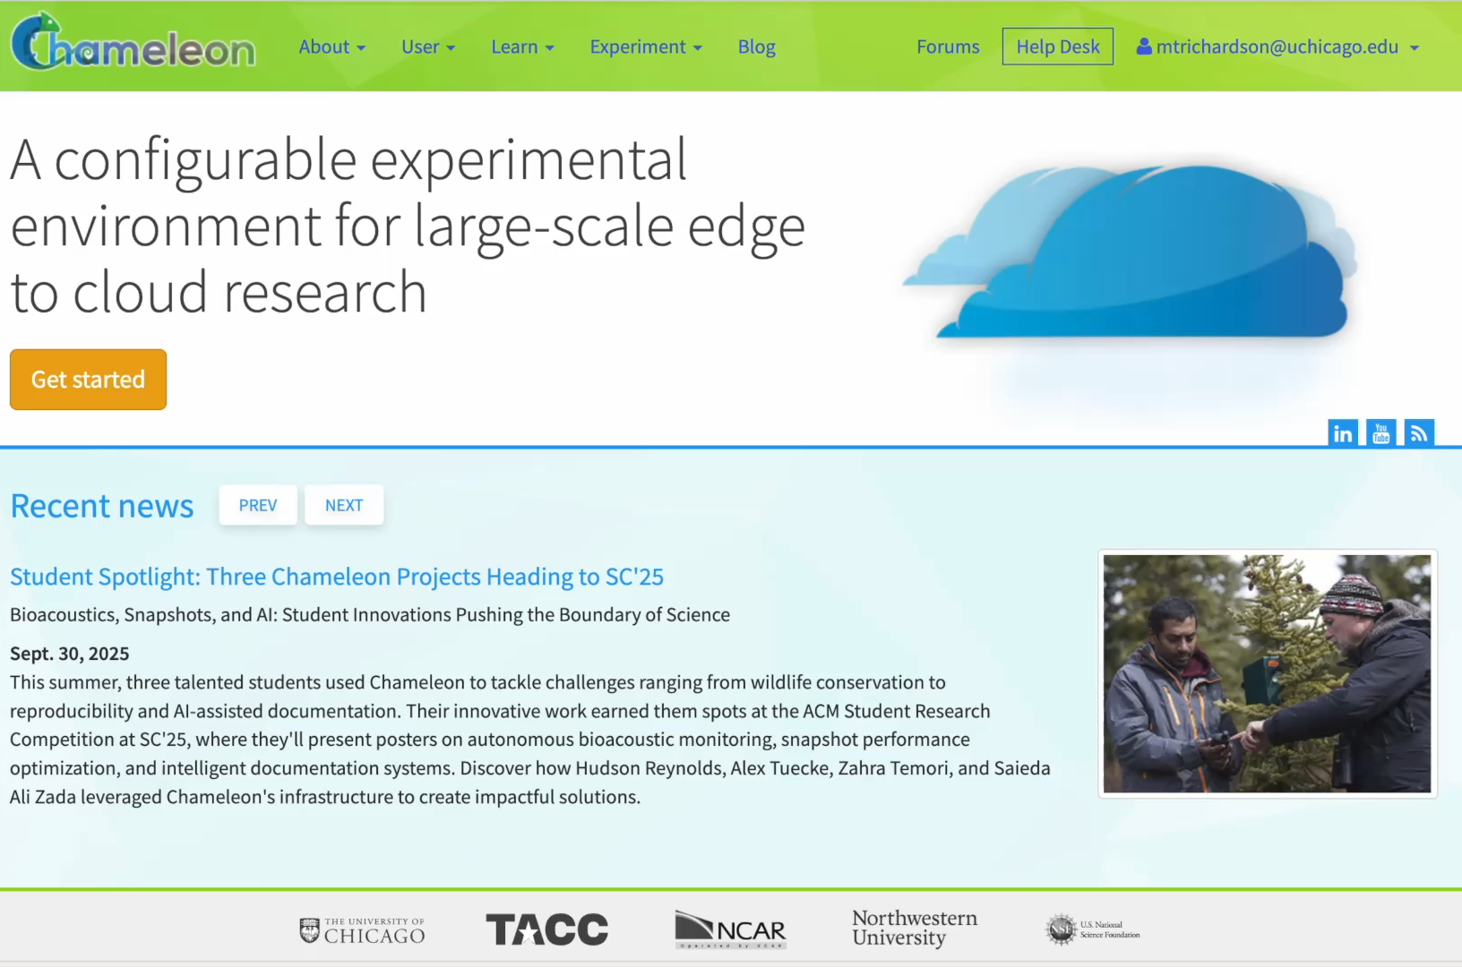
GETTING ACCESS: Create or join a Project
After account creation, CREATE or JOIN a project
New project: 6-mo. resource allocation (with renewals) and resource budget (20,000 hrs)
Requires ‘PI Status’ - decision within 1 business day
Not eligible? Ask a supervisor to add you to a project

Slide 7

Guides and resources for getting started
Getting Started Guide: Interactive walkthrough of core testbed interfaces & capabilities -> chameleoncloud.org/docs/getting-started
Learning Resources: Tips&Tricks blogs, User Experiment Interviews, documentation & FAQs, webinars - all on chameleoncloud.org
Getting Help: Chameleon Help Desk available M-F during business hours; Chameleon Forum for non-urgent questions, community threads – chameleoncloud.org/user/help

Slide 8
spinal strength

Slide 9
Experiment Workflow
Create experimental environment
Run
experiment body
discover
resources
allocate
resources
configure environment
- Fine-grained
- Complete
- Up-to-date
- Versioned
- Verifiable
- Allocatable resources: nodes, VLANs, IPs
- Advance reservations and on-demand
- Non-fungible
- Isolation
- Bare metal, KVM, containers
- Image catalog
- Snapshotting
- Network stitching
- Orchestration
Analyze and present results
Authentication via federated identity, accessed via GUI, CLI, and python-chi
Paper: “Lessons Learned from the Chameleon Testbed”, USENIX ATC 2020
Notes:
Highlight:
Interfaces – everything goes via OpenStack-based API (even if it is just a veneer as for CHI@Edge)
Emphasis on *programmatic interfaces* with python-chi and Jupyter – they can be easily scripted/repeated (unlike GUI), preferred by most users

Slide 10




Chameleon Hardware
CHI@UC
Skylake, CascadeLake, IceLake, AMD nodes, and GigaIO GPUs (A100, V100, RTX6000), FPGAs (Xilinx Alveo U280)
Storage (NVMe SSD, NVDIMM)
Network (Corsa SDN, 25G Ethernet, 200G InfiniBand)
Commercial Clouds via CloudBank
FABRIC, FAB
and other partners
Storage
~0.5 PB
Chameleon Volunteer Sites
CHI@Edge
Raspberry Pi, Jetson Nano, Jetson Xavier NX, AGX Orin
+ User-added devices
Network
100Gbps public network
Chicago
Austin
CHI@TACC
Haswell, SkyLake, CascadeLake, Fugaku (ARM64 + HBM), AMD nodes, and LIQID/GigaIO disaggregated hardware
GPU (K80, M40, P100, MI100, H100), FPGAs (Altera)
Storage (NVMe, SSD, NVDIMM)
Network (Corsa SDN, 25G Ethernet, 200G InfiniBand)
CHI@NCAR
Storage
~3.5PB
Notes:
UC
42x Intel nodes with 48 cores and 192GB of RAM, 10x AMD Epyc with 48 cores, 256GB of RAM, and a 960GB NVMe root disk. Additionally, a subset:
2 nodes, each with 2x Intel D7-P5510 7.68TB datacenter SSDs
2 nodes, each with 2x Samsung PM1733 7.68TB datacenter SSDs
2 nodes, each with 4x Samsung PM1733 1.92TB datacenter SSDs
2 nodes, each with 2x Corsair Force MP600 2TB consumer SSDs
2x: Intel Optane nodes with 112 Cores, 768GB of RAM, and 3TB of NVDIMMs
3x: Intel nodes with 4x Nvidia V100 GPUs connected by NVLink
1x: Intel node with 4x Nvidia V100 GPUs connected by PCIe
16x of the regular compute nodes have HDR100 (100gb/s) InfiniBand, as do all of the Optane and GPU nodes. All the SSD nodes have HDR (200gb/s) InfiniBand.
At TACC
32x compute_zen3: AMD nodes, each with 2x two AMD EPYC 7763 (128c / 256t), 256GB RAM, 480GB ssd storage.
8x gpu_mi100: same specs as compute_zen3, with addition of 2x AMD MI100 GPUs each
All 40 are connected via HDR100 Infiniband.
Volunteer sites:
NCAR: ARM Thunder Nodes
IIT, Northwestern, & UIC: Chameleon Legacy program
Purdue: ~400 of their own Haswells added on an ephemeral basis to support IndySCC specifically

Slide 11
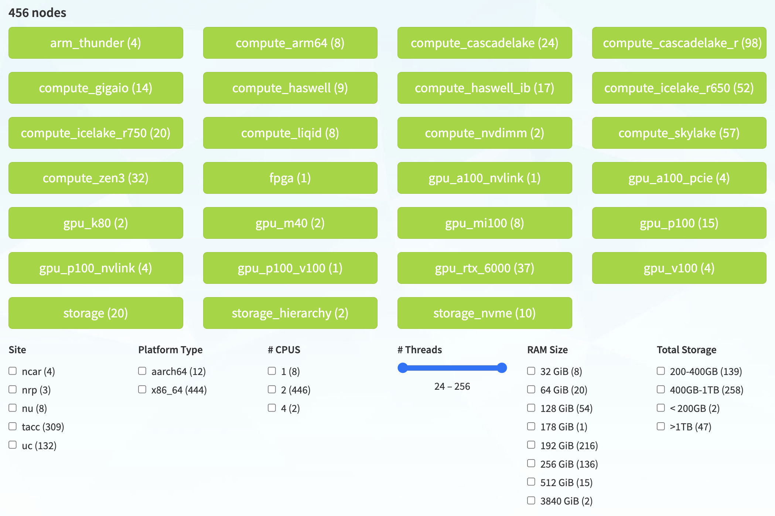
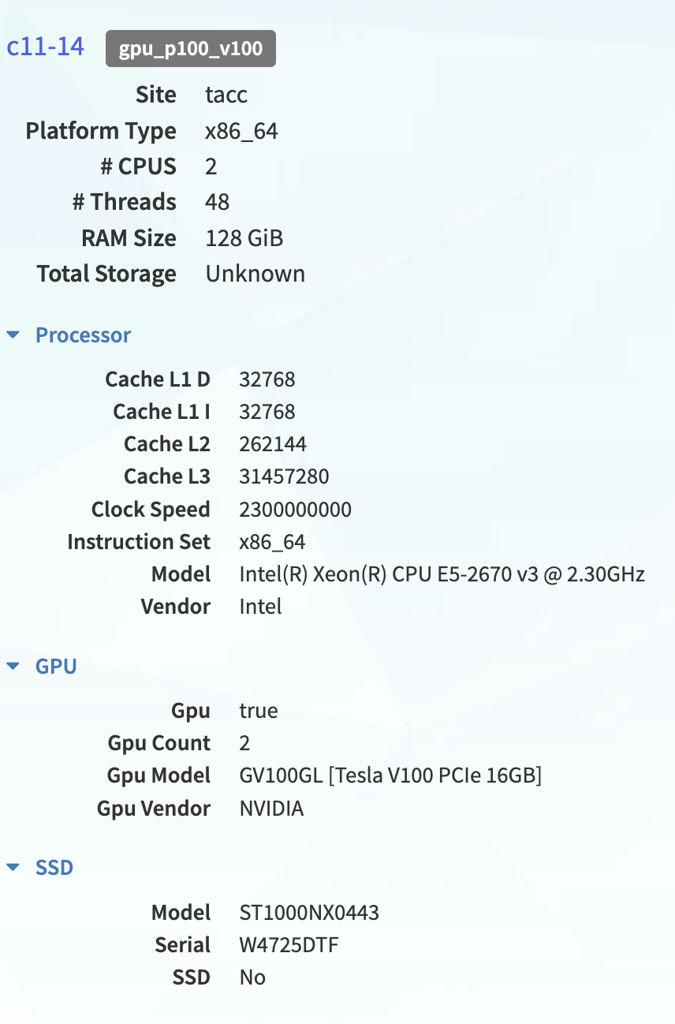
Resource discovery & hardware catalog
View detail for specific nodes
See all nodes across all sites
Filter based on configuration

Slide 12
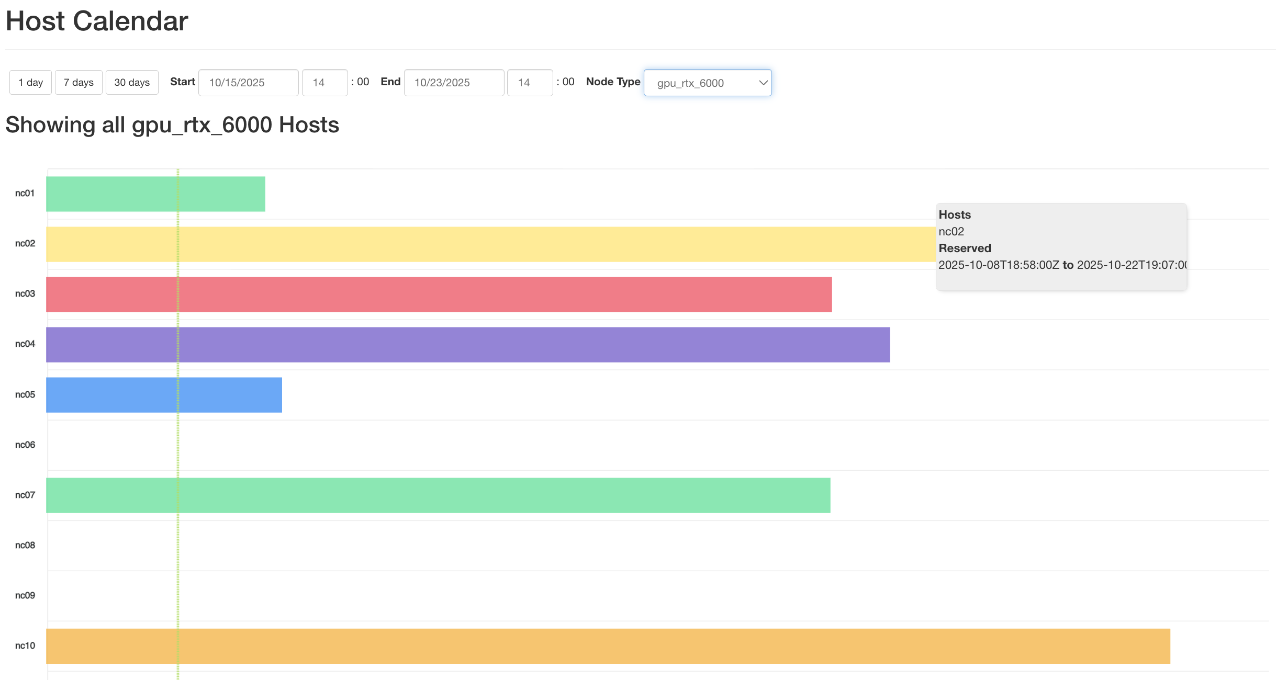
Advanced reservations
Date and Node Type Filters
All Chameleon resources need a reservation to use!! Bare metal and virtualized
View hardware availability to find open nodes
Make a lease to reserve nodes
Open Hosts

Slide 13
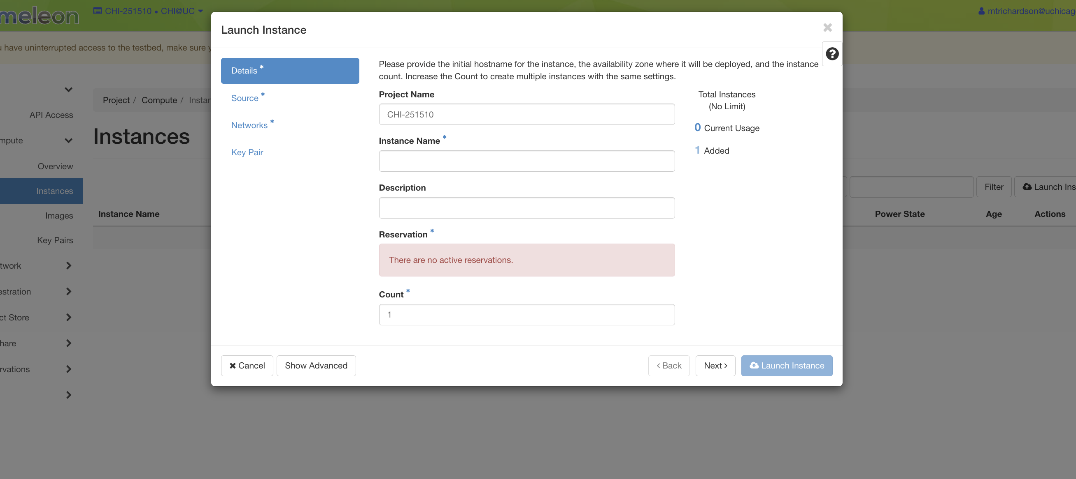
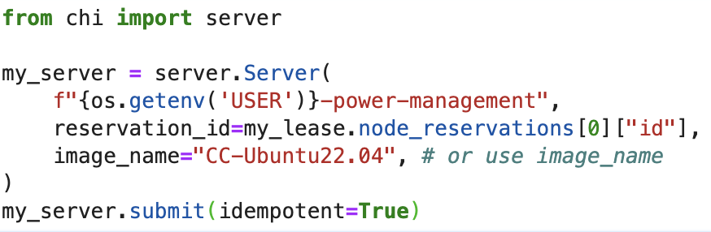
Bare Metal configuration – CHI@TACC/UC
Build and launch your own instance on a bare metal node of your choosing
Configure your environment with
Key pairs
Storage (object store, file shares)
OS
Networks (may require reserving additional resources)
Notes:
Start by showing things through the GUI, then demonstrate how the same tasks can be accomplished programmatically⁠⁠​
Consider showing a Jupyter notebook with Python-chi code rather than just static slides⁠⁠​
You can explain that users could also use Bash instead of Python-chi, but they won't have access to data structures and other programming conveniences⁠⁠​
The goal is to show there are multiple interfaces to the infrastructure without going too deep into technical details

Slide 14
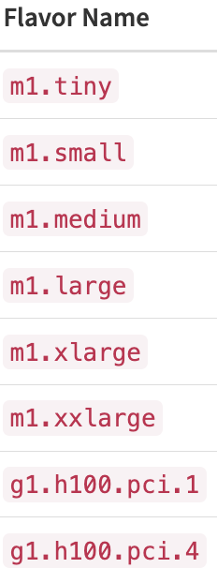
Virtualized Resources – KVM@TACC
Reserve virtual machines on KVM@TACC (now with GPU attachments – H100s)
Compute flavors can be reserved up to 6 months for long-term projects (great for teaching classes and long-running jobs)
Storage volumes for scalable data management and sharing
Configure security groups at the VM level, through dashboard
Cost-Effective: virtualized instances cost a fraction of bare metal

Slide 15

Containers – CHI@Edge
All the features you love in CHI, plus:
Reconfiguration through non-prescriptive container deployment via OpenStack interfaces (using K3 under the covers)
Support for “standard” IoT peripherals (camera, GPIO, serial, etc.) + easy for you to add support for your own peripherals
Bring Your Own Device (BYOD): Mixed ownership model via an SDK with devices, virtual site, and restricted sharing – building on OpenBalena
Paper: “Chameleon@Edge Community Workshop Report”, 2021
Notes:
Non-prescriptive!

Slide 16
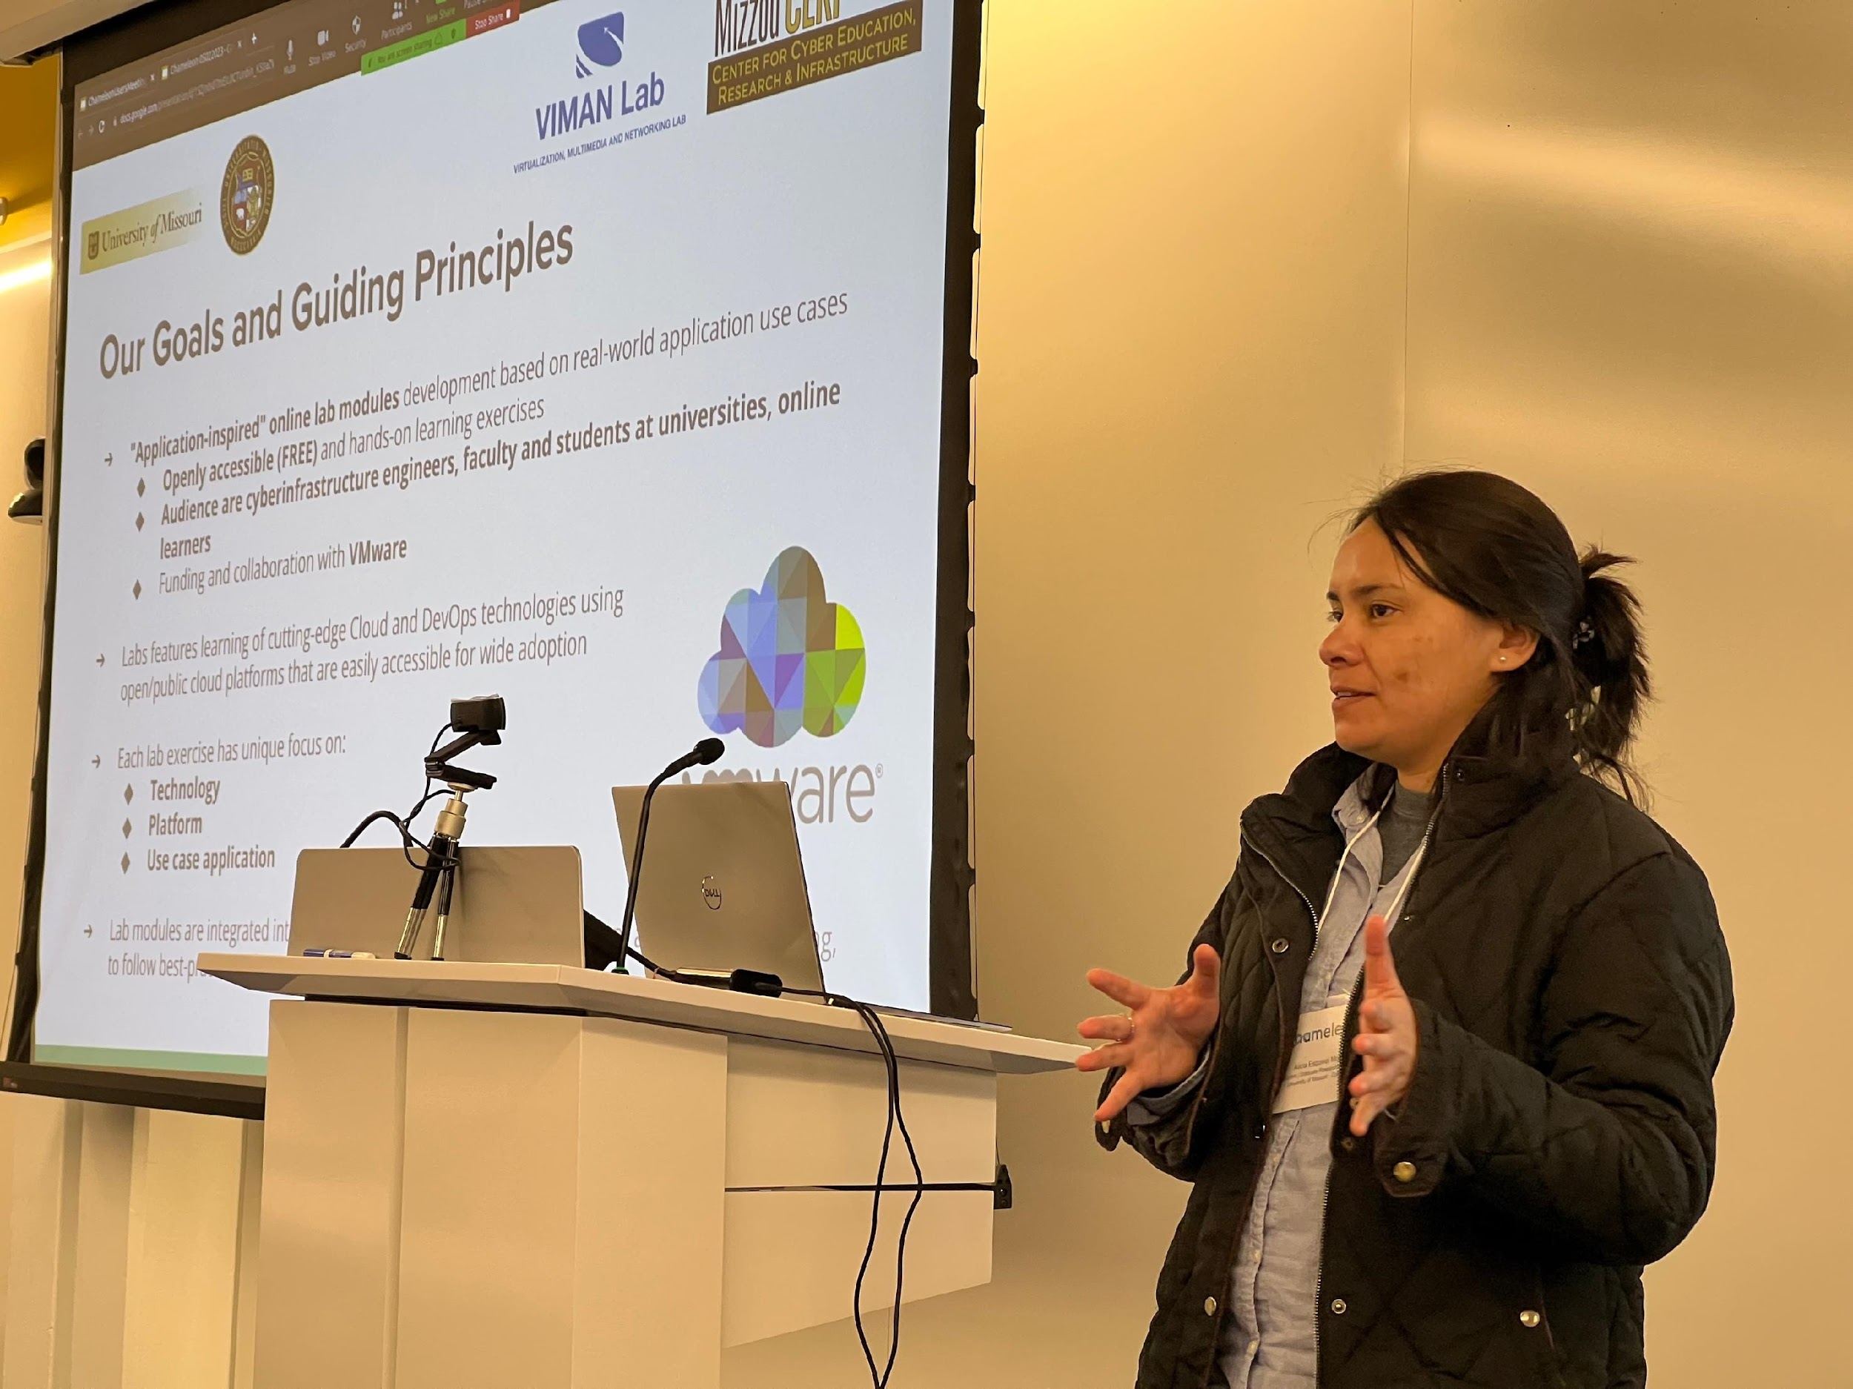
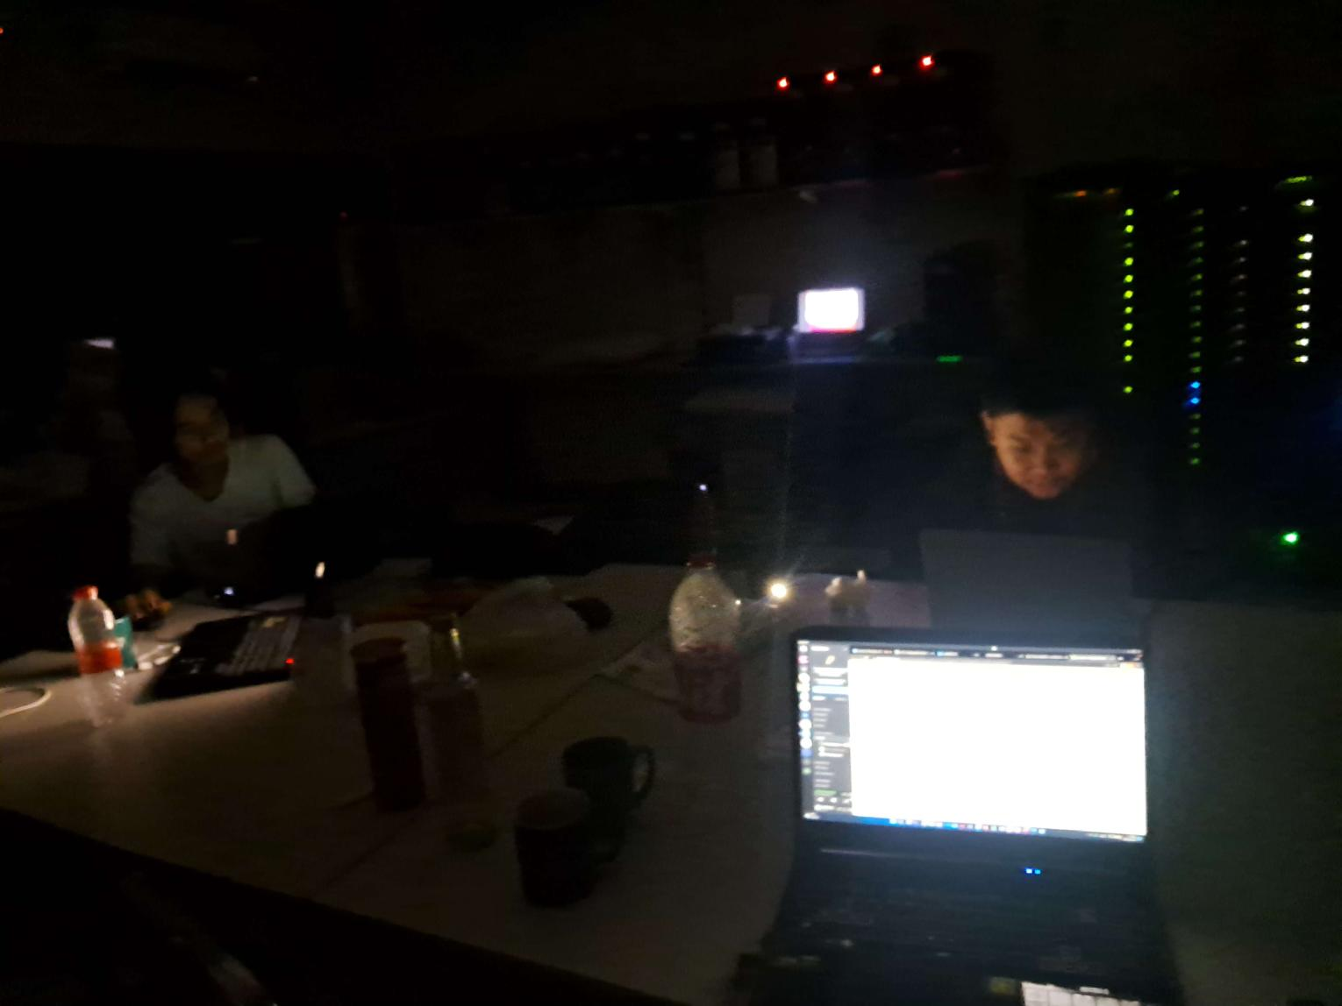
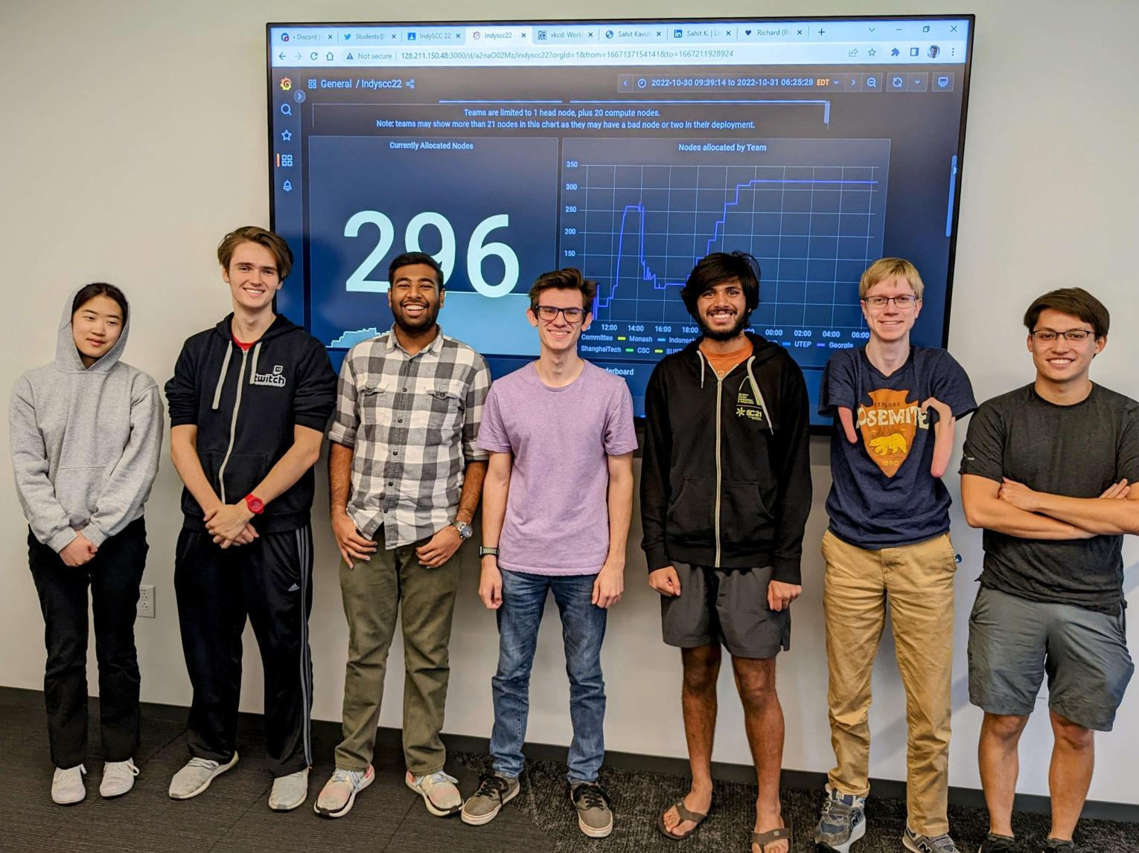
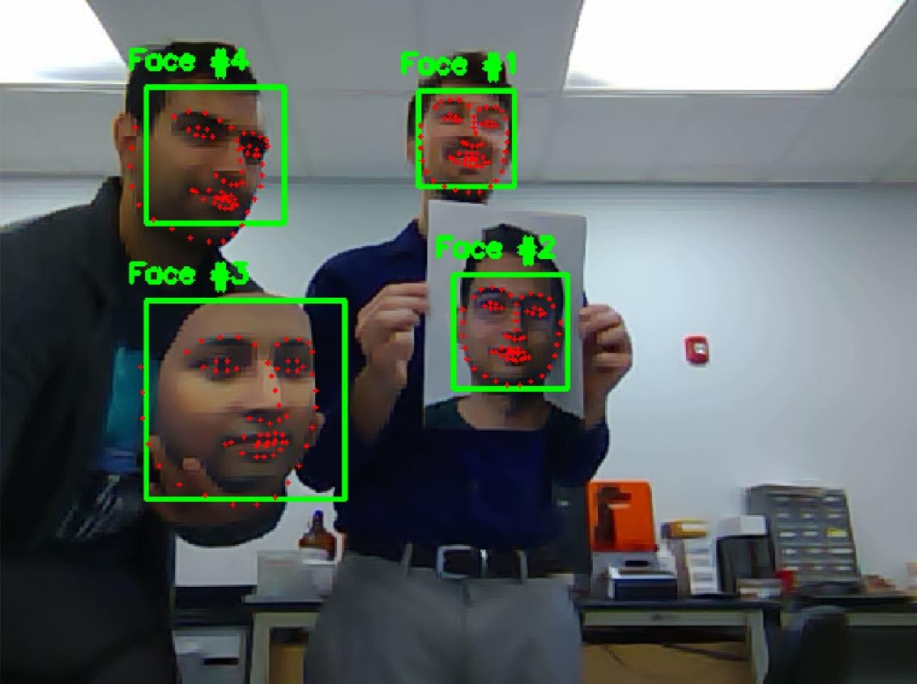
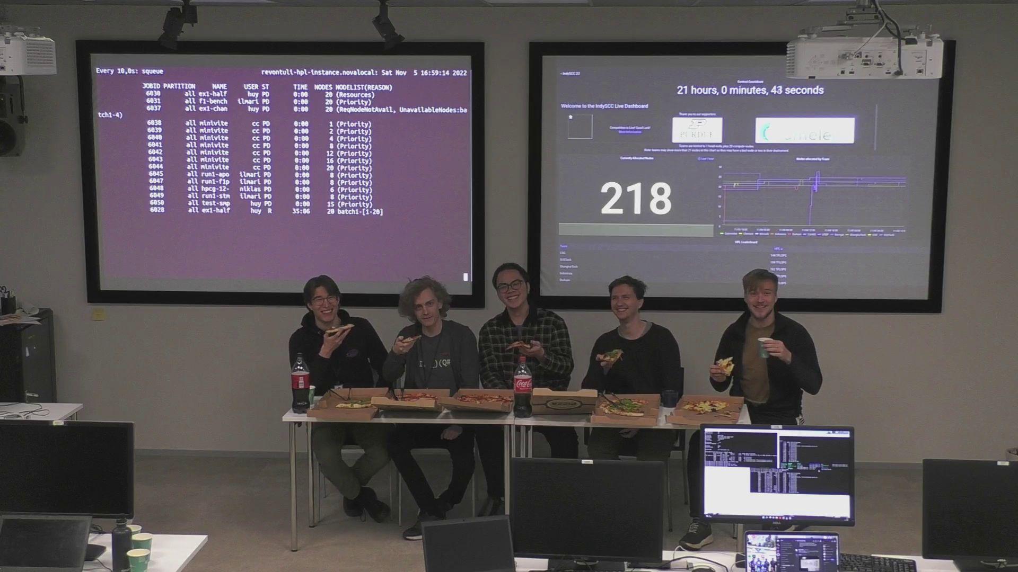
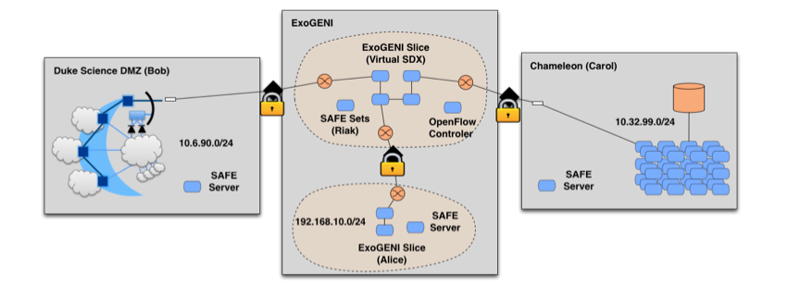
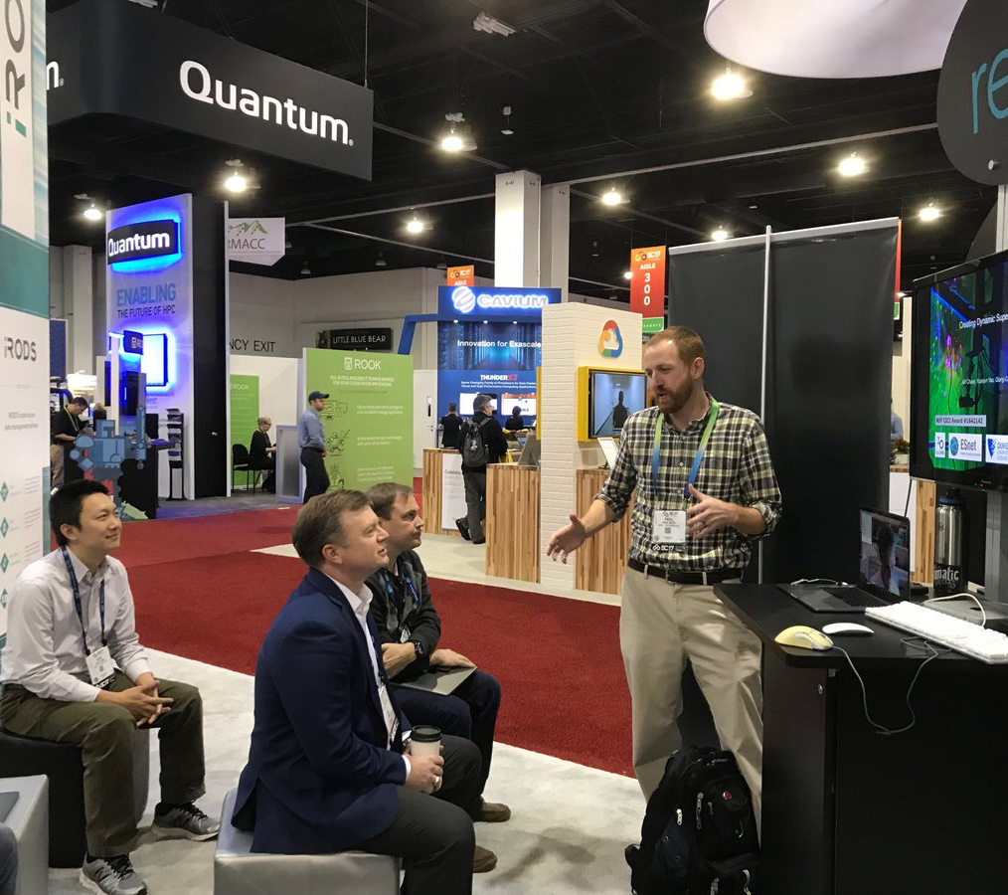
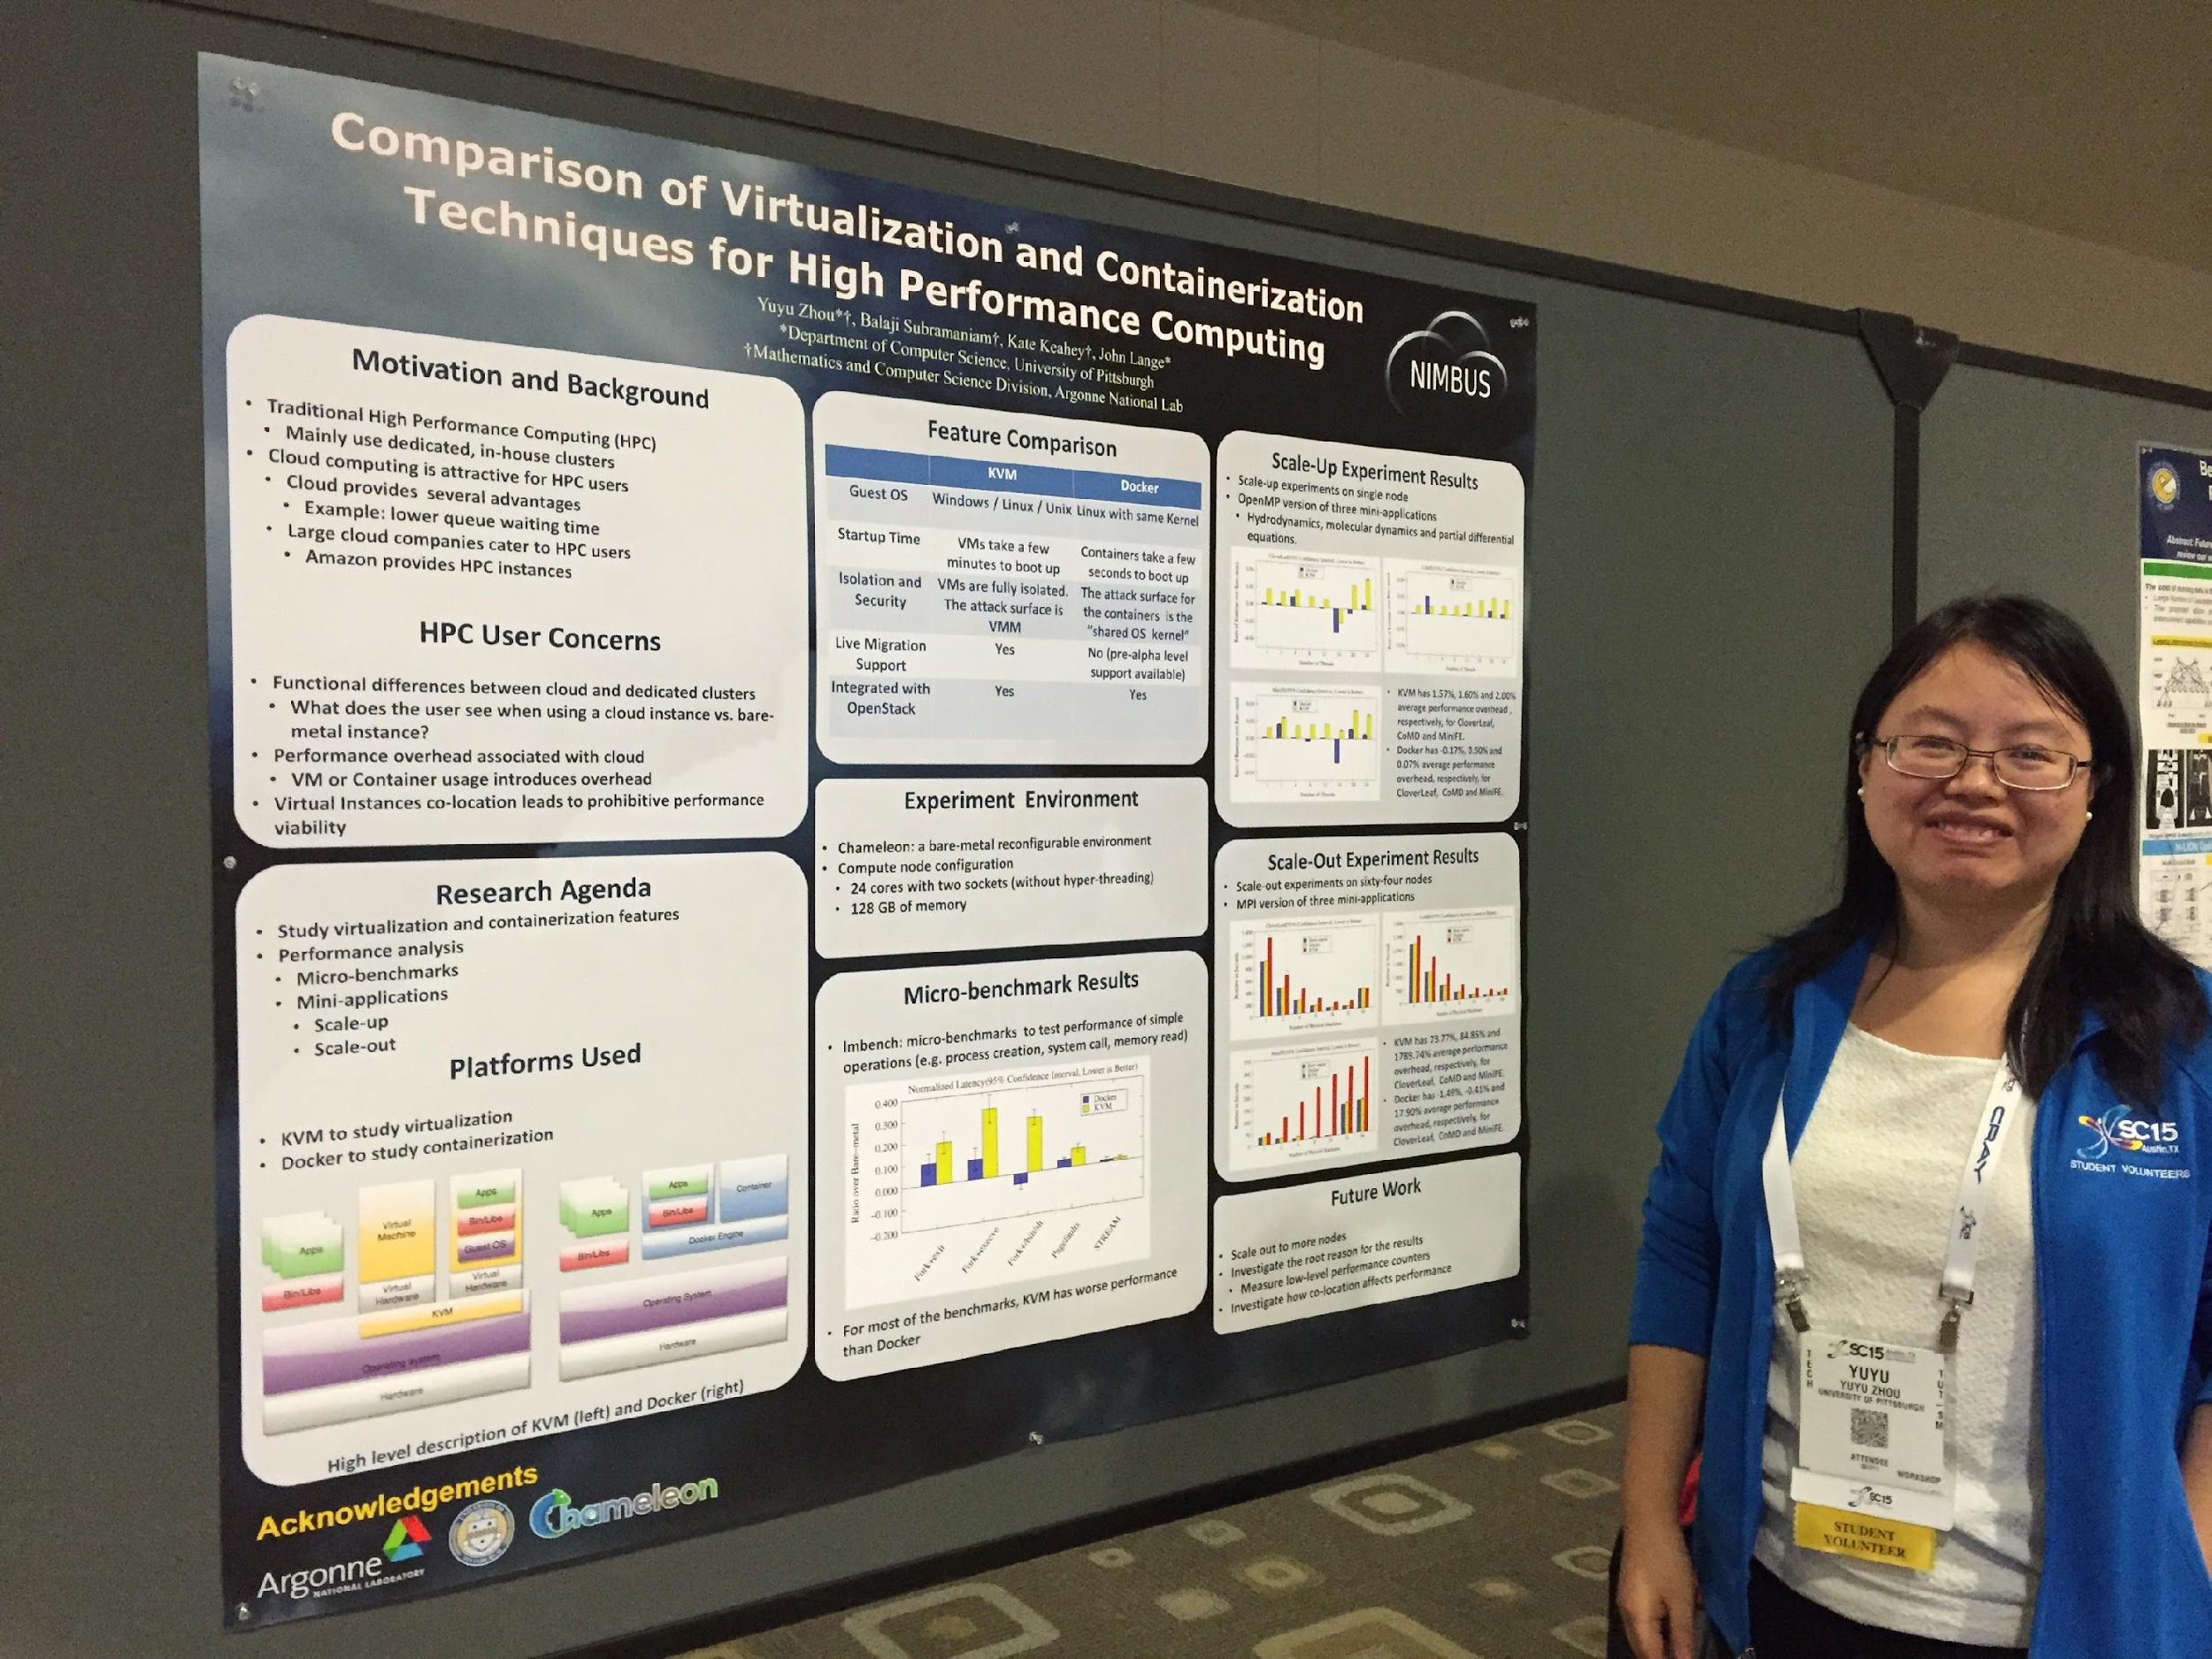
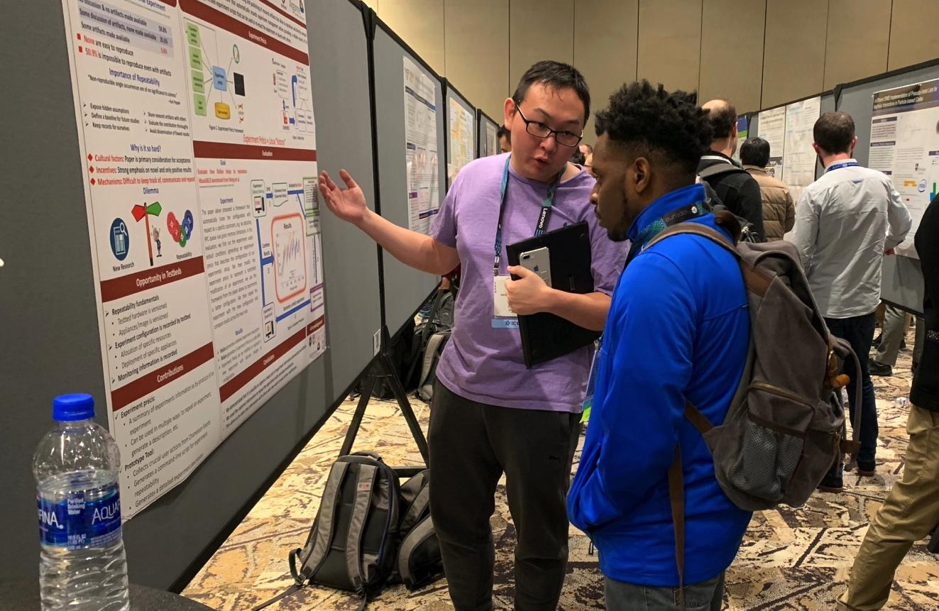

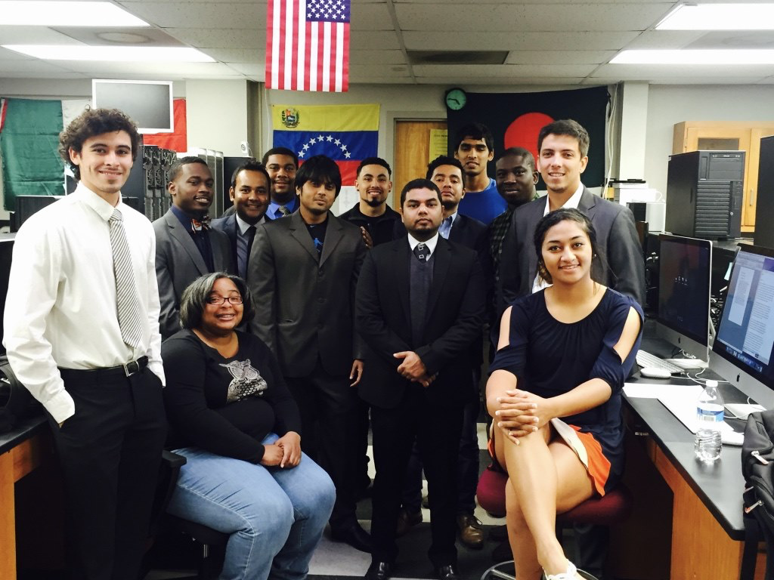

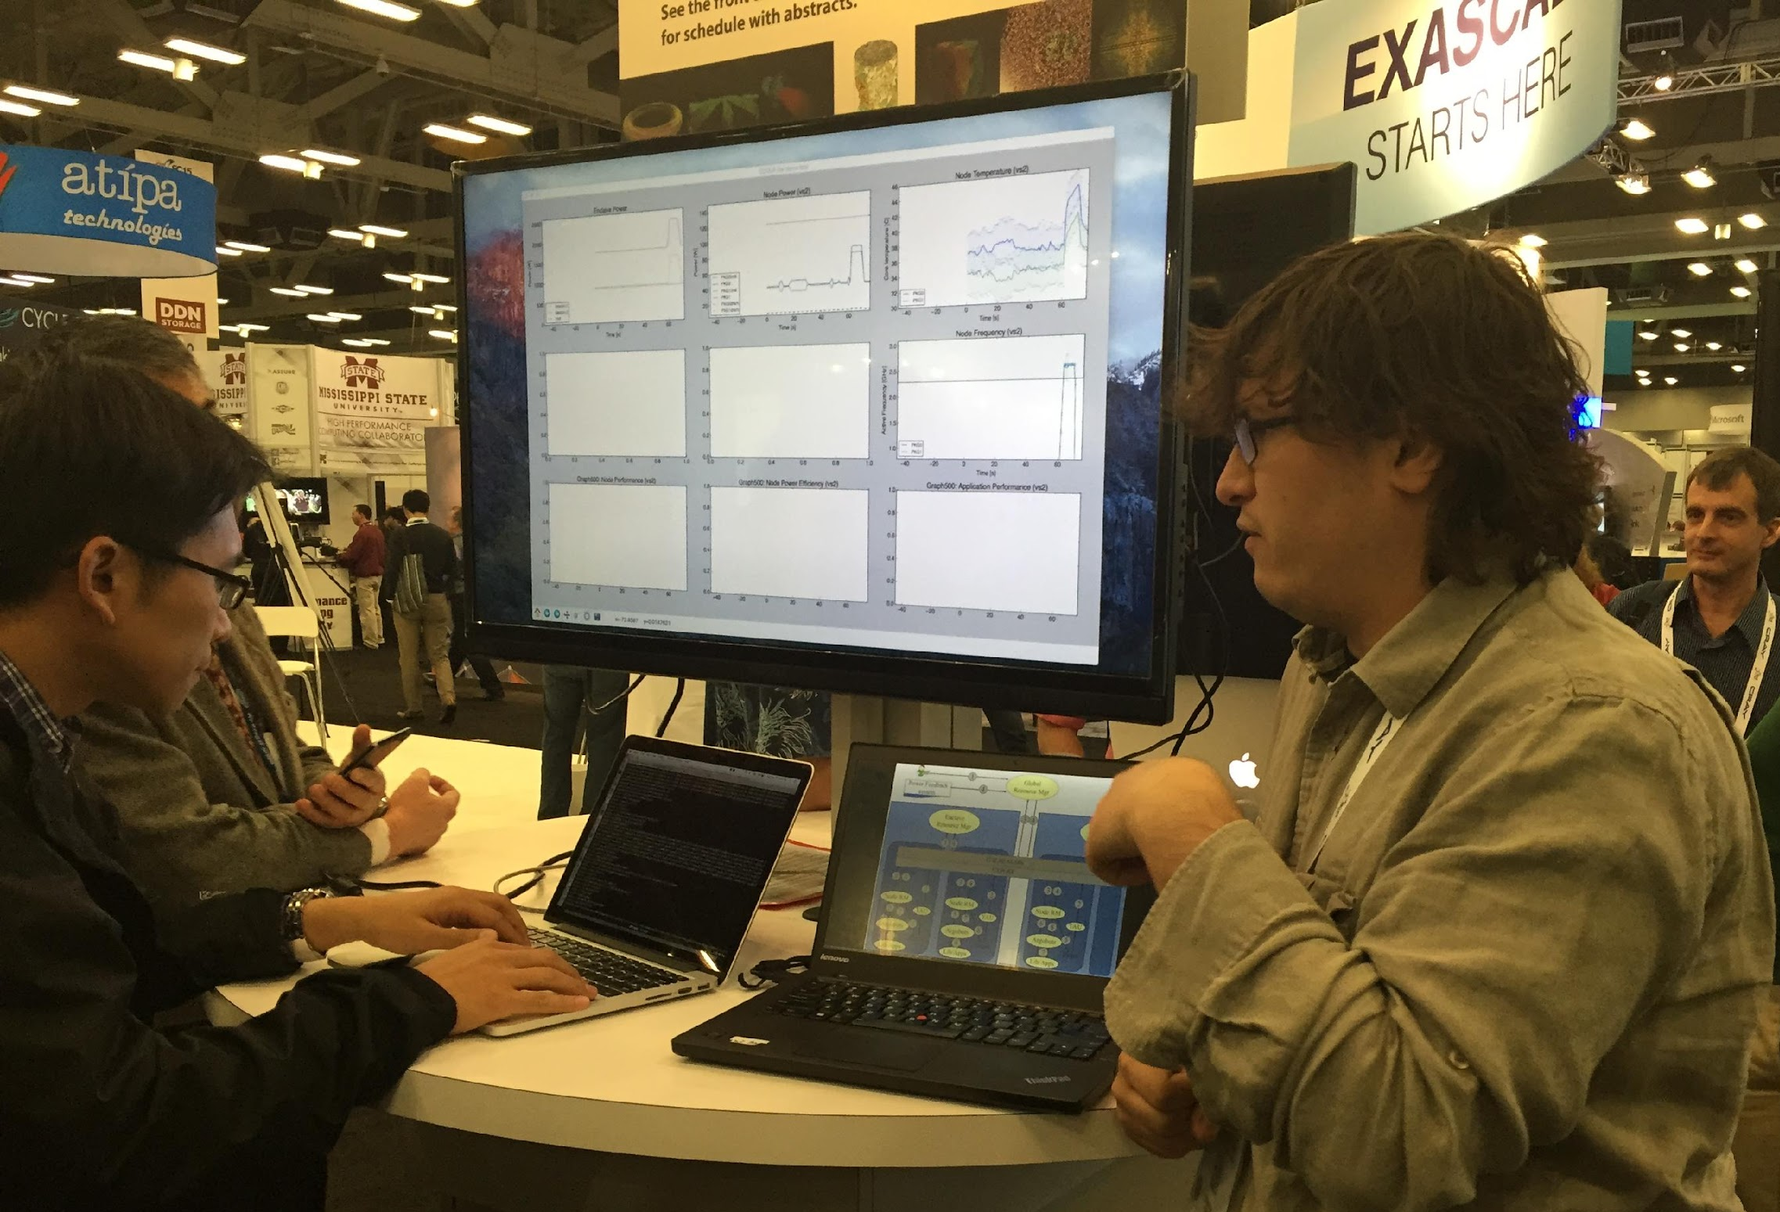
Not Just a Testbed, a Community
Supporting research projects in architecture, operating systems design, virtualization, power management, real-time analysis, security, storage systems, databases, networking, machine learning, neural networks, data science, and many others.
Check out user experiment stories on our blog:
https://www.chameleoncloud.org/blog/category/user-experiments/
Notes:
Anybody wants to find out more it is under the user experiments tab on our blog

Slide 17

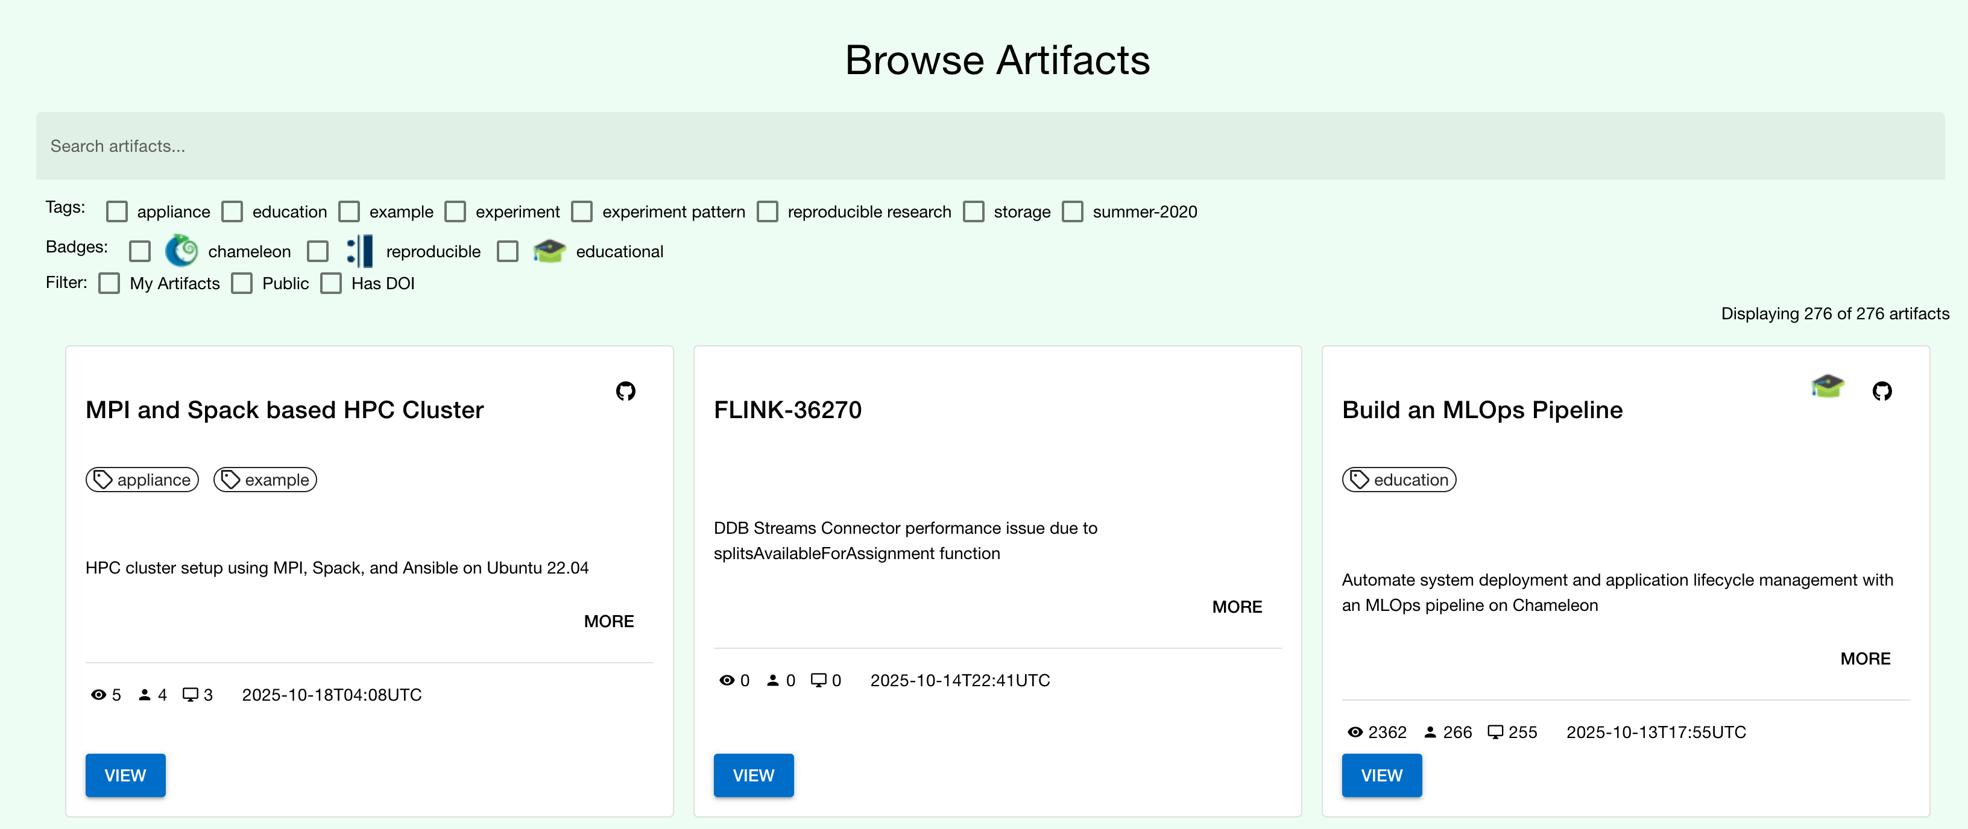

TROVI: SHARING AND FINDING ARTIFACTS
A testbed-integrated open experiment sharing repository integrated with multiple testbeds
Trovi artifacts
Collection of information about all the experiment
Assumes that artifact will be implemented in a variety of ways
Connected to the testbed such that the experimental environment is easy to deploy
Artifacts support fine-grained sharing, versioning, and provide metrics about usage
Portal to present, browse, filter, and find interesting experiments
Open APIs: can be integrated with any testbed
Paper: “Three Pillars of Reproducibility,” ReWords’23

Slide 18
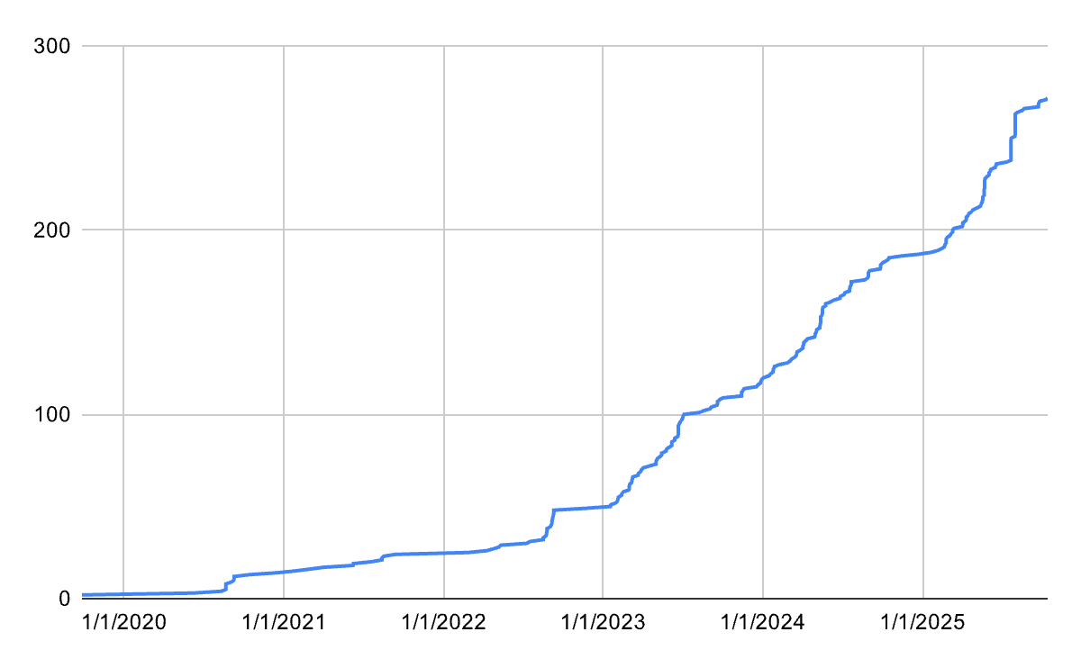
Sharing via Trovi
Total Artifacts Shared
Total artifacts | 272
Unique authors | 111
Daypass enabled artifacts | 26
Chameleon supported | 16
Repeto badges | 42
Fount badges | 55
Max access count ("launches") | 2362
Mean access count | 77.44
Median access count | 18.00
Max unique access count | 216
Mean unique access count | 18.87
Median unique access count | 6.00
Max unique cell execution | 209

Slide 19
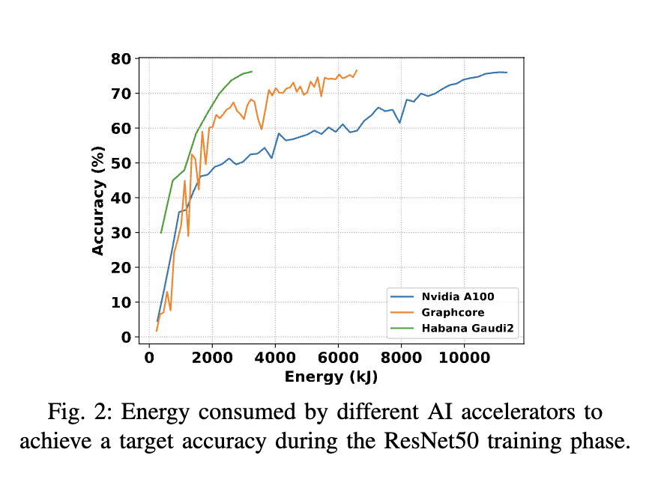
Research Example: ENERGY EFFICIENCY
Can we characterize performance and power consumption of HPC simulations and AI applications on heterogeneous CPU-GPU systems?
1)Ran a series of HPC and AI workloads to measure runtime performance under different system configurations; 2)Monitored power usage during execution; 3)Adjusted power settings to understand their impact on performance and energy efficiency
Use of Chameleon hardware enables apples-to-apples comparisons of training/inference energy consumption, throughput, and efficiency across architectures
Paper: Ferdaus et. al. “Evaluating Energy Efficiency of AI Accelerators Using Two Mlperf Benchmarks”, CCGRID’25

Slide 20
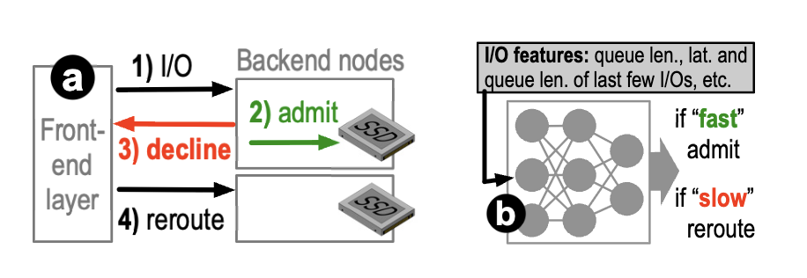
Research Example: OPERATING SYSTEMS
Flash storage (SSDs) is fast, but sometimes it gets slowed down by maintenance tasks happening inside
Heimdall uses machine learning to improve accuracy—it can spot periods when storage will be fast or slow, and reroute data requests to avoid slowdowns
Chameleon infrastructure to run experiments with different deployment targets (user-level, kernel-level, distributed) and validate performance and adaptability under varied conditions
Paper: Kurniawan et. al. ‘Heimdall: Optimizing Storage I/O Admission with Extensive Machine Learning Pipeline.’ EuroSys’25.

Slide 21
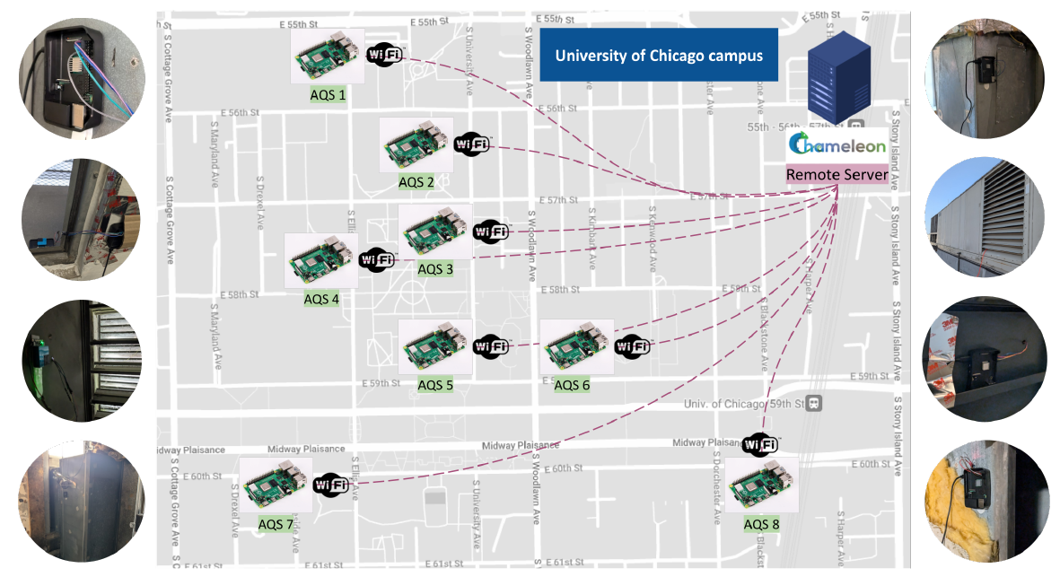
Research Example: Federated Learning
Compare simulation, emulation, and real-world deployments for Federated Learning
Deployed 8 Raspberry Pis with air quality sensors on UChicago campus
Simulating FL training on a single compute node can accurately reproduce model performance metrics (accuracy), but presents limitations for reproducing system metrics (training time, CPU usage, and communication latency)
Paper: “On Reproducibility Challenges of Federated
Learning: Investigating the Gap between Simulation,
Emulation and Real-World Deployments”, CCGrid’25

Slide 22
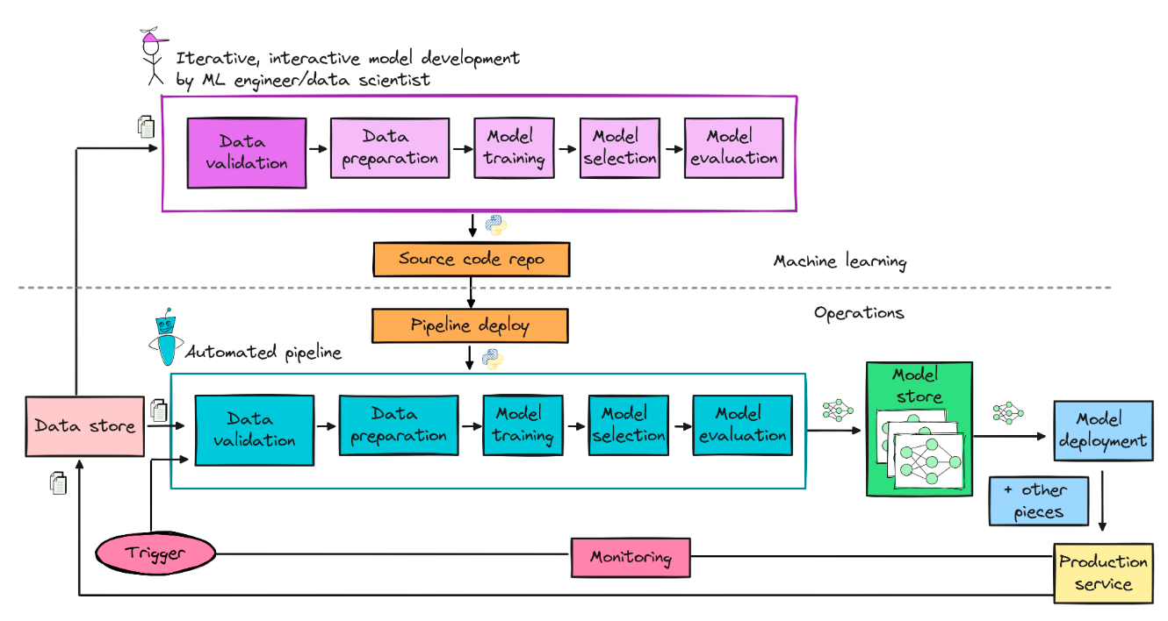
EDUCATION: ML Systems Engineering (1)
Prof. Fraida Fund • NYU Spring 2025 Class • 191 Students
Operational ML demands skills in:
Infrastructure provisioning
Model deployment
Systems operations
Performance monitoring
Automation
Students configured nodes on Chameleon - often through interactive materials on Trovi
Paper: Fraida Fund, ‘The Cost of Teaching Operational ML.’ EduHPC’25

Slide 23

ML Systems Engineering (2): Scale and Impact
Students reserved VM (m1.small to m1.xxlarge), bare metal (GPUs P100, mi100, V100), network (floating IPs), and edge resources (Raspberry Pi 5) driving exceptional utilization across CHI (even when working in 3-4 person teams to optimize resource usage)
Why Chameleon?
186K
VM Hours
Equivalent Cost on Commercial Clouds: $50,000 ($250 per student)
18K
Bare Metal Hours
Scale
- Launching multiple GPU clusters
- Evaluating performance
Edge Computing
- Real edge ML serving
11TB
Total Storage
Scan to find the coursework on Trovi!
1500+
Leases Created
Interactive
- Creating VM clusters for storage/training
- Trovi lesson modules

Slide 24

REPRODUCIBILITY: SC24 ARTIFACT Evaluation
Each year, Chameleon supports users running artifact evaluations for major HPC and systems conferences (SC, CSS, FAST, OSDI, EuroSys, ICPP)
Spotlight: Supercomputing (SC) 24 artifact evaluation on Chameleon Cloud
Authors and reviewers reserved hardware, packaged artifacts, and evaluated them on configured instances
Project management on Chameleon simplified giving anonymous access to authors and reviewers
Chameleon appliances and Trovi artifacts facilitate experiment environment set-up
30+ authors and reviewers from SC24 and SC25 used Chameleon for AE; Best Artifact Award in ‘24 went to a paper reproduced on Chameleon!
Paper: Report on the Challenges of Practical Reproducibility for HPC and Systems Computer Science. Apr. 2025

Slide 25

We’re here to change
www.chameleoncloud.org

Slide 26
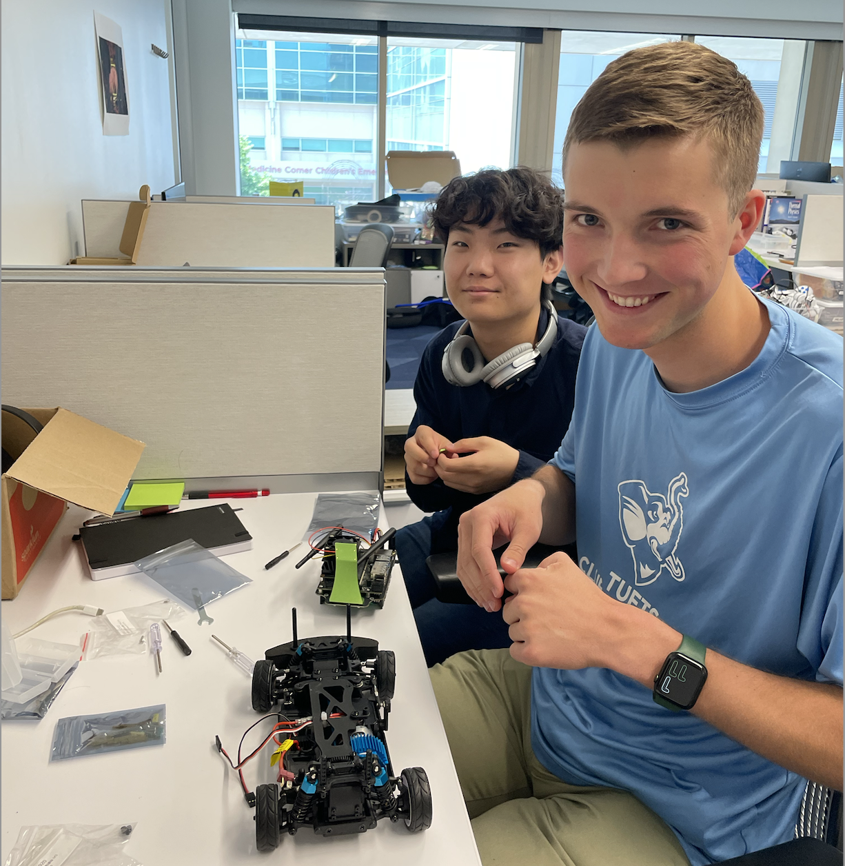
A few Application examples
Autonomous Driving (AutoLearn)
Data collection (sim and real)
Machine Learning
Verification (sim and real)
Digital Twin (combined)

